Slide 2
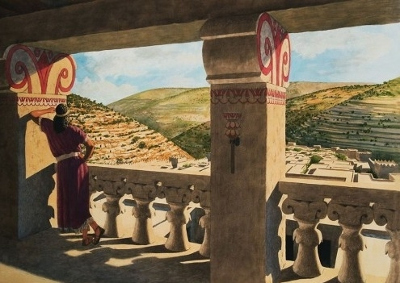
David and Bathsheba
Second Samuel 11-12

Slide 3
1. The Power of Lust
David sinned when he pursued his lust (James 1:14-15).
The Bible warns of the danger of looking to lust (Matt. 5:28; Prov. 6:24-25).
We must put forth an effort not to look to lust (Job 31:1).
We can be equally guilty of dressing or acting in a manner as to cause others to lust after us.

Slide 4
2. One Sin Can Easily Lead To Multiple Sins
David got Uriah drunk (Habakkuk 2:15).
David had Uriah killed.
Sin is like leaven (1 Cor. 5:6-7); left alone it grows and spreads.
David’s lust led to adultery, drunkenness, murder, all in an effort to lie.

Slide 5
3. Sin Cannot Be Hidden From God
God knew of David’s sin.
  Hebrews 4:13
  2 Corinthians 5:10
Our sin will find us out (Num. 32:23).

Slide 6
4. We Must Handle Our Sins in the Proper Manner
“I acknowledged my sin to You, and my iniquity I have not hidden. I said, ‘I will confess my transgressions to the Lord,’ and You forgave the iniquity of my sin” (Ps. 32:5).
Forgiveness comes through repentance, confession and prayer.
  1 John 1:9; Acts 8:22

Slide 7
5. God Does Not Spare Us of the Physical Consequences of Our Sins
The sword would not depart from David’s house (Amnon, Tamar, Absalom).
His wives were openly defiled by his own son Absalom (16:21-22).
The son born to Bathsheba died (v. 18).
We reap what we sow (Gal. 6:7-8).
The way of the transgressor is hard (Prov. 13:15, KJV).

Slide 8
6. David’s View of God’s Sovereign Will
2 Sam. 12:22 – “who can tell”
Esther 4:14 – “who knows”
Joel 2:12-14 – “who knows”
Amos 5:15 – “it may be”
Jonah 3:9 – “who can tell”
Zephaniah 2:3 – “it may be”
1 Samuel 14:6 – “it may be”
Philemon 15 – “perhaps”

Slide 9
6. David’s View of God’s Sovereign Will
2 Sam. 12:22 – “who can tell”
Esther 4:14 – “who knows”
Joel 2:12-14 – “who knows”
Amos 5:15 – “it may be”
Jonah 3:9 – “who can tell”
Zephaniah 2:3 – “it may be”
1 Samuel 14:6 – “it may be”
Philemon 15 – “perhaps”
These are not statements of doubt or a lack of faith. These are statements from people of faith who refused to make presumptions about God’s will.

Slide 10
7. David’s View of Life After Death
David had an accurate understanding of his son’s death.
“he shall not return to me” – death is permanent.
“I shall go to him” – David would be reunited with his son in death.
Provided we die in the same spiritual state, we will be with our loved ones in death (1 Thess. 4:17).

Slide 11
8. David Wasn’t Where He Should Have Been
The kings went out to battle, but David remained at Jerusalem (11:1).
If David had been out in the fields of battle, he would not have seen Bathsheba or committed the sins that followed.
How many Christians get themselves into trouble because they are somewhere they shouldn’t be?
  At a dance, bar, party, alone with a member of the opposite sex, forsaking the assemblies, etc.

