Slide 2

Studies in the
Sermon on the Mount

Slide 3
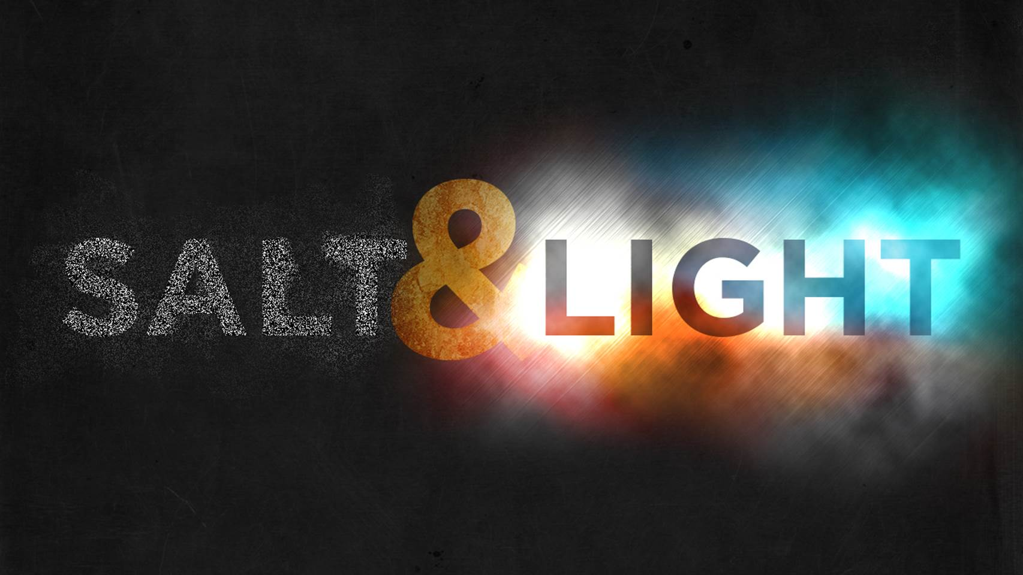
The Similitudes
Matthew 5:13-16

Slide 4
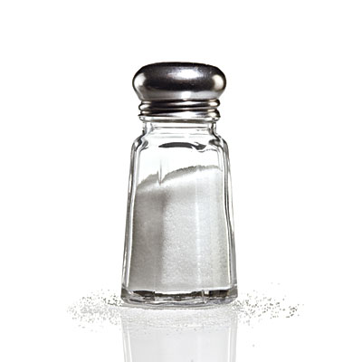
The Salt of the Earth
In the First Century, salt was used primarily as a food preservative.
Righteous people have a “preserving” power.
  Genesis 18:23-33
  Jeremiah 5:1

Slide 5
The Salt of the Earth
We must maintain our influence if it is to be effective.
If salt becomes contaminated, it loses its ability to preserve.
However, because it has the ability to kill vegetation, it must be disposed of in the street - Luke 14:34-35.

Slide 6
The Salt of the Earth
We must maintain our influence if it is to be effective.
If salt becomes contaminated, it loses its ability to preserve.
However, because it has the ability to kill vegetation, it must be disposed of in the street (Luke 14:34-35).
We must live up to our profession (2 Tim. 2:19); we must “practice what we preach.”
We cannot compromise with sin and error.
We cannot practice tolerance with regard to sin and worldliness.

Slide 7
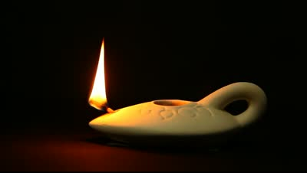
The Light of the World
Light reveals and illuminates - Ps. 119:130
Light gives guidance - Ps. 119:105
Light drives away darkness - John 3:19-20
Light attracts those who want to come out of darkness - John 3:21

Slide 8
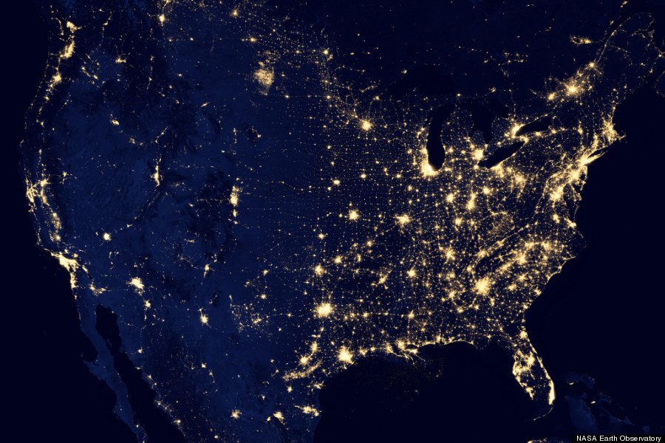
“A city set on a hill cannot be hidden.”

Slide 9

“Nor do they light a lamp and put it under a basket, but on a lampstand, and it gives light to all who are in the house.”

Slide 10
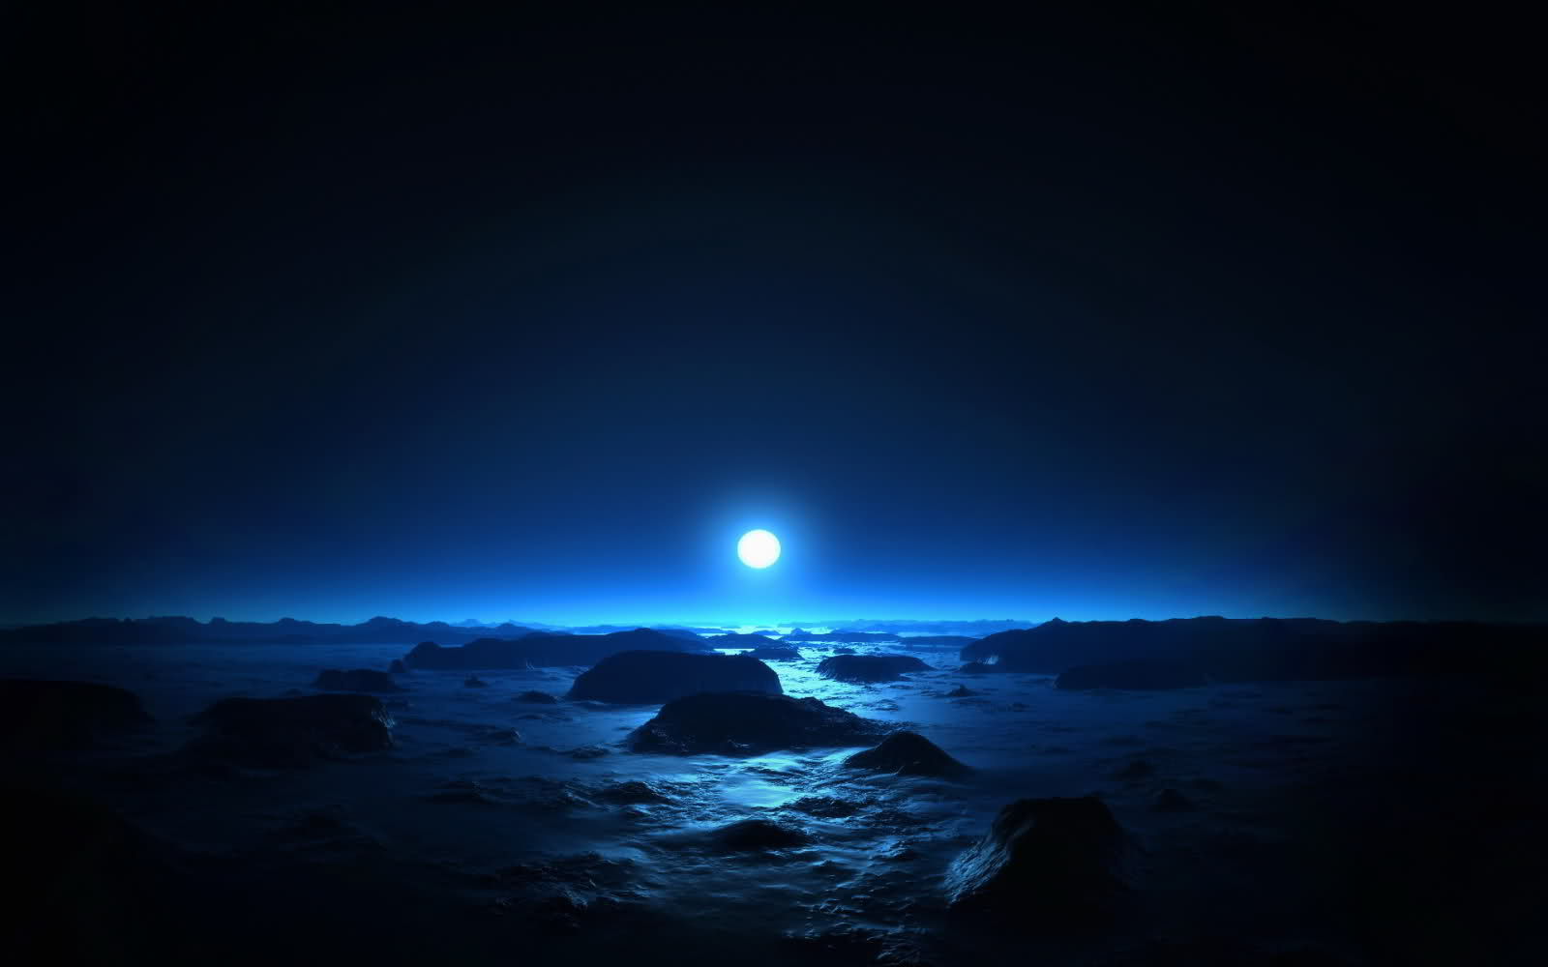
“Let your light so shine before men, that they may see your good works and glorify your Father in heaven.”

Slide 11


