Slide 2
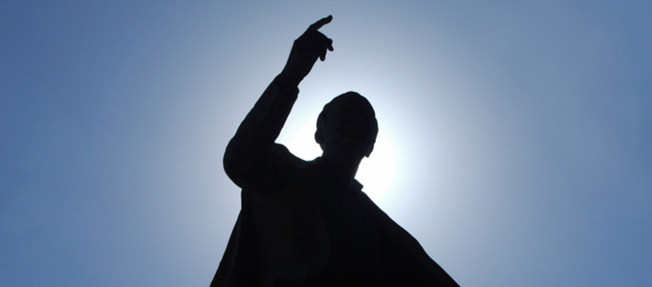
The Character of a Gospel Preacher

Slide 3
Man-Made Qualifications for Gospel Preachers
He must have a degree from a “brotherhood college.”
He must come highly recommended.
He must be able to get outside support.
He must not speak over twenty minutes.
He must have a dynamic personality, and good looks to match.

Slide 4
Man-Made Qualifications for Gospel Preachers
He must be the right age.
He must be married and have the right kind of family.
He must be good at visiting, counseling, setting up classes, writing, keeping visiting preachers, etc.
He must be able to do personal work.

Slide 5
1. Sanctified and Useful (vs. 20-21)
To be sanctified is to be set apart; to live a holy life.
useful – “easy to make use of;” a ready and willing servant.
prepared – equipped
A preacher must live a life that enables him to exert an effective influence.

Slide 6
2. Flee Youthful Lusts (v. 22)
To flee is “to shun or run away from.”
This command is not confined to sexual temptations. Many lusts or desires are stronger in one’s youth (pride, ambition, impatience, etc.).
Involvement in such sins can impair one’s influence and effectiveness in the Lord’s work for the rest of his life.

Slide 7
3. Pursue (v. 22)
“To run swiftly in order to catch, to seek after eagerly, to earnestly endeavor to acquire.”
righteousness – that which is right by God’s standards.
faith – a life of faith, and the things which accompany it (obedience)
love – benevolent good will
peace – a life of peace with brethren (Matt. 5:9)

Slide 8
4. Avoid (v. 23)
To avoid is to shun, refuse, or reject.
foolish and ignorant disputes - there are some questions which simply do not have answers (Deut. 29:29).
A preacher must not waste his time getting involved in arguments and questions that will only result in confusion, uncertainty and strife among brethren.

Slide 9
5. A Servant Mentality (v. 24)
doulos – “a slave; one who gives himself up wholly to another’s will” (Thayer).
A gospel preacher is a servant (minister). He serves his Master – the Lord.
He must also have a servant mentality regarding his relationship with the elders and the members.

Slide 10
6. Must Not Quarrel (v. 24)
To quarrel is to strive, fight or dispute.
A preacher must know how to avoid disputing with others.
He must contend for the faith without being contentious.

Slide 11
7. Be Gentle To All (v. 24)
To be mild.
The Greek word referred to the way a nurse would care for a patient or a parent would treat a young child (1 Thess. 2:7).
A preacher must possess the ability to deal with different kinds of people under different circumstances.
A preacher must be approachable.

Slide 12
8. Able To Teach (v. 24)
“skilled in teaching”
While we all teach through our example, not all men are capable and effective instructors.
To be a preacher a man must possess both the desire and the ability to teach.

Slide 13
9. Patient (v. 24)
“patient of ills and wrongs” (Thayer)
“enduring of ill” (Strong)
A preacher must develop a thick skin with regards to the brethren.
A preacher must be patient with the brethren:
  patient with their shortcomings
  patient when wronged by them

Slide 14
9. Patient (v. 24)
“patient of ills and wrongs” (Thayer)
“enduring of ill” (Strong)
A preacher must develop a thick skin with regards to the brethren.
A preacher must be patient with the brethren:
  patient with their shortcomings
  patient when wronged by them
“You therefore must endure hardship as a good soldier of Jesus Christ” (2 Tim. 2:3).
“But you be watchful in all things, endure afflictions, do the work of an evangelist, fulfill your ministry” (2 Tim. 4:5).

Slide 15
10. Humility (v. 25)
meekness
“Gentle” (v. 24) describes the outward action while “meekness” describes the inward disposition of one’s heart.
While one challenge of preaching is surviving hardships, another challenge is surviving praise (Rom. 12:3; 1 Cor. 3:5-7).
Also, a preacher must possess the ability to be corrected.

Slide 16
11. Correcting Those Who Are In Opposition (vs. 25-26)
Such people must not be looked upon as enemies to be destroyed, but victims to be rescued.
The power for conversion (correction) is in the word, not in the persuasive abilities of the preacher.
The object is to win the soul – not the argument! (2 Cor. 10:3-5)

Slide 17
Gospel Preachers must make sure they are doing their work and conducting themselves in the proper manner.
Churches must make sure they have asked the right man to work with them.
“Take heed to yourself and to the doctrine. Continue in them, for in doing this you will save both yourself and those who hear you.”
1 Timothy 4:16

