Slide 2
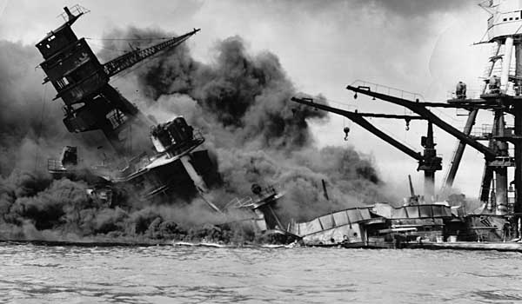
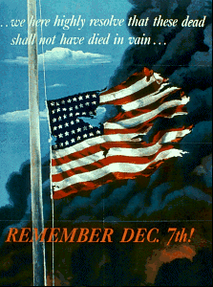
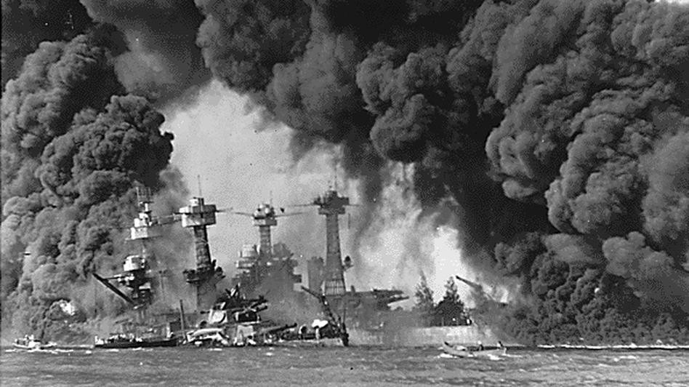
Pearl Harbor

Slide 3
Within two hours…
2,330 service men were killed and 1,145 had been wounded.
Five battleships were at the bottom of the harbor.
Two destroyers had been reduced to gutted hulks of steel, and a third was badly crippled.
Many other warships were severely damaged.
188 aircraft were destroyed along with the airfield.

Slide 4
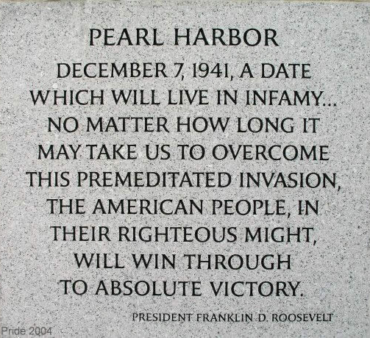
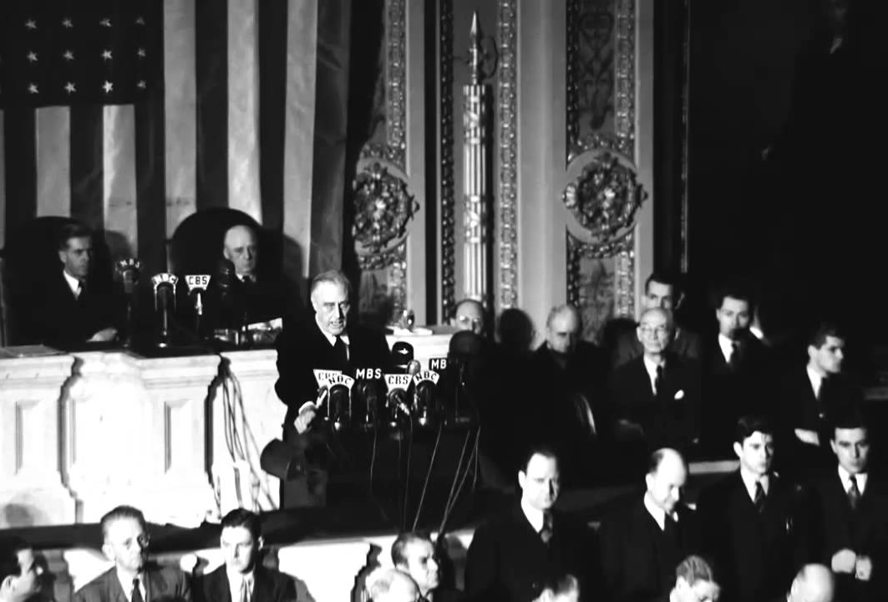

Slide 5
Why didn’t the US see the Japanese planes approaching on the radar?
They did, they just didn’t know what they were seeing.
The base was expecting some B-17s from the mainland, and assumed that is what they were seeing on the radar.
The ranking officer on duty, a young lieutenant, said “Don’t worry about it.”

Slide 6
“Don’t worry about it.”
We are to take our enemy seriously (1 Peter 5:8-9).
We are to put on the armor of God and stand ready to fight (Eph. 6:10-17).
We are to be “watchful” (Rev. 3:2-3).
Our enemy is not to be taken lightly!

Slide 7
How did the Japanese fleet get so close to Hawaii without being spotted?
They tricked the US by sending “fake” radio chatter.
While the US believed they were returning to Japan, they were really sailing to Hawaii.
The plans were kept so secret that many senior ranking officers weren’t told until just before the attack.
The fleet was just 230 miles north of Hawaii.

Slide 8
Sin sometimes works the same way.
Sin works like leaven (1 Cor. 5:1, 6-7).
False teachers secretly creep in.
  Ephesians 4:14
  2 Peter 2:1-2
  Jude 3-4

Slide 9
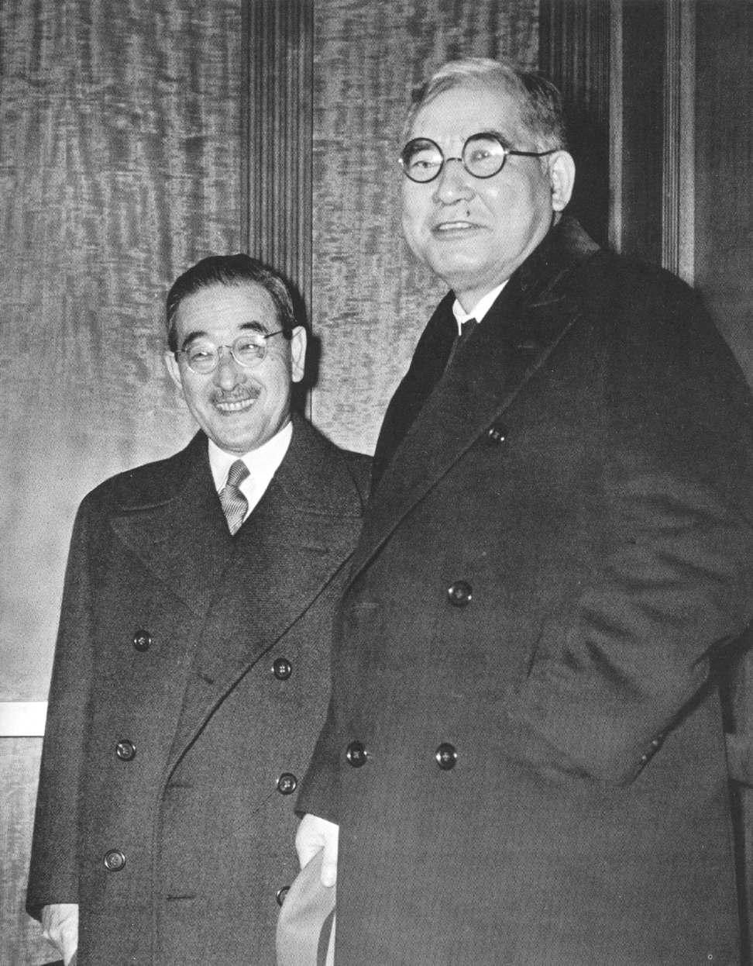
Did the Japanese Ambassador to the US know about the attack?
Kichisaburo Nomura (on right) was the Japanese ambassador to the US.
Saburo Kurusu was a special diplomat sent to the US to help Nomura.

Slide 10
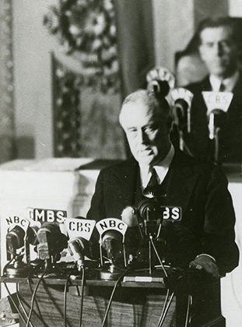
Did the Japanese Ambassador to the US know about the attack?
“Indeed, one hour after Japanese squadrons had commenced bombing Oahu, the Japanese ambassador to the United States and his colleague delivered to the Secretary of State a formal reply to a recent American message.”

Slide 11
Have we let the enemy within the gates?
We are to make no provision for the flesh (Romans 13:14).
  We do not need to provide the devil with an embassy in our hearts!
We are not to give place or opportunity to the devil (Ephesians 4:27).
We are to resist the devil he will flee from us (James 4:7; 1 Peter 5:9).

Slide 12

“we are more than conquerors through Him who loved us” (Rom. 8:37)

