Slide 2
Things We “Must” Do

Slide 3
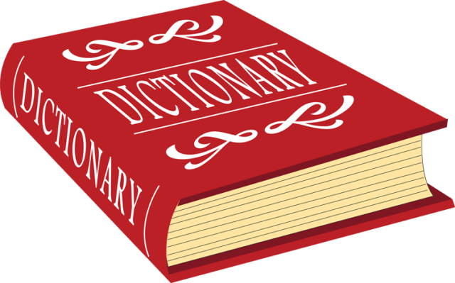
“must”
compulsion, obligation, requirement, or necessity
certainty or inevitability

Slide 4

1. We Must Believe In God
“But without faith it is impossible to please Him, for he who comes to God must believe that He is, and that He is a rewarder of those who diligently seek Him.”
Hebrews 11:6

Slide 5
2. We Must Be Born Again
“Jesus answered and said to him, ‘Most assuredly, I say to you, unless one is born again, he cannot see the kingdom of God’… Do not marvel that I said to you, ‘You must be born again.’”
John 3:3, 7

Slide 6
2. We Must Be Born Again
“Jesus answered, ‘Most assuredly, I say to you, unless one is born of water and the Spirit, he cannot enter the kingdom of God.’”
John 3:5
“Not by works of righteousness which we have done, but according to His mercy He saved us, through the washing of regeneration and renewing of the Holy Spirit.”
Titus 3:5

Slide 7
3. We Must Worship God Correctly
“But the hour is coming, and now is, when the true worshipers will worship the Father in spirit and truth; for the Father is seeking such to worship Him. God is Spirit, and those who worship Him must worship in spirit and truth.”
John 4:23-24

Slide 8
4. We Must Take Our Salvation Seriously
“Therefore we must give the more earnest heed to the things we have heard, lest we drift away.”
Hebrews 2:1

Slide 9
5. We Must Answer To God
“For we must all appear before the judgment seat of Christ, that each one may receive the things done in the body, according to what he has done, whether good or bad.”
2 Corinthians 5:10

