Slide 1
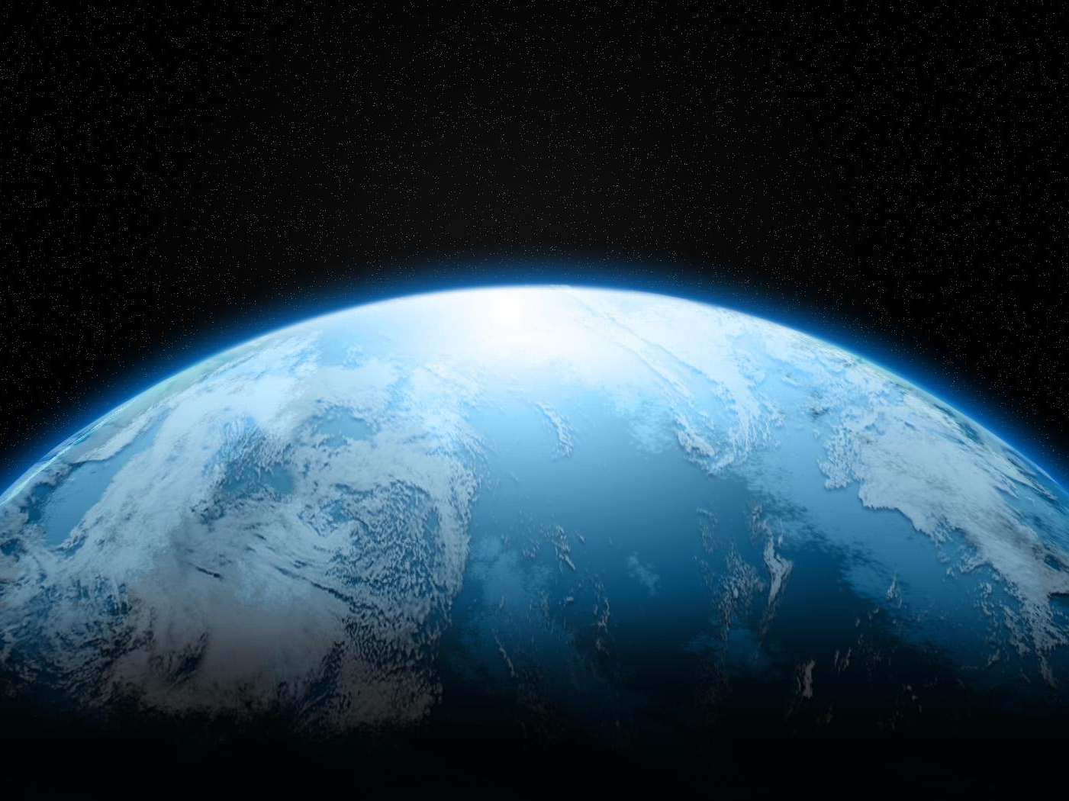
“New Creation Theology”
Will Heaven Be On Earth?

Slide 2
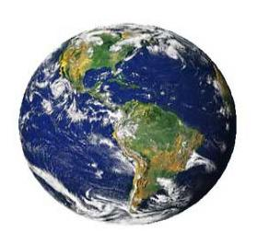
New Creation Theology
This theory seeks to redefine the “traditional” (Biblical) view of Heaven as being located in the spiritual realm.
Instead, it insists that Heaven will be on earth.
It teaches that, after the Judgment Day, the righteous will come back and live with God on a renewed or renovated Earth for all eternity.

Slide 3
The Christian’s Hope Is In Heaven
1 Peter 1:3-4 – our inheritance is “reserved in heaven for you.”
2 Corinthians 5:1 – “in the heavens.”
John 14:1-3 – “I go to prepare a place for you.”
Philippians 3:20 – our citizenship is in Heaven.

Slide 4
The Christian’s Hope Is In Heaven
1 Peter 1:3-4 – our inheritance is “reserved in heaven for you.”
2 Corinthians 5:1 – “in the heavens.”
John 14:1-3 – “I go to prepare a place for you.”
Philippians 3:20 – our citizenship is in Heaven.
Is there any evidence that would cause us to give these passages a non-literal interpretation?

Slide 5
New Heavens and a New Earth
Isaiah 65:17, 66:22
This is giving a figurative description of the glorious change that will take place when the Messiah comes and establishes His kingdom.
It describes the institution of a new and better covenant; a new dispensation.

Slide 6
New Heavens and a New Earth
Revelation 21:1
John saw a New Heaven and a New Earth because the old ones had “passed away.”
They “fled away… found no place for them” (Rev. 20:11).
“Heaven and earth will pass away” (Matt. 24:35).

Slide 7
Change in Dispensations
Law of Moses
Gospel of Jesus Christ
The Church Age
New Heavens New Earth
Eternity
Heaven
New Heavens New Earth

Slide 8
New Heavens and a New Earth
2 Peter 3:10-13
Tells us when this change will occur.
“the day of the Lord”
The Second Coming of Christ

Slide 9
New Heavens and a New Earth
2 Peter 3:10-13
Tells us what will occur.
Heavens will pass away with a great noise.
Elements will melt (be destroyed – NASB, be dissolved – ESV).
Earth will be burned up.
All physical things will be dissolved.

Slide 10
The Deliverance of Creation
Romans 8:19-22
We never interpret a difficult passage in a way that contradicts plain passages of Scripture.
This passage does not require a “renewed earth” interpretation. The creation will be delivered from the bondage of corruption when it is destroyed.
The glory is going to be revealed in us (v. 18), not in the earth.

Slide 11
The Restoration of All Things
Acts 3:21
That which is being “restored” (can also be translated as “established” or “fulfilled”) are the prophecies that were made about the Messiah and His kingdom.

Slide 12
The Restoration of All Things
Will God hit the “reset” button on the universe?
If “all things” refers to all physical created things, then it would certainly include all men, yet not all men will be restored – many will be lost eternally.
The “New Heavens and the New Earth” will not be like the one created in Genesis.
  There will be no sun, moon, or night (Rev. 21:23, 25, 22:5).
  There is no rotation of the earth, no orbiting the sun.

Slide 13
The Restoration of All Things
Will time exist in Heaven?
“That the new universe is a real space/time world means that, as with all created being, time will exist just as it does now, moment succeeding moment and event following event” (Cottrell 566).
Time was measured by day and night (Gen. 1:5), yet there is no night in Heaven, thus – no time!

Slide 14
Changed Bodies Indicate a Changed Realm of Existence
1 Corinthians 15:42-44, 50-53
Why are our bodies changed from a natural/physical body only to be made to dwell on a physical planet?
If the “restoration of all things” means the earth goes back to the way it was before the Fall, then why wouldn’t man go back to the way he was before the Fall – a physical, flesh and blood being?

Slide 15
What Will We Be Doing In Heaven?
“Are we to spend eternity somewhere off in space, wearing white robes, plucking harps, singing songs, and flitting from cloud to cloud while doing so?”

Slide 16
What Will We Be Doing In Heaven?
“On the contrary, the Bible assures us that God will create a new earth on which we shall live to God’s praise in glorified, resurrected bodies. On that new earth we shall spend eternity, enjoying its beauties, exploring its resources, and using its treasures to the glory of God” (Anthony A. Hoekema 274).

Slide 17
What Will We Be Doing In Heaven?
“On the contrary, the Bible assures us that God will create a new earth on which we shall live to God’s praise in glorified, resurrected bodies. On that new earth we shall spend eternity, enjoying its beauties, exploring its resources, and using its treasures to the glory of God” (Anthony A. Hoekema 274).
“And there shall be no more curse, but the throne of God and of the Lamb shall be in it, and His servants shall serve Him” (Rev. 22:3).

Slide 18
The Christian’s Hope
The Bible teaches that the Christian’s hope is in an eternal home in Heaven, which is a spiritual abode away from this temporary physical realm.
Why not make Heaven your home by obeying the gospel today!

