Slide 2
Filthy Speech, Profanity, and Euphemisms

Slide 3
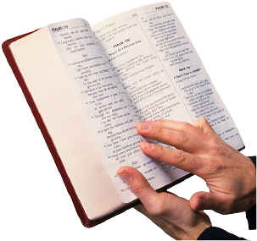
“But I say to you that for every idle word men may speak, they will give account of it in the day of judgment.”
Matthew 12:36

Slide 4
“But now you yourselves are to put off all these: anger, wrath, malice, blasphemy, filthy language out of your mouth.”
Colossians 3:8

Slide 5
1. Corrupt Words

Slide 6
1. Corrupt Words
“Let no corrupt word proceed out of your mouth, but what is good for necessary edification, that it may impart grace to the hearers.”
Ephesians 4:29

Slide 7
2. Filthy Talk

Slide 8
2. Filthy Talk
“But fornication and all uncleanness or covetousness, let it not even be named among you, as is fitting for saints; neither filthiness, nor foolish talking, nor coarse jesting, which are not fitting, but rather giving of thanks.”
Ephesians 5:3-4

Slide 9
3. Profanity Using God’s Name in Vain

Slide 10
3. Profanity Using God’s Name in Vain
Profane: “to show disrespect or contempt for sacred things, to put to a base or improper use.”

Slide 11
3. Profanity Using God’s Name in Vain
“You shall not take the name of the Lord your God in vain, for the Lord will not hold him guiltless who takes His name in vain.”
Exodus 20:7

Slide 12
3. Profanity Using God’s Name in Vain
“You shall not take the name of the Lord your God in vain, for the Lord will not hold him guiltless who takes His name in vain.”
Exodus 20:7
It is a sin to use God’s name in a common, empty, or careless manner, without an attitude of sincere reverence or respect.

Slide 13
3. Profanity Using God’s Name in Vain
“And whoever blasphemes the name of the Lord shall surely be put to death. All the congregation shall certainly stone him, the stranger as well as him who is born in the land. When he blasphemes the name of the Lord, he shall be put to death.”
Leviticus 24:16

Slide 14
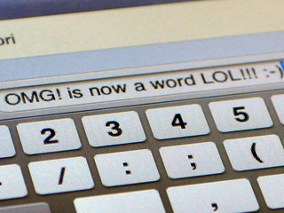
3. Profanity Using God’s Name in Vain
To use God’s name as a means of mindlessly expressing one’s emotions is to use God’s name is a profane manner. Such is a sin.
In our texting, OMG stands for “Oh my God!”

Slide 15
4. Euphemisms

Slide 16
4. Euphemisms
Euphemism: “the substitution of an agreeable or inoffensive expression for one that may offend of suggest something unpleasant.”

Slide 17
4. Euphemisms
Euphemism: “the substitution of an agreeable or inoffensive expression for one that may offend of suggest something unpleasant.”
dang, darn, heck, shoot, shucks, gosh, golly, doggone, gee whiz, cripes, etc.

Slide 18
4. Euphemisms
While being “less offensive,” it is not proper for a Christian to use euphemisms because…
They mean the same thing as the “less offensive” word.
They are prompted by the same emotions.
They betray what is really in our hearts.

Slide 19
How To Overcome Corrupt Speech
Think before we speak - Prov. 15:28, James 1:19
Remember our words have power - Prov. 18:21
Seek to edify others with our speech - Eph. 4:29
Honor others with our speech - 1 Pet. 2:17
Remember we are always in the presence of God - Ps. 139:4, 7-12
Pray for God’s help - Ps. 141:3-4
Keep our heart pure - Matt. 12:33-35

Slide 20
“But I say to you that for every idle word men may speak, they will give account of it in the day of judgment.”
Matthew 12:36

Slide 21
“Let the words of my mouth and the meditation of my heart be acceptable in Your sight, O Lord, my strength and my Redeemer.”
Psalm 19:14

