Slide 2
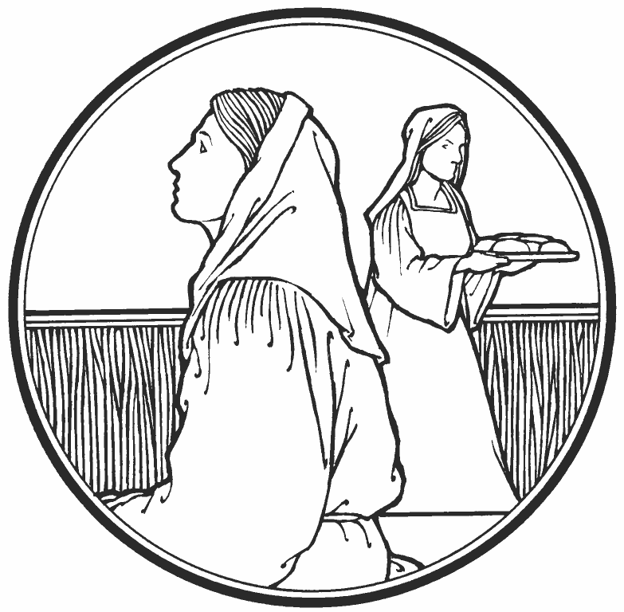
Martha and Mary
Luke 10:38-42

Slide 3
Our Lord’s Relationship With These Siblings
Along with their brother Lazarus, Martha and Mary were dear friends of the Lord (John 11:5).
Jesus is mentioned with them three times:
  When Jesus raised Lazarus (John 11)
  When Mary anointed Jesus (Matt. 26:6-13; Mark 14:3-9; John 12:1-8)
  When Martha received Jesus into her home (Luke 10:38-42)

Slide 4
1. Martha’s Problem
She was “distracted with much serving” (v. 40)
She was “worried and troubled about many things” (v. 41)
We are not to be worried over the physical things of life (Matt. 6:25-33)

Slide 5
2. Martha’s Pride
“Lord, do You not care that my sister has left me to serve alone? Therefore tell her to help me” (v. 40).
Martha was serving others, but she was focused upon herself.

Slide 6
3. Martha’s Priorities
“Mary has chosen that good part” (v. 42).
Mary was not being lazy or neglectful; she had her priorities straight and made the right choice.
“one thing is needed” (v. 42).

Slide 7
3. Martha’s Priorities
“Mary has chosen that good part” (v. 42).
Mary was not being lazy or neglectful; she had her priorities straight and made the right choice.
“one thing is needed” (v. 42).
“Whatever the duties of men, whether real or imagined, whether less or greater, the one great obligation of all who were ever born is that they shall heed the word of the Son of God. Much of the failure of modern Christianity lies in the fact that Christians are busy with all kinds of things, many of them important and necessary, of course; but yet they have no time for the word of the Lord” (Coffman, 233).

Slide 8
4. Mary’s Blessing
Martha gave the Lord her service, but Mary gave the Lord her attention.
Worship is to take priority over service.
“which will not be taken away from her” (v. 42)
  The hospitality would be used up and needed again, but the Bread of Life provided a blessing that would never pass away (John 6:35; 1 Pet. 1:24-25)

Slide 9
Martha was rebuked by the Lord for her anxiety, her pride, and her misplaced priorities.
Mary was blessed because she chose the good part.
Which one are we: Martha or Mary?

