Slide 1
Institutionalism Vs. The Bible
Institutionalism Webster’s Dictionary
emphasis on organization (as in religion) at the expense of other factors
public institutional care of disabled, delinquent, or dependent persons
Liberalism (thinking that leads to institutionalism)
loose, not strict, tolerant
Free of or not bound by traditional ideas or values

Slide 2
Bible Examples of Liberal Thinking
Numbers 15
32 Now while the sons of Israel were in the wilderness, they found a man gathering wood on the Sabbath day.
33 Those who found him gathering wood brought him to Moses and Aaron and to all the congregation;
34 and they put him in custody because it had not been declared what should be done to him.
35 Then the LORD said to Moses, "The man shall surely be put to death; all the congregation shall stone him with stones outside the camp."
36 So all the congregation brought him outside the camp and stoned him to death with stones, just as the LORD had commanded Moses.

Slide 3
Bible Examples of Liberal Thinking
Leviticus 10
1 Now Nadab and Abihu, the sons of Aaron, took their respective firepans, and after putting fire in them, placed incense on it and offered strange fire before the LORD, which He had not commanded them.
2 And fire came out from the presence of the LORD and consumed them, and they died before the LORD.
3 Then Moses said to Aaron, "It is what the LORD spoke, saying, 'By those who come near Me I will be treated as holy, And before all the people I will be honored.'" So Aaron, therefore, kept silent.

Slide 4
Bible Examples of Liberal Thinking
Numbers 16
1 Now Korah…with Dathan and Abiram, the sons of Eliab, and On… 2 and they rose up before Moses, together with some of the sons of Israel, two hundred and fifty leaders of the congregation, chosen in the assembly, men of renown.
3 And they assembled together against Moses and Aaron, and said to them, "You have gone far enough, for all the congregation are holy, every one of them, and the LORD is in their midst; so why do you exalt yourselves above the assembly of the LORD?“
32 and the earth opened its mouth and swallowed them up, and their households, and all the men who belonged to Korah, with their possessions.

Slide 5
Bible Examples of Liberal Thinking
1 Samuel 15
3 'Now go and strike Amalek and utterly destroy all that he has, and do not spare him; but put to death both man and woman, child and infant, ox and sheep, camel and donkey.'"
13 Samuel came to Saul, and Saul said to him, "Blessed are you of the LORD! I have carried out the command of the LORD."
20 Then Saul said to Samuel, "I did obey the voice of the LORD, and went on the mission on which the LORD sent me, and have brought back Agag the king of Amalek, and have utterly destroyed the Amalekites.
21 "But the people took some of the spoil, sheep and oxen, the choicest of the things devoted to destruction, to sacrifice to the LORD your God at Gilgal."

Slide 6
Bible Examples of Liberal Thinking
Matthew 7
21 "Not everyone who says to Me, 'Lord, Lord,' will enter the kingdom of heaven, but he who does the will of My Father who is in heaven will enter.
22 "Many will say to Me on that day, 'Lord, Lord, did we not prophesy in Your name, and in Your name cast out demons, and in Your name perform many miracles?'
23 "And then I will declare to them, 'I never knew you; DEPART FROM ME, YOU WHO PRACTICE LAWLESSNESS.'

Slide 7
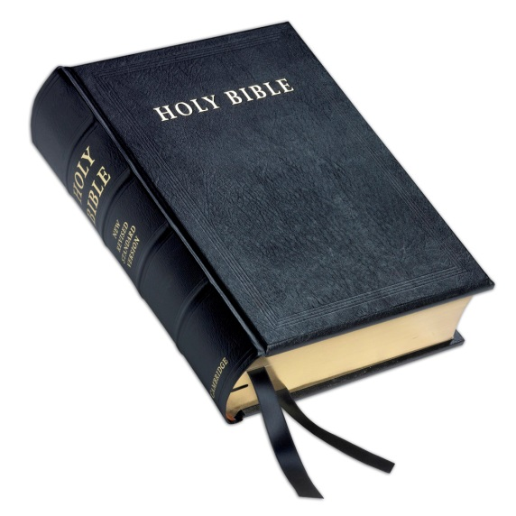
Bible Examples of Liberal Thinking
2 John 1
9 Anyone who goes too far and does not abide in the teaching of Christ, does not have God; the one who abides in the teaching, he has both the Father and the Son.
10 If anyone comes to you and does not bring this teaching, do not receive him into your house, and do not give him a greeting;
11 for the one who gives him a greeting participates in his evil deeds.

Slide 8
Modern Examples of Liberal Thinking
Denominationalism – Matt. 15:7-9
Instrumental Music – 1859
American Christian Missionary Society – 1849
LIBERAL THINKING LED TO INSTITUTIONALISM
C
College
Orphan Home
Home for Unwed Mothers
K-12 Schools
Sponsoring Church
C
$
I
C
INSTITUTIONALISM: Churches supporting man-made institutions to do the work God assigned to His church.

Slide 9
The Church: God’s Divine Institution
The Work of the Church
  Preach the gospel (1 Tim. 3:15)
  Help needy saints (1 Cor. 16:1-3; Rom. 15:26)
  Edify the body of Christ (Eph. 4:12)
The church is God’s institution for carrying out His work.
Colossians 3
17 Whatever you do in word or deed, do all in the name of the Lord Jesus, giving thanks through Him to God the Father.
The church does not have authority from God to send funds to other institutions to do the work God gave her to do.

