Slide 2
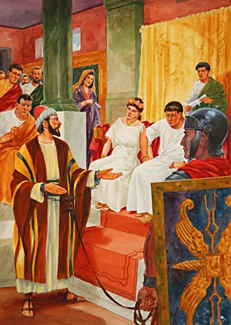
“Become As I Am”
Acts 26:24-29

Slide 3
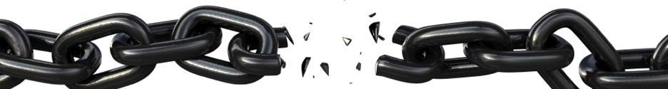
1. Free From the Bondage of Sin
The one who commits sin is a slave of sin - John 8:31-36
Freedom from sin comes when we obey the gospel - Rom. 6:17-18
We are set free from the spiritual and eternal consequences of sin (death) - Rom. 6:21-22

Slide 4
2. Free From the Guilt of His Past
Paul had left a path of violence and destruction in his opposition to the Lord’s church - Acts 26:9-11; Gal. 1:13

Slide 5
2. Free From the Guilt of His Past
However, these sins were no longer held against him - Heb. 8:12
Instead of hanging on to these haunting memories, he left them behind - Phil. 3:13-14
He was a new creation - 2 Cor. 5:17
  Spiritually speaking, Paul got to “start over.”

Slide 6
3. Free From Uncertainty
God’s word gives us…
Light - Ps. 119:105
A goal to press toward - Phil. 3:14
A pattern to follow - Phil. 3:17
Our life meaning and purpose - 1 Cor. 6:20; Matt. 5:16; John 15:8

Slide 7
Do You Need To Become Free Like Paul?
Believe in Jesus - John 8:24
Repent of your sins - Luke 13:3
Confess your faith - Romans 10:9-10
Be baptized - Mark 16:16

