Slide 2
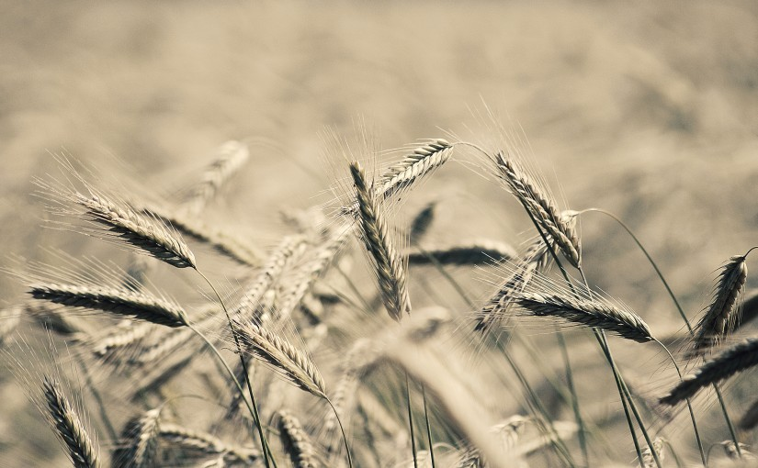
Patience

Slide 3
What Is Patience?
MAKROTHUMIA
macros – “long,” thumos – “wrath, temper”
“that quality of self restraint in the face of provocation which does not hastily or promptly punish” (Vine’s)
Patience is the ability to wait or endure without complaint, forbearing, refusing to be provoked or angered.

Slide 4
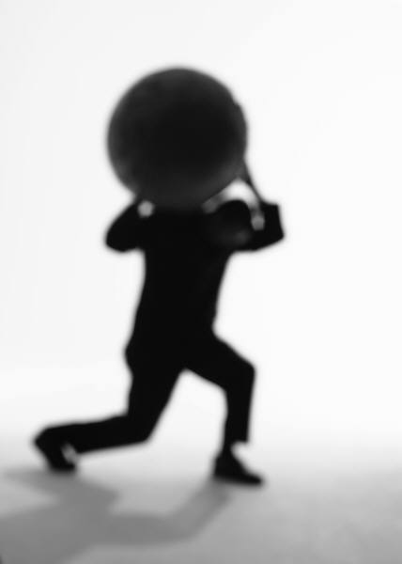
What Is Patience?
HUPOMONE
hupo – “under,” meno – “to abide”
The ability to bear under a load and keep going.

Slide 5
What Is Patience?
HUPOMONE
hupo – “under,” meno – “to abide”
The ability to bear under a load and keep going.
MAKROTHUMIA generally expresses patience with regard to people.
HUPOMONE generally expresses patience with regard to things.

Slide 6
The Value of Patience
We gain our souls - Luke 21:19; Heb. 6:11-12
Endure hardships - Heb. 10:36; Rom. 12:12
Necessary to bear fruit - Luke 8:15
Helps us wait on the Lord - Rom. 8:25

Slide 7
Examples of Patience
God is patient with us
  Psalm 103:8, 13-14
  2 Peter 3:9
The Patience of Jesus
  Matt. 14:25-31
  Luke 9:51-56
  John 13:12-17
  John 14:7-9

Slide 8
When Do We Need Patience?
When dealing with others - 1 Thess. 5:14
In our homes - Col. 3:18-21
In the church - Eph. 4:1-2
With the Lord - James 5:7-11

