Slide 2


Slide 3
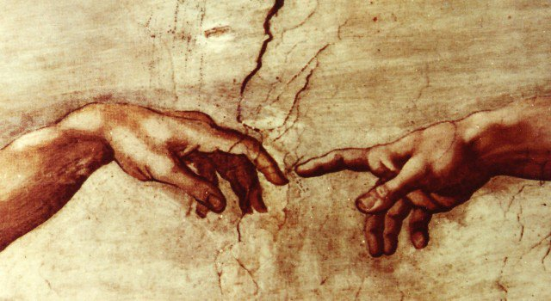
We have been created for fellowship with God
“Draw near to God and He will draw near to you…” (James 4:8).

Slide 4
What is Peace?
In the OT peace refers to the completeness, soundness, and well-being of the total person. The emphasis was often upon the physical: security, contentment, and the absence of war or conflict.
In the NT, the emphasis of peace is often upon one’s inner tranquility; a combination of hope, trust, and quiet in the mind and soul, brought about by a reconciliation with God.

Slide 5
Drawing near to God requires us to be at peace with God.
Our sin causes us to be enemies of God.

Slide 6
Drawing near to God requires us to be at peace with God.
Our sin causes us to be enemies of God.
“Draw near to God and He will draw near to you. Cleanse your hands, you sinners; and purify your hearts, you double-minded” (James 4:8).

Slide 7
Drawing near to God requires us to be at peace with God.
Our sin causes us to be enemies of God.
“and by Him to reconcile all things to Himself, by Him, whether things on earth or things in heaven, having made peace through the blood of His cross. And you, who once were alienated and enemies in your mind by wicked works, yet now He has reconciled” (Col. 1:20-21).

Slide 8
Drawing near to God requires us to be at peace with God.
Our sin causes us to be enemies of God.
“When I kept silent, my bones grew old through my groaning all the day long.
For day and night Your hand was heavy upon me; my vitality was turned into the drought of summer” (Psalm 32:3-4).

Slide 9
Drawing near to God requires us to be at peace with God.
Our sin causes us to be enemies of God.
Our desire for the world causes us to be enemies of God.

Slide 10
Drawing near to God requires us to be at peace with God.
Our sin causes us to be enemies of God.
Our desire for the world causes us to be enemies of God.
“Adulterers and adulteresses! Do you not know that friendship with the world is enmity with God? Whoever therefore wants to be a friend of the world makes himself an enemy of God” (James 4:4).

Slide 11
Drawing near to God requires us to be at peace with God.
Our sin causes us to be enemies of God.
Our desire for the world causes us to be enemies of God.
1 John 2:15-16 – “lust of the flesh, lust of the eyes, pride of life”
James 1:27 – “keep oneself unspotted from the world”
2 Cor. 6:17-18 – “come out from among them and be separate”

Slide 12
Drawing near to God requires us to be at peace with others.
“…live in peace; and the God of love and peace will be with you” (2 Cor. 13:11).
“Pursue peace with all people, and holiness, without which no one will see the Lord” (Heb. 12:14).

Slide 13
God teaches us how to be at peace with others.
“But if you have bitter envy and self-seeking in your hearts, do not boast and lie against the truth. This wisdom does not descend from above, but is earthly, sensual, demonic” (James 3:14-15).
Bitter envy = wounded pride
Self-seeking = “me first”

Slide 14
God teaches us how to be at peace with others.
When I follow the wisdom of the world…
I will go to war with others (4:1-2). I will fight with others to defend my pride and to get what I want.
When they anger me or disappoint me, I will speak evil of them and judge them (vs. 11-12).

Slide 15
God teaches us how to be at peace with others.
James 3:17 - the wisdom that is from above…
is first pure
then peaceable
gentle
willing to yield
full of mercy and good fruits
without partiality and without hypocrisy

Slide 16
When are we most like God?
“Blessed are the peacemakers, for they shall be called sons of God” (Matt. 5:9).
Let us deal properly with the sin in our life.
Let us maintain the right relationship with the world.
And let us strive to learn how to be at peace with all men.

