Slide 2
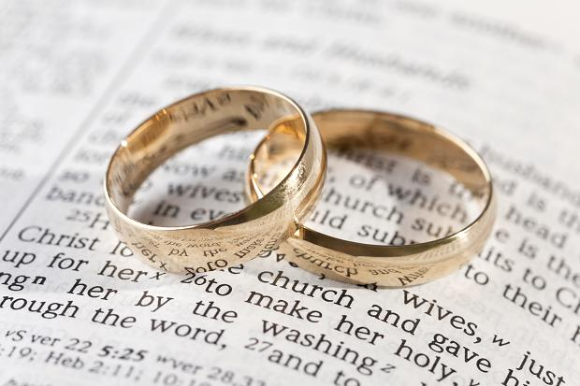
Acquila and Priscilla
How To Make Your Marriage Work (For the Lord)

Slide 3

They Worked Together
Acquila and Priscilla are always mentioned together.
  Acts 18:2, 18, 26
  Romans 16:3
  1 Corinthians 16:19
  2 Timothy 4:19
They were of the same mind when it came to making their marriage work for the cause of Christ.

Slide 4

They Practiced Hospitality
Paul stayed with them for a year and a half (Acts 18:1-3, 11).
  Both parties benefitted from this arrangement.
The church met in their house on two different occasions:
  Ephesus (1 Cor. 16:19, 8)
  Rome (Rom. 16:3-5)

Slide 5
The Christian and Hospitality
Christians are to be given to hospitality (Rom. 12:13) and are to hospitable without grumbling (1 Pet. 4:9).
Hospitality helps the members of the church to grow closer together.
Hospitality provides opportunities to introduce people to the gospel.

Slide 6
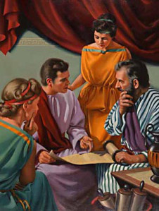
They Supported Preachers and Preaching
They helped Paul
  Acts 18:1-3, 18-19; Rom. 16:3-4
They helped Apollos
  Acts 18:24-28

Slide 7

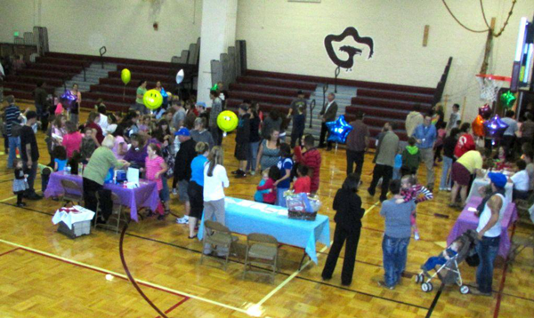
They Were Evangelistically Opportunistic
They put themselves in situations where they would come into contact with those who would be interested in the gospel.
They took advantage of opportunities.

