Slide 2
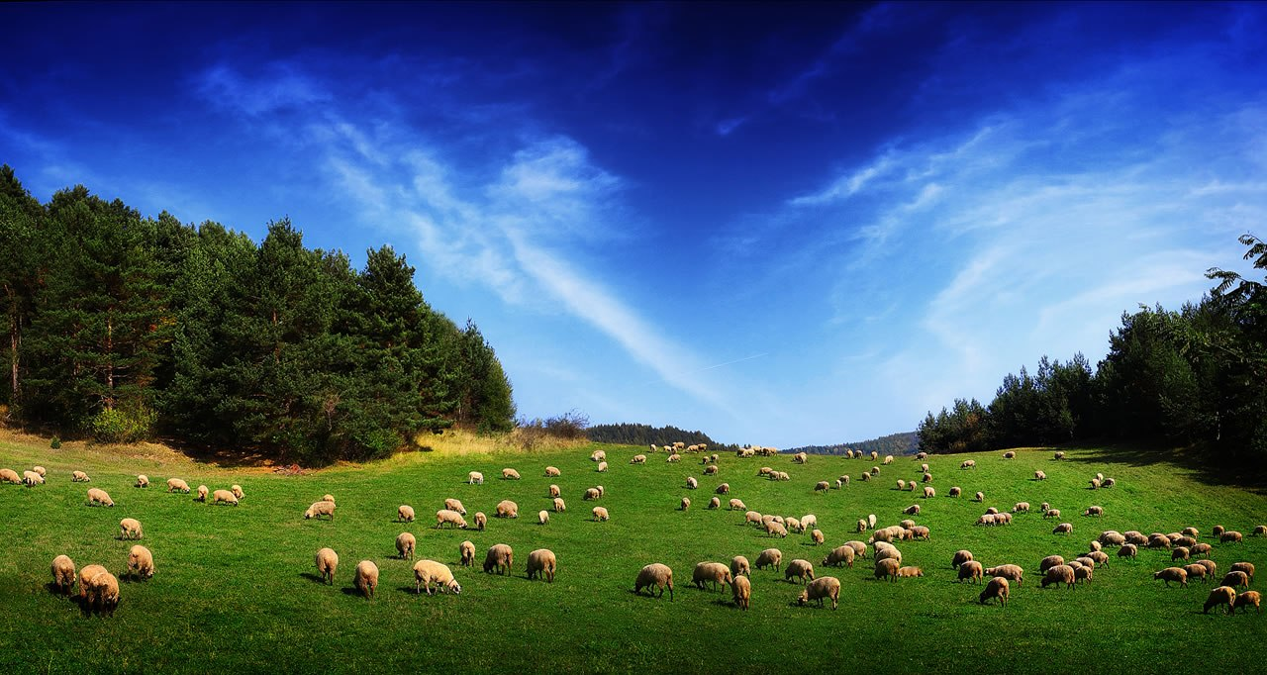
Who Can Be An Elder?

Slide 3

Qualifications For Elders
First Timothy 3:1-7
Titus 1:6-9

Slide 4
Qualifications For Elders - part 1
Blameless
Temperate, Sober-Minded, Self-Controlled
Of Good Behavior
Given To Hospitality
Not Given To Wine
Not Violent, But Gentle, Not Quarrelsome, Not Quick Tempered

Slide 5
Qualifications For Elders - part 2
Not Covetous, Not Greedy For Money
Not Self Willed
Lover of What is Good
Just
Holy
Must Have a Good Reputation With Those Outside the Church

Slide 6
1. Must Be A Man
1 Tim. 3:1; Titus 1:6
This qualification is consistent with the roles God has given men and women in the Lord’s church (1 Cor. 11:3; 1 Tim. 2:11-15).

Slide 7
2. Must Desire the Work
1 Tim. 3:1
No man is to serve because he is coerced or pressured into serving, but because he wants to serve.
The motivation must come from within, not from without.

Slide 8
3. The Husband of One Wife
1 Tim. 3:2; Titus 1:6
An elder must be a married man.
The Greek has no specific words for “husband” or “wife.” Literally means “one-woman man.”
One who is scripturally remarried is a “one-woman man.”

Slide 9
4. Must Rule His Own House Well
1 Tim. 3:4-5
He must show he can manage his marriage and his house in a blameless manner.
The reason for this qualification - the manner in which he leads his household is an indication of his ability to take care of the church (v. 5).

Slide 10
5. Must Have Faithful Children
Titus 1:6; 1 Tim. 3:4
An elder must have the experience of raising his own children.

Slide 11
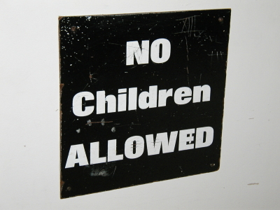
Does this qualification require a plurality of children?
The Bible uses the word “children” in both the plural and singular sense.
Genesis 21:7
Deuteronomy 6:7
Mark 10:29-30
1 Timothy 5:4
1 Timothy 5:9-10

Slide 12
5. Must Have Faithful Children
Titus 1:6; 1 Tim. 3:4
This emphasis of this qualification is placed upon the age and character of the children raised by the elder.
  “faithful”
  “in submission with all reverence”
  “not accused of dissipation or insubordination”

Slide 13
6. Apt To Teach
1 Tim. 3:2; Titus 1:9-11
From a Greek word which refers to one who is skilled in teaching.
An elder must be able and ready to teach.
As a “shepherd” or “pastor,” he must be able to feed the flock with the pure word of God.
This teaching is done publicly, but is also done privately from house to house (Acts 20:20).

Slide 14
6. Apt To Teach
1 Tim. 3:2; Titus 1:9-11
One who has been “taught” the “faithful word.”
One who is unmoved from “sound doctrine” (“holding fast”).
One who can “exhort and convict those who contradict” sound doctrine, and can “stop the mouths” of those who teach things they ought not to teach.

Slide 15
7. Not A Novice
1 Tim. 3:6
An elder cannot be a beginner or a “new convert” (NASB).

Slide 16
8. His Wife
1 Tim. 3:11
Reverent (grave – KJV, dignified – NASB)
Not Slanderers (not malicious gossips – NASB)
Temperate (sober – KJV, sober minded - ESV)
Faithful in All Things

Slide 17
Qualifications For Elders - part 1
Blameless
Temperate, Sober-Minded, Self-Controlled
Of Good Behavior
Given To Hospitality
Not Given To Wine
Not Violent, But Gentle, Not Quarrelsome, Not Quick Tempered

Slide 18
Qualifications For Elders - part 2
Not Covetous, Not Greedy For Money
Not Self Willed
Lover of What is Good
Just
Holy
Must Have a Good Reputation With Those Outside the Church

Slide 19
Qualifications For Elders - part 3
Must Desire the Work
Married Man Who Rules His Own House Well
Must Have Raised Faithful Children
Able and Willing To Teach
Not A New Convert
Married To A Reverent, Temperate, Faithful Woman Who Is Not A Slanderer

