Slide 1
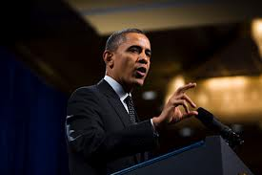
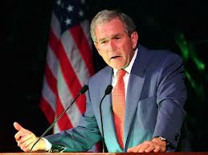

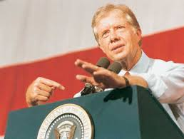
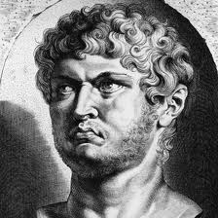
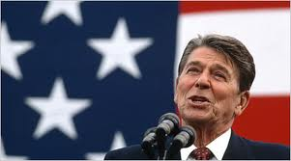

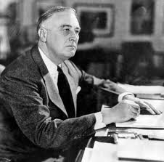
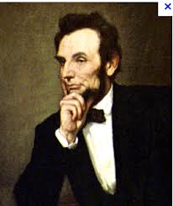
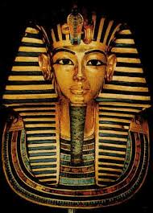
The Christian and Politics
Notes:
This sermon
Not about who we should be voting for
Instead, where should our priorties be?
Can it be hindering in the Christian life?
Romans 13:1-7

Slide 2
“A good soldier of Jesus Christ”
“No one engaged in warfare entangles himself with the affairs of this life, that he may please him who enlisted him as a soldier.” 2 Timothy 2:4
Satan will use any tactic to prevent us from fighting our important battles.
Can politics become an entanglement? Can it hinder us from serving God fully?
Notes:
2 Timothy 2:4
Not all things are sinful, but when something is distracting us from truly serving God, there is a problem!
The Devil knows all our weaknesses. We should know that he will use any tactic to hinder our service from God. Distractions from what really matters is a potential threat!
So what about politics? How can it hinder us from truly living for God? Can that even be possible?

Slide 3
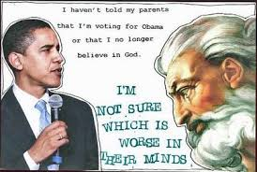
Really, which is worse?
What answer do we show in our living example?
Notes:
Funny, but think about it!
Some people are more concerned about his presidency then the nature of sin in general.
We do have the right to disagree. But Christians are also commanded to pray for and honor our leaders (1 Timothy 2:1-2)
Really, which is worse? Maybe an obvious answer
But what answer do we show in our living example?
What do we get more concerned about? Where do we spend more time and energy talking about with others?

Slide 4
The Kingdom of Israel
God was king of the nation.
  Later he appointed kings, but he was still in control.
Israel had laws appointed by God
  Yet over again, its earthly kings and citizens failed him.
“Righteousness exalts a nation, but sin is a reproach to any people.” Proverbs 14:34
  This passage, written under the Old Covenant, discuses the importance of God’s chosen Israel to remain faithful to God, being his chosen people.
Notes:
Most, if not all of us, would like to see laws of higher moral standards in this country.
But we sometimes forget that Israel HAD the godliest laws for its nation.
Did that guarantee that Israel followed God? (Every man followed what was right in their own eyes, generation after generation)
Proverbs 14:34
A commonly quoted verse when speaking of matters in America’s moral downfall.
Nations are blessed when they follow God.
But the question: What is God’s nation today?

Slide 5
“My kingdom is not of this world”
God’s kingdom today is not physical. (John 18:36)
  Such kingdom is not reliant on physical nations…for good reason! (Daniel 2:44-45)
Our true citizenship is in the kingdom of God.
The way we view government, citizens, and issues….what should be our perspective?
  Political Perspective? Or the Christian perspective? Are they the same?
Notes:
We must remember, that God’s kingdom is the spiritual kingdom that you are a part of if you’re here and a Christian today. (John 18:36)
That’s something to take comfort in. It does not rely on the morality of physical nations, nations that are not meant to last! (Daniel 2:44-45)
Christians today should take comfort in that this kingdom that Jesus built cannot be destroyed.
That alone should change how we live our lives. Are we truth driven? Or are we agenda driven?

Slide 6
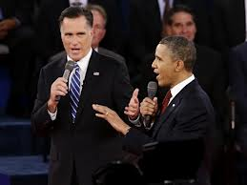
Do Christians get too political?
Some Christians try to fight Worldliness primarily through political means.
  Concerned over worldly ideas taking hold of the government. Understandable, but electing the so called “Christian” candidate will not solve that problem.
Notes:
Are we more concerned about 2016 than the condition of the soul of our neighbor?
Would electing the so called “Christian” candidate solve the problems of sin?
Sin is the true problem in America, not a political party!

Slide 7
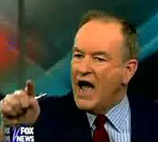
Do Christians get too political? (continued)
What do the “Christian” politicians fight for?
  School Prayer
  The name of God on dollar bills, coins, monuments, the pledge, etc.
  Ending the legal process of abortion
  Outlawing same-sex unions
  The Death Penalty
  Welfare
Those factors alone will not earn God’s approval!
Notes:
I may say a prayer publicly at school. I may say the pledge every day, and respect that God’s name is on my money. I may support a country who puts murderers to death. I may oppose abortion and homosexuality, meanwhile loving my wife and children in a godly way. But if I am not following God in his plan for salvation, do not worship him according to Scripture, then I am not a follower of him!
Is the Republican’s party’s motives always parallel with God’s? We need to be careful
School Prayer
Often not the prayers we think of.
“The Lord’s Prayer”
Abortions
Roe vs Wade spurned out of a growing problem of back alley abortions
Roe vs Wade did not begin the problem of mothers not wanting their unborn children.
Does not justify legalizing it, but a law alone won’t stop someone.
Welfare
There are those who abuse the system, and choose not to work.
But what about bad luck? Work injury? Environmental injuries?
The Great Depression
People that had no role in the wreck of the economy had no food. Was that their fault?
Politicians encourage us to believe in their inaccurate black and white idealogies. (Both parties)
If you’re suffering, you must have done something wrong! (Get into this for this afternoon’s sermon)
One scenario fits all?
Yet the Bible has many characters of righteousness who suffered poverty, persecution, and difficult temptations, not because of wrongdoings

Slide 8
Misunderstandings of the power of politics
Legislation alone cannot change people’s hearts. (Proverbs 6:12-15, 18)
Assume that we could never bring political opponents to Christ
  Have to convert them to a party before teaching the gospel?
  Pray that day never comes!
America is not the bride of Christ!
  The main battle we should be focused on is
  the battle between the kingdom of Christ and the
  secular world, not between the conservatives and
  liberals of America!
Notes:
No amount of laws will stop a person from sinning if their hearts are not right. (Proverbs 6:12-15, 18)
Prohibition
Back door alley abortions
Homosexuality
A law forbidding same sex unions for example, does not stop people from choosing the lifestyle.
We assume if someone is part of an opposite party, that they could never become Christians
Automatically give up spreading the word of God to those we assume would never accept it.
The Gospel is for all!

Slide 9
The Gospel of Christ
“Therefore, if anyone is in Christ, he is a new creation; old things have passed away; behold, all things have become new.” 2 Corinthians 5:17
  The gospel of Christ, not a political party has the power to change a person’s soul and mind for the better.
Why would a Christian spend more time in politics than spreading the gospel?
  Confused priorities?
  Fear of nation-spread immorality?
  Not faithful enough?
Notes:
When a person accepts the word of God and lets the gospel change the heart, all of his or her stances will then be based on God’s standard’s, including political viewpoints.
Not the other way around!
So why are some so politically involved?

Slide 10
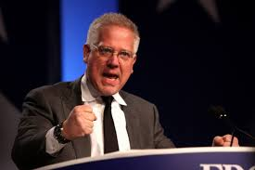
“Fox News Christians”
Even conservatives lie!
  Quick to judge irrational comments from liberals.
    …then say similar comments about them!
Examples of lying?
  Shooting at Columbine
    Martyrs for their beliefs?
  Bill Cosby “I’m 83 and tired.”
  The President, a Muslim?
Notes:
Conservatives are quick to judge irrational comments from liberals
“George W. Bush is our own Hitler.”
But look at what Republicans say!
Obama, a Muslim?
His faith was questionable at one point, but old arguments continued to be said by believers, even in the church.
I’m 83 and tired
Hasn’t been seen since Cosby’s secret allegations went public
Whole article is a lie (Cosby never wrote it). Is it ever ok to do “good” by doing something wrong?
Some are simply misinformed. Others continue to spread such lies, even when they know it’s not honest.
Columbine
“She Said yes” was used as political propaganda
Tapes reveal such conversation did not occur
Still a sad tragedy, but not geared as a sole attack on Christianity, contrary to what many said at the time of the shooting.
“This wouldn’t have happened if more people in this country listened to God”
Rain falls on just and unjust
Why are we putting more emotions and time toward a flawed organization?
Is this the party that saves our soul?
Is our faith based on how conservative we are? It should not be.
News sites and shows all use tactics to get our attention, to make use look at only one side, to believe anything that is said, no matter how false.
God doesn’t do that!
There is no hidden agenda. He genuinely wants us to be saved!

Slide 11
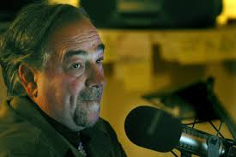
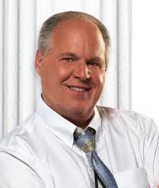
“Fox News Christians”
Will gladly take on
a liberal in their ungodly views, but
are too shy to mention Jesus?
  Fox News does not equal with God’s salvation!
“We need morals back in this country!”
  Then stay silent on divorce, verbal abuse?
    Cursing? Materialism?
    Lying? False accusation?
Seek First the Kingdom of God!! (Matt 6:33)
Notes:
Our expectations of Washington are sometimes higher than we expect of our own selves in the Lord’s Church
“Righteousness exalts a nation”
We are God’s nation, his church. Have we been showing such righteousness?
Why are we so shy to mention Jesus, but are very quick to voice our political thoughts?
Sometimes, political statements are more offensive then the loving word of God!
Fox News and the Bible are not the same!
Quick to oppose Democrat’s open views toward homosexuality, abortion, drugs…
Yet…
Rush Limbaugh (married 4 times)
Michael Savage, Glen Beck (verbally abusive to callers when disagreeing)
Many republicans embrace materialism!
A difference in political views does not allow us to act however we want to prove our point.
We are quick to be supportive of these people, while accusing well known Democrats of supporting immorality
Which side is more immoral? Does it even matter?
Only one has shown such consistency and perfection with his word, and that is God! (Matt 6:33) That is who should come first in our lives!

Slide 12

You can be patriotic, but…….
God cares more for his own spiritual nation, THE
CHURCH, more than any physical nation.
God cares more about saving
souls than he is about raising a
nation’s morality standard!
“You shall have no other gods before
Me.”
It is not commanded for the U.S, or any
nation “to have responsibility to lead the
world to the light of God.” That responsibility is for us Christians!
No matter how long this physical nations lasts, it is so short in God’s eyes. (2 Peter 3:8)
Notes:
We should vote! It is a privilege of this country, and we should take advantage of our opportunities.
But this very world we live is not meant to last
Yet our souls will exist somewhere forever.
But who is God more concerned about?
Who did he send his son to die for?
Trying to make this world a better place won’t be profitable if you and the souls around you are lost forever.
It is understandable to have love for our country. Yet our long history, has not had as such a timely impact on God (2 Peter 3:8)

Slide 13
The Bible is not going away….
“Last eve I paused beside the blacksmith’s door,
And heard the anvil ring the vesper chime;
Then looking in, I saw upon the floor,
Old hammers, worn with beating years of time.
“‘How many anvils have you had,’ said I,
‘To wear and batter all these hammers so?’
‘Just one,’ said he, and then with twinkling eye,
‘The anvil wears the hammers out, you know.’
“And so, I thought, the Anvil of God’s Word
For ages skeptic blows have beat upon;
Yet, though the noise of falling blows was heard,
The Anvil is unharmed, the hammers gone.”
Notes:
“Last eve I paused beside the blacksmith’s door,
And heard the anvil ring the vesper chime;
Then looking in, I saw upon the floor,
Old hammers, worn with beating years of time.
“‘How many anvils have you had,’ said I,
‘To wear and batter all these hammers so?’
‘Just one,’ said he, and then with twinkling eye,
‘The anvil wears the hammers out, you know.’
“And so, I thought, the Anvil of God’s Word
For ages skeptic blows have beat upon;
Yet, though the noise of falling blows was heard,
The Anvil is unharmed, the hammers gone.”

Slide 14
God vs Government
“And He changes the times and the seasons;
He removes kings and raises up kings;
He gives wisdom to the wise
And knowledge to those who have understanding.
He reveals deep and secret things;
He knows what is in the darkness,
And light dwells with Him.” (DANIEL 2:21-22)
The Word has survived through corrupt governments that have risen and fallen
  Why believe that is not true today?
Notes:
Governments come and go. Nations rise and fall. But God’s Word shall stand forever!
Nero, Decius, Napoleon, Hitler, Stalin
God’s word endured them and continues to spread. What leader has any hope of stopping this today?

Slide 15
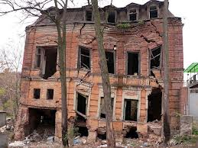
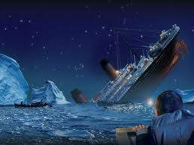
In Conclusion
Would someone ever…?
Walk into a condemned building and
build new windows?
Stay on a sinking ship and
wash dishes?
”Therefore, since all these things will be dissolved, what manner of persons ought you to be in holy conduct and godliness, looking for and hastening the coming of the day of God, because of which the heavens will be dissolved, being on fire, and the elements will melt with fervent heat?”
Notes:
Carpenters don’t walk into a place that truly cannot be fixed.
Women don’t clean up a kitchen on a ship that is sinking.
No country on this earth is meant to last forever. Our world is living off of limited time
2 Peter 3:11
But not the kingdom of God!
What is worth fighting for more?
America? Or the kingdom of God?

Slide 16
In Conclusion
We are to love all our enemies, including our political opponents. We should desire all to be saved!
Our brightest influence is our own godly life. Would you be willing to have an open opportunity to teach the gospel to another if it meant putting aside your political views?
Keep things in perspective. Jesus died not for a political party, or a physical nation, but for an eternal kingdom!
Notes:
Next time engaged in a conversation, bring up God. Simple questions, like “What do you think about God?” go a long way!
We should not feel more comfortable talking about political matters than about God!
So what war are you fighting for? For America? Or for the kingdom of God? They are not the same.
If you are not a Christian
Not hesitant to admitting being an American?
Not hesitant to vote?
So why have you not become a Christian, and join the ETERNAL kingdom? (Phillipians 3:20-21)

