Slide 2
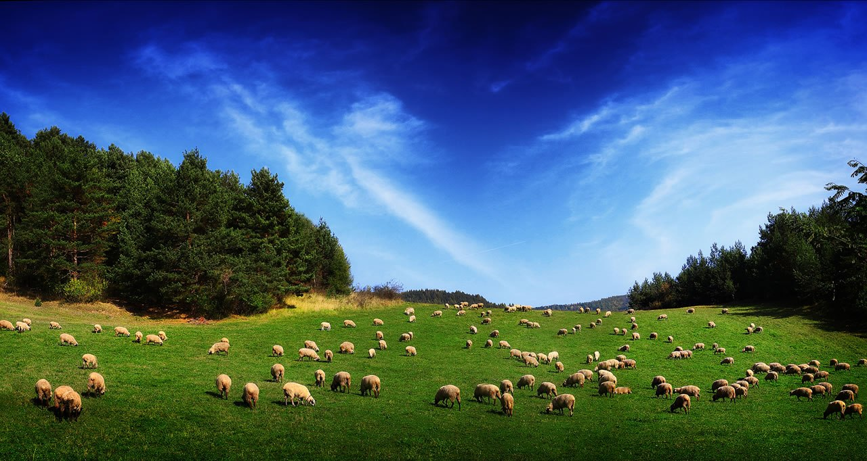
Who Can Be An Elder?

Slide 3

Qualifications For Elders
First Timothy 3:1-7
Titus 1:6-9
This lesson will continue a study of the qualifications which have to do with a man’s character.

Slide 4
1. Not Covetous, Not Greedy For Money
1 Tim. 3:3; Titus 1:7
“free from the love of money” (NASV) – one who is not a friend or lover of silver or money.
“not given to filthy lucre” (KJV), “not fond of sordid gain” (NASV) – refers to indecent or dishonorable gain.
Describes a person who does not care how the money is made, just so long as there is a profit.

Slide 5
1. Not Covetous, Not Greedy For Money
A rich man can be an elder, but a man who has a love of money cannot be an elder (1 Tim. 6:10).
He must care that money is made and spent in the proper manner.
As a “steward of God” (Titus 1:7), he must not look upon the church treasury as a means of hoarding wealth for the Lord, but must make proper use of it.
He must not be affected or persuaded by one’s wealth (or lack thereof).

Slide 6
2. Not Self Willed
Titus 1:7
A self-willed man is self-pleasing; asserting his own will above the will and needs of others.
The opposite of “gentle.” Intolerant and inconsiderate of the wants, needs, feelings, and desires of others.
As a part of an eldership, he must be willing and able to cooperate with and work with the other elders.

Slide 7
3. Lover of What is Good
Titus 1:8
“lover of good men” (KJV)
Elders must be men who encourage, support and promote that which is good – either good people or good things.
They know “good” is determined by God’s word, not by man’s opinions.

Slide 8
4. Just
Titus 1:8
“upright” (ESV)
An elder must be judiciously fair, exact, impartial and honest in all his dealings with others. He will do the right thing, and insist the right thing always be done.
He must be guided by a commitment to do what is right.

Slide 9
5. Holy
Titus 1:8
“devout” (NASB)
Undefiled by sin, free from wickedness, religiously observing every moral obligation.
One who pursues holiness (Heb. 12:14), perfects holiness (2 Cor. 7:1), and strives to be holy as God is holy (1 Pet. 1:15).

Slide 10
6. Must Have A Good Testimony Among Those Who Are Outside
1 Tim. 3:7
“must have a good report of them which are without” (KJV)
“must have a good reputation with those outside the church” (NASV)
“he must be well thought of by outsiders” (ESV)
What kind of a reputation does this man have with those who are not members of the church?

Slide 11
Qualifications For Elders - part 1
Blameless
Temperate, Sober-Minded, Self-Controlled
Of Good Behavior
Given To Hospitality
Not Given To Wine
Not Violent, But Gentle, Not Quarrelsome, Not Quick Tempered

Slide 12
Qualifications For Elders - part 2
Not Covetous, Not Greedy For Money
Not Self Willed
Lover of What is Good
Just
Holy
Must Have a Good Reputation With Those Outside the Church

