Slide 1
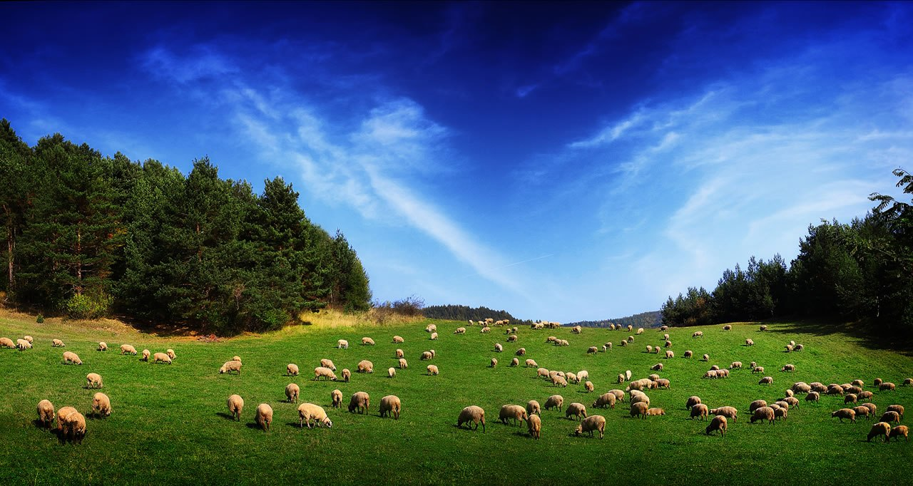
Who Can Be An Elder?

Slide 2

Qualifications For Elders
First Timothy 3:1-7
Titus 1:6-9
Today we will discuss some of the qualifications which have to do with a man’s character.

Slide 3
1. Must Be Blameless
1 Tim. 3:2; Titus 1:6-7
“above reproach” (NASB, ESV)
Cannot mean sinless perfection.
Translated from a Greek word meaning, “that cannot be laid hold of.” “Signifies that which cannot be called into account… with nothing laid to one’s charge as the result of public investigation.”

Slide 4
2. Temperate, Sober-Minded, Self Controlled
1 Tim. 3:2; Titus 1:8
temperate, vigilant (KJV) – watchful, circumspect, a state of mind which is free from the excessive influence of passion, lust, or emotion.
sober-minded, prudent (KJV), sensible (NASV) – self-disciplined, self-restrained, showing mental and emotional balance.
self-controlled, temperate (KJV) – having power over oneself, moderate.

Slide 5
2. Temperate, Sober-Minded, Self Controlled
1 Tim. 3:2; Titus 1:8
temperate, vigilant (KJV) – watchful, circumspect, a state of mind which is free from the excessive influence of passion, lust, or emotion.
sober-minded, prudent (KJV), sensible (NASV) – self-disciplined, self-restrained, showing mental and emotional balance.
self-controlled, temperate (KJV) – having power over oneself, moderate.
These words describe a man with a balanced mind; reasonable in his attitude, thinking, and behavior; not given to extremes.
One who is not controlled by his emotions, but can hold himself in check; who is alert and focused; not easily fooled by others.

Slide 6
3. Of Good Behavior
1 Tim. 3:2
“respectable” (NASB, ESV)
Translated from the word kosmios - “orderly, well-arranged, decent, modest.”
A man who’s life is organized, well-balanced and blended together; thus making him a great example to follow (1 Pet. 5:3).

Slide 7
4. Given To Hospitality
1 Tim. 3:2; Titus 1:8
“a lover of hospitality” (Titus 1:8, KJV)
Translated from a Greek word that literally means “a love of strangers.”
One who cares about others and is willing to do what he can to care for the needs of others.

Slide 8
5. Not Given To Wine
1 Tim. 3:3; Titus 1:7
“not addicted to wine” (NASB)
“not a drunkard” (ESV)
Translated from a Greek word which refers to one who tarries at the wine, one who stays at the wine.

Slide 9
Does this qualification require abstinence or only moderation?
An elder must be sober, temperate, and vigilant. Alcohol impairs these qualities.
Alcohol is addictive (1 Cor. 6:12).
God has condemned leaders who were given to intoxicating drink (Is. 28:7, 56:9-12).
An elder is to be an example (1 Pet. 5:3).
This qualification requires abstinence.

Slide 10
6. Not Violent, But Gentle, Not Quarrelsome, Not Quick Tempered
1 Tim. 3:3; Titus 1:7
violent, striker (KJV), pugnacious (NASV) - to strike, a violent person both in actions as well as in words, one who is ready to fight, takes offense easily.
A man with such a trait will not make for peace, but will certainly make for strife within the eldership and the congregation.

Slide 11
6. Not Violent, But Gentle, Not Quarrelsome, Not Quick Tempered
1 Tim. 3:3; Titus 1:7
gentle, patient (KJV) - the ability to look humanely and reasonably at the facts of a case, to consider the greater needs of an individual or situation.
Elders cannot tolerate sin, but they must strive to understand the weaknesses and ignorance of brethren and be patient and gentle while exhorting and correcting them.

Slide 12
6. Not Violent, But Gentle, Not Quarrelsome, Not Quick Tempered
1 Tim. 3:3; Titus 1:7
not quarrelsome, not a brawler (KJV), uncontentious (NASV) - not disposed to fight, without battle or controversy.
One who has the ability to contend for the faith (Jude 3) without being contentious.

Slide 13
6. Not Violent, But Gentle, Not Quarrelsome, Not Quick Tempered
1 Tim. 3:3; Titus 1:7
not quick-tempered, not soon angry (KJV) – one who is not prone to anger, not irritable, touchy, testy or grouchy.
These words have to do with an elder’s emotional temperament. An elder has to be approachable. No one would want to go to, or follow, a man with a short fuse and a quick temper.

Slide 14
Qualifications For Elders - part 1
Blameless
Temperate, Sober-Minded, Self-Controlled
Of Good Behavior
Given To Hospitality
Not Given To Wine
Not Violent, But Gentle, Not Quarrelsome, Not Quick Tempered

