Slide 2
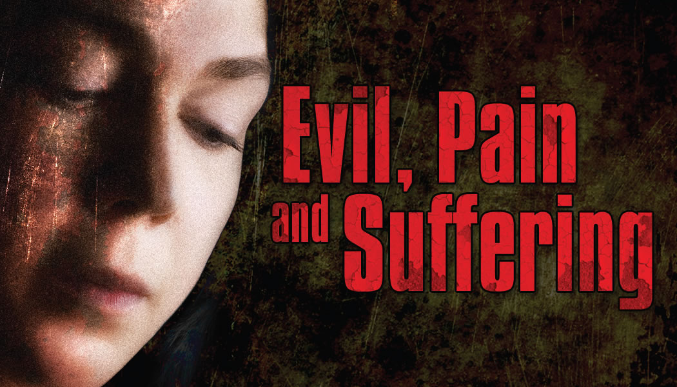

Slide 3
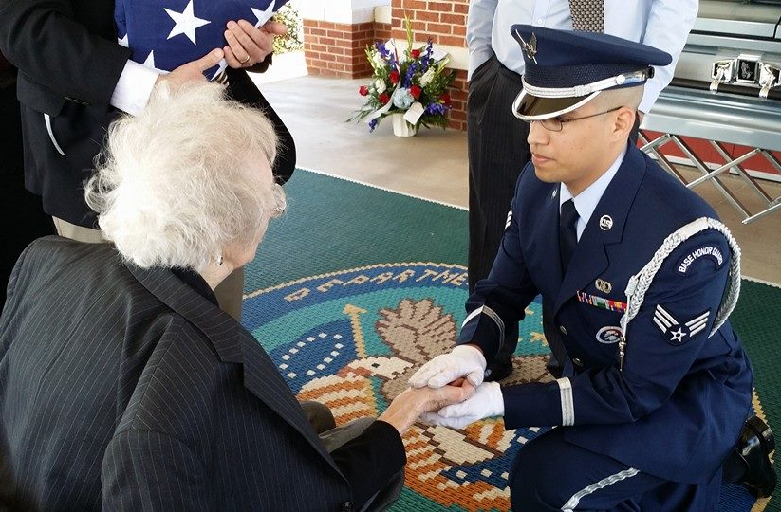
How Do We Fit God Into This Reality?
Innocent people are injured and killed in accidents; and are victims of violence.
Extreme weather destroys property and claims lives.
Loved ones are taken from us due to illness.

Slide 4
How Do We Fit God Into This Reality?
Innocent people are injured and killed in accidents; and are victims of violence.
Extreme weather destroys property and claims lives.
Loved ones are taken from us due to illness.
“If someone lives their life like this and this happens, it really tests your faith.”
Tom Murphy, on the shooting death of his neighbors Bud and June Runion (1/27/15).

Slide 5
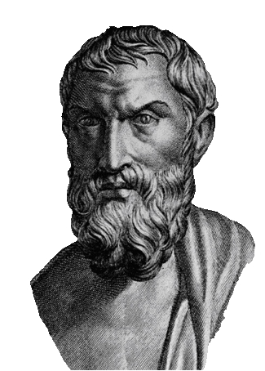
Epicurus (342-270 BC)
“If there is a God who wishes to prevent evil, but cannot, he is not all powerful, and thus is not God.”
“If he has the power to prevent evil, but will not, then he is not good, and thus is not God.”
“If there is a God who has both the power and desire to eliminate evil, then why is evil and suffering present in the world today?”

Slide 6
The Origin of Evil
Argument: “God created everything, therefore He must have created evil.”
Not true! Everything God created was good:
“Then God saw everything that He had made, and indeed it was very good…” (Gen. 1:31).

Slide 7
The Origin of Evil
Man was uniquely created with the ability to think, reason, and choose. We have free will.
God respects our choices, even when we choose to do wrong.
God has always warned man of the consequences of choosing to disobey Him (Gen. 2:16-17).

Slide 8
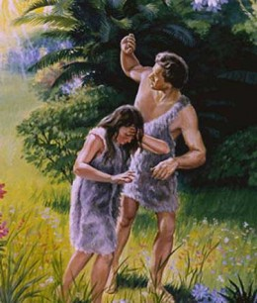
The Origin of Evil
Genesis 3 - The first sin introduced…
Shame (vs. 7-8)
Fear (v. 10)
Sorrow and Pain (v. 16)
Earth Cursed (v. 17)
Death (v. 19)

Slide 9
Why Man Suffers
His Wrong Choices
  Gal. 6:7; Prov. 13:15
Wrong Choices of Others
Wrong Choices of Past Generations
  Ex. 20:4-6
Violates Laws of Nature
  Luke 13:4-5; Eccl. 9:11-12

Slide 10
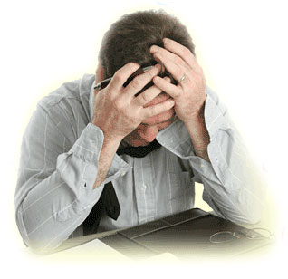
Dealing With the Problem of Evil, Pain and Suffering

Slide 11
1. Evil Will Eventually Be Dealt With
We are not to envy sinners (Prov. 23:17-18).
All evildoers will eventually receive their reward (2 Thess. 1:4-10; Matt. 25:31-46).

Slide 12
2. God Will Not Allow Us To Suffer More Than We Can Handle
“No temptation has overtaken you except such as is common to man; but God is faithful, who will not allow you to be tempted beyond what you are able, but with the temptation will also make the way of escape, that you may be able to bear it.”
1 Corinthians 10:13

Slide 13
3. There Are Benefits To Pain and Suffering
Pain alerts us to danger; allowing us to escape or seek needed medical help.
We learn right from wrong by suffering the consequences of our actions.
Discipline is needed, but it is not pleasant (Heb. 12:11).
The “testing of fire” strengthens our faith (1 Pet. 1:6-7).

Slide 14
3. There Are Benefits To Pain and Suffering
If endured properly, suffering can build character (James 1:2-4).
  Bravery, valor, honor, courage, love, self-sacrifice, etc., are borne out of affliction.
Suffering equips us to comfort others who suffer (2 Cor. 1:3-4).
Suffering causes us to long for, and thus prepare for, Heaven (Rev. 21:4).

