Slide 1


Slide 2
Is There Any Evidence?
Science involves the study of things that can be observed and repeated.
  God cannot be observed (John 4:24)
  Creation cannot be repeated
Science cannot prove God exists.
Neither can science prove God does not exist!

Slide 3

Is There Any Evidence?
God has left evidence of His existence in this world and in the affairs of the lives of men.
  Psalm 19:1
  Romans 1:18-20
  Acts 14:15-17

Slide 4
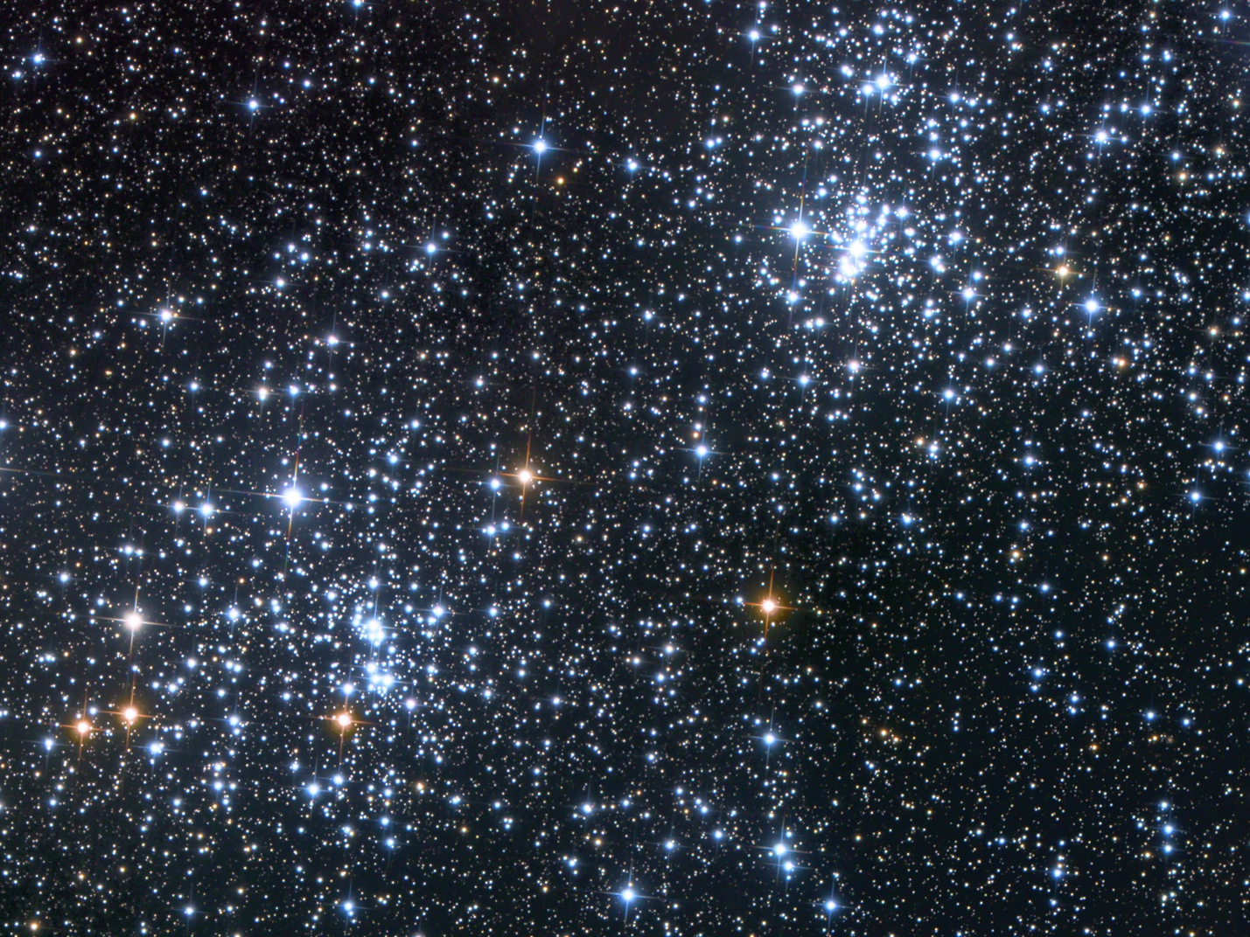
The Origin of the Universe

Slide 5
The Origin of the Universe
The Law of Cause and Effect
“for every effect there must be an adequate cause that existed before the effect.”

Slide 6
The Origin of the Universe
Three Options
the universe has always existed
the universe created itself
the universe was created by something else

Slide 7
The Origin of the Universe
1. The Universe Has Always Existed
Violates the law of cause and effect.
Violates the second law of thermodynamics (also called the law of increasing entropy).
This law states that everything is moving from an organized state to a disorganized state.
In other words, the universe is winding down, and matter cannot be eternal.

Slide 8
The Origin of the Universe
2. The Universe Created Itself
Violates the law of cause and effect, we know that “nothing comes from nothing.”
Violates the first law of thermodynamics (the law of the conservation of matter).
This law states that matter cannot be created or destroyed.

Slide 9
The Origin of the Universe
3. The Universe Was Created By Something Else

Slide 10
The Origin of the Universe
3. The Universe Was Created By Something Else
Which is more reasonable?
To conclude (with no mandate or scientific evidence) that there was a time when the laws of nature did not exist and matter created itself?
Or to believe that a powerful being created the physical universe?
Both explanations require a leap of faith!

Slide 11
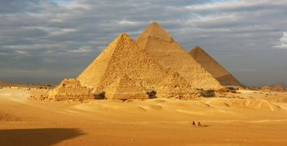

The Design of the Universe
Design demands a designer.

Slide 12
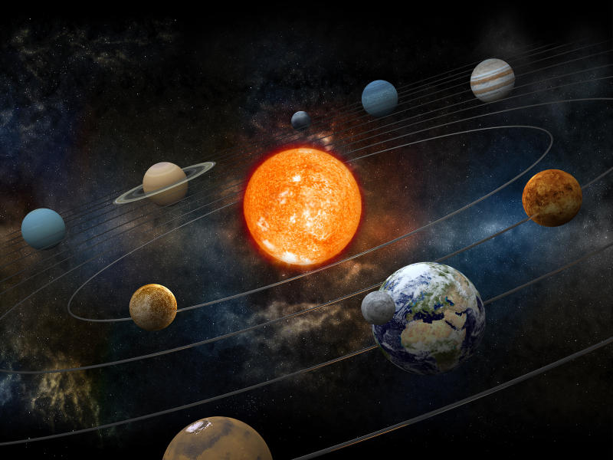
The Design of the Universe

Slide 13
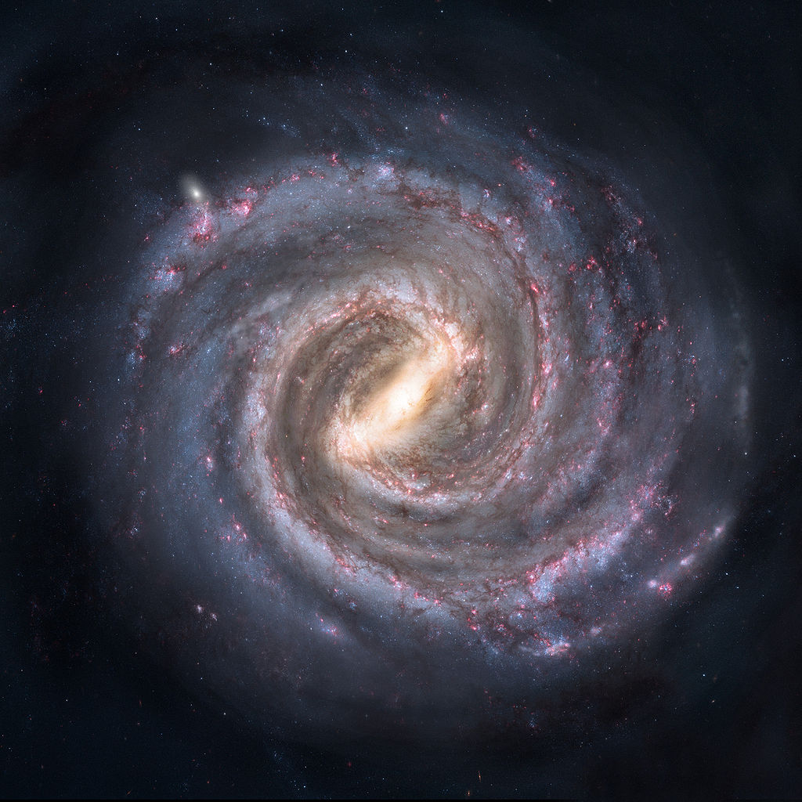
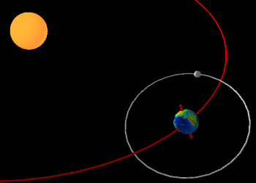
The Design of the Universe

Slide 14
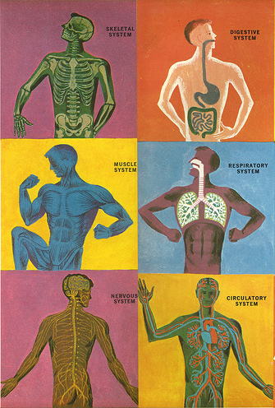
The Design of the Human Body
“For I am fearfully and wonderfully made”
Psalm 139:14

Slide 15


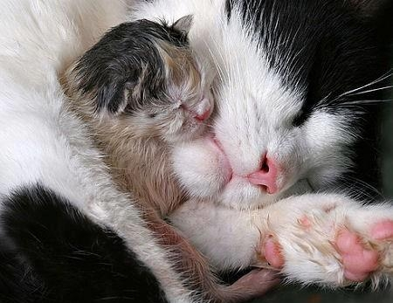
Animal Instinct and Man’s Morality

Slide 16

Animal Instinct and Man’s Morality
“Let Us make man in Our image, according to Our likeness…”
Genesis 1:26

Slide 17
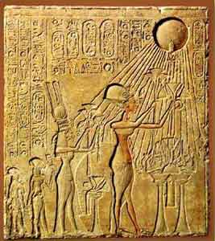

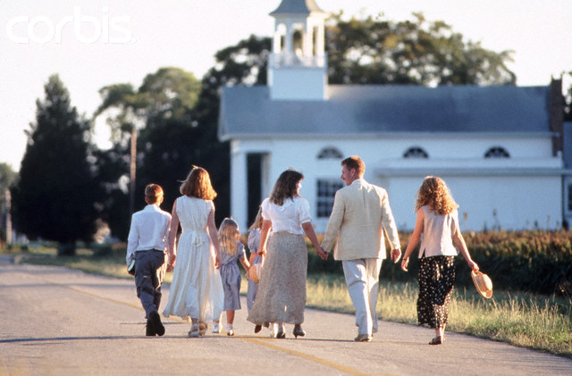
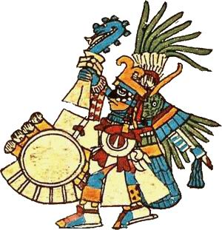
Man’s Universal Recognition of a Higher Power

Slide 18
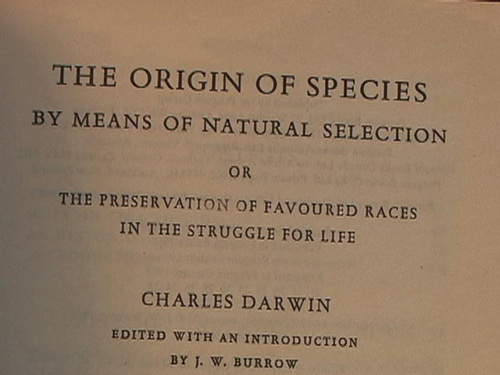
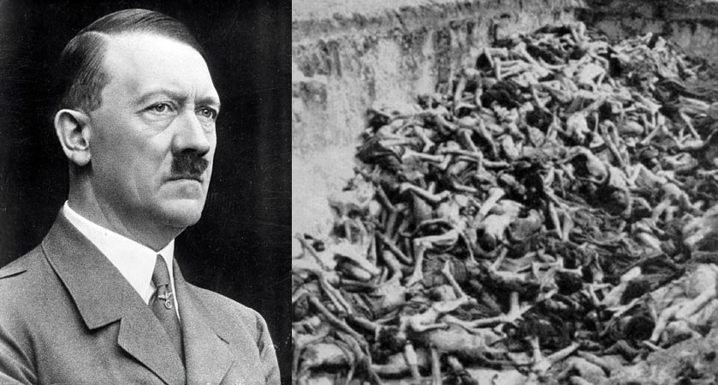
Consequences of Unbelief
No Standard of Right and Wrong (Is. 5:20)
“Might Makes Right”
Cheapens Human Life
Leaves Man Without Hope

Slide 19
Evidence For the Existence of God
The Origin of the Universe
The Design of the Universe
Animal Instinct and Man’s Morality
Man Universal Recognition of a Higher Power
What is my honest response to this evidence? Which is a more reasonable: to believe it happened by chance, or believe it was created by God?

