Slide 1
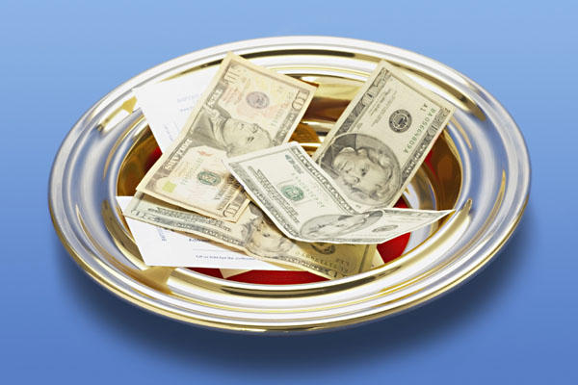
Our Weekly Contribution
Are We Giving As We Should?

Slide 2
Why Talk About This Subject?
Temptation to avoid sermons like this:
Makes the preacher look greedy.
Meddles in personal affairs of the members.
Sends wrong message to visitors.
Sermons like this are needed sometimes:
We have to preach the whole counsel of God.
Sometimes members need to hear these kinds of sermons.
Visitors need to know why we take up a collection.

Slide 3
The church had funds to spend.
In the support of gospel preachers
  Phil. 4:15-17; 2 Cor. 11:8
To help needy saints
  Acts 6:1; 1 Tim. 5:3-16

Slide 4
How were these funds raised?

Slide 5
How were these funds raised?
Now concerning the collection for the saints, as I have given orders to the churches of Galatia, so you must do also:
On the first day of the week let each one of you lay something aside, storing up as he may prosper, that there be no collections when I come.
1 Corinthians 16:1-2

Slide 6
How were these funds raised?
Now concerning the collection for the saints, as I have given orders to the churches of Galatia, so you must do also:
On the first day of the week let each one of you lay something aside, storing up as he may prosper, that there be no collections when I come.
1 Corinthians 16:1-2

Slide 7
How were these funds raised?
Now concerning the collection for the saints, as I have given orders to the churches of Galatia, so you must do also:
On the first day of the week let each one of you lay something aside, storing up as he may prosper, that there be no collections when I come.
1 Corinthians 16:1-2

Slide 8
How were these funds raised?
Now concerning the collection for the saints, as I have given orders to the churches of Galatia, so you must do also:
On the first day of the week let each one of you lay something aside, storing up as he may prosper, that there be no collections when I come.
1 Corinthians 16:1-2

Slide 9
How were these funds raised?
Now concerning the collection for the saints, as I have given orders to the churches of Galatia, so you must do also:
On the first day of the week let each one of you lay something aside, storing up as he may prosper, that there be no collections when I come.
1 Corinthians 16:1-2

Slide 10
How were these funds raised?
Now concerning the collection for the saints, as I have given orders to the churches of Galatia, so you must do also:
On the first day of the week let each one of you lay something aside, storing up as he may prosper, that there be no collections when I come.
1 Corinthians 16:1-2

Slide 11
The New Testament Leaves the Amount Given Up To the Christian
We are to give as we have prospered
  1 Corinthians 16:2
We are to give as we purpose in our heart
  2 Corinthians 9:7
This does not mean God doesn’t care about the amount we are giving!

Slide 12
1. God Must Come First In Our Life
Children of Israel were to give God the “First Fruits.”
  Ex. 23:19; Deut. 26:2; Neh. 10:35-37
An acknowledgement and thanksgiving for God’s provisions and blessings.
What does God get from us - the “first fruits” or the “left-overs”?

Slide 13
1. God Must Come First In Our Life
Haggai 1:2-9
They had abandoned the Temple of God to focus on themselves.
They lived in nice houses while the Temple lay in disrepair.
What percentage of our income is spent on our comfort, entertainment, luxuries as opposed to our weekly contribution?

Slide 14
2. We Can Rob God
Malachi 3:8-10
They were robbing God by failing to give Him what was rightfully His.
They were “cursed with a curse.”
Are we robbing God, even though we are putting something in the collection plate?

Slide 15
3. We Are Under A Better Covenant
The Children of Israel were commanded to tithe
  Lev. 27:30-33; Num. 18:21-32; Deut. 12
Tithing is giving ten percent.
Sometimes Christians use the 10% figure as a “measuring stick” for their giving, but this isn’t always an accurate calculation.

Slide 16
It isn’t within the scope of this author’s knowledge or wisdom to create an absolute standard for every individual’s calculation of prosperity. But given that the Old Testament worthies based their tithe on “all” they possessed, can we calculate our prosperity only on our “take home” pay, after insurances, taxes, retirement investments and the like are subtracted? Do we logically exclude investment income, including interest, dividends, capital gains and other various profits?
Again, trying to merely create a program for what I “owe” is counterproductive, since it may strip the gift of its love component. But, on the other hand, we are sometimes thoughtless about the true “basis” for calculating what is reasonably expected of us.
Randy Blackaby, Blessed To Bless, pages 84-85

Slide 17
3. We Are Under A Better Covenant
Christians are serving God under a better covenant than the Children of Israel
  Heb. 8:6, 9:23, 10:10, 19-23
We are not commanded to give a specific amount, but to give bountifully, cheerfully, and as we purpose in our heart (2 Cor. 9:6-7).
If we are under a better covenant, why would we feel comfortable giving less than what was required under the old covenant?

Slide 18
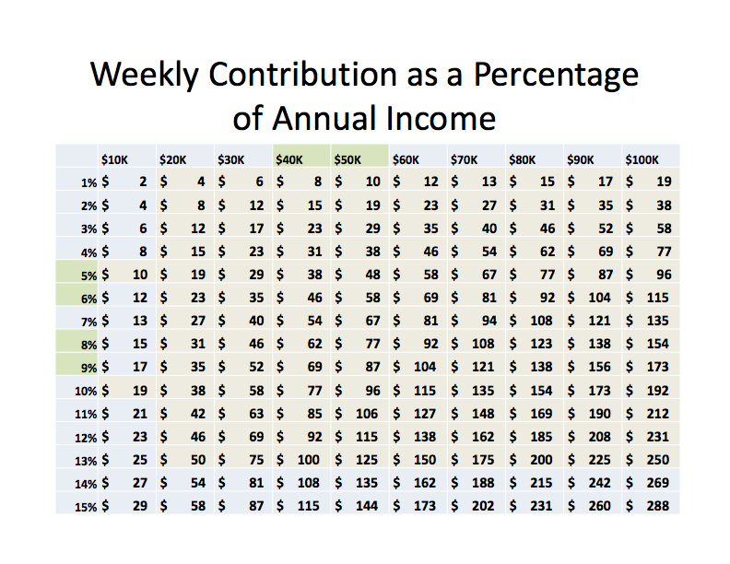

Slide 19
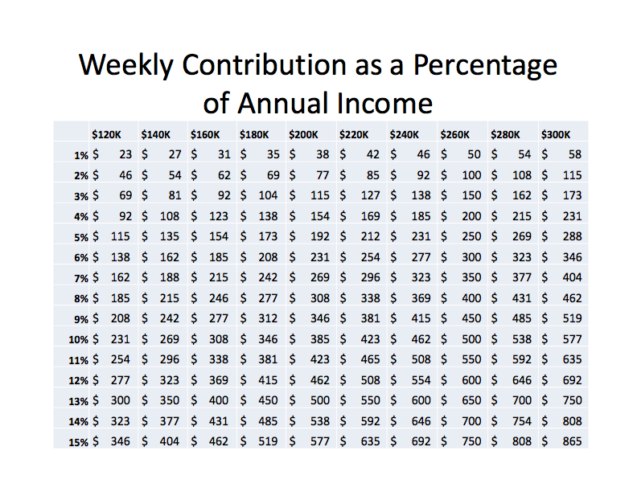

Slide 20
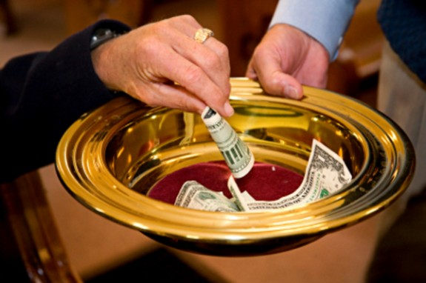
Are We Giving As We Should?
It does matter to God how much we give.
Our giving should show that God comes first in our lives.
It is possible to rob God, and thus lose our soul’s salvation.
Our giving should be a reflection of our gratitude for living under a better covenant.

