Slide 1
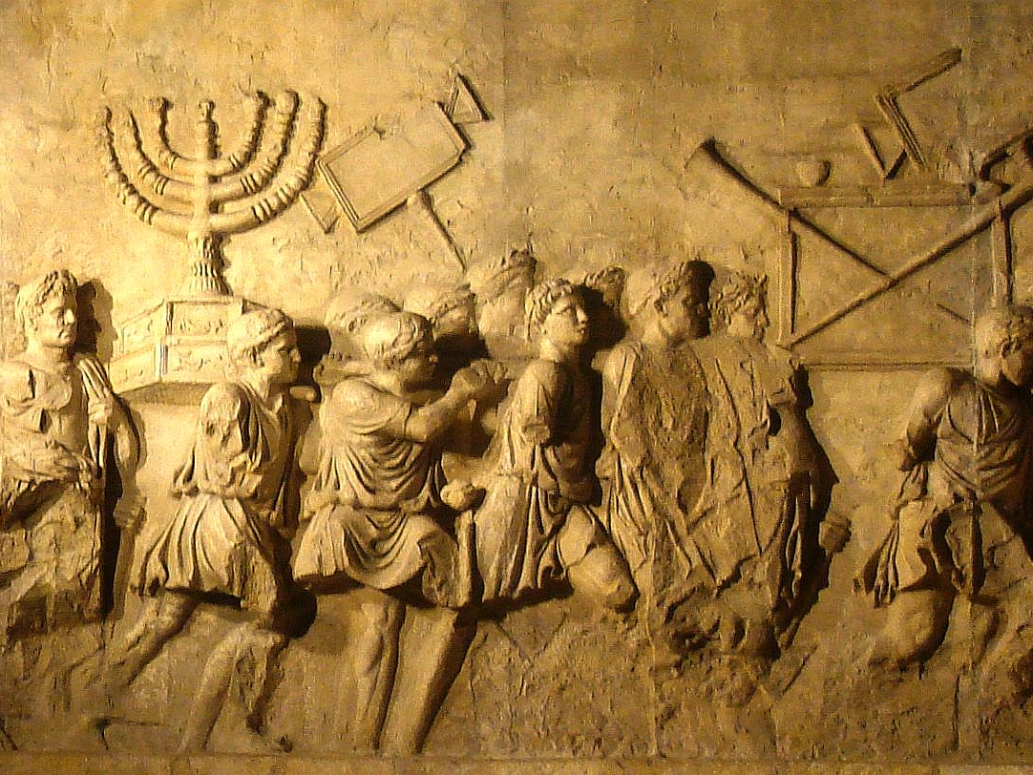

The A.D. 70 Doctrine

Slide 2
What is the A.D. 70 Doctrine?
The Holy Scriptures teach that the second coming of Christ, including the establishment of the eternal kingdom, the day of judgment, the end of the world and the resurrection of the dead, occurred with the fall of Jerusalem in 70 A.D.
Studies in Bible Prophecy, March-May 1987

Slide 3
“Realized Eschatology”
Eschatology – “the branch of theology dealing with last or final things”
Realized – “accomplished or completed”

Slide 4
“Realized Eschatology”
Eschatology – “the branch of theology dealing with last or final things”
Realized – “accomplished or completed”
The false belief that every prophecy concerning end times has already been “realized” or fulfilled.
The Second Coming of Christ, Final Judgment, the Resurrection of the Dead, and the End of the World all occurred when Jerusalem was destroyed by Rome in 70 AD.

Slide 5
Overlapping of the Covenants

Slide 6

Overlapping of the Covenants
New Covenant (Gospel)
Old Covenant (Law of Moses)
33 AD
70 AD

Slide 7
Overlapping of the Covenants
New Covenant (Gospel)
Old Covenant (Law of Moses)
33 AD
70 AD
Advocates of the A.D. 70 Doctrine insist the prophecies concerning the end of the world, judgment, the resurrection, etc., have to do with the end of this overlapping period – not the end of time.

Slide 8
Overlapping of the Covenants
This idea is based upon a false interpretation and application of Paul’s allegory concerning Isaac and Ishmael in Galatians 4:21-31.
Ishmael never was an heir. God made it clear from the beginning that he was not the child of promise. He was never an equal with Isaac.

Slide 9
Overlapping of the Covenants
The Law of Moses never co-existed with the Law of Christ.
The Law of Moses was abolished when Jesus died on the cross (Eph. 2:14-17; Col. 2:13-14), at which time the Law of Christ went into effect (Heb. 9:16-17).

Slide 10
The Second Coming of Christ
The A.D. 70 Doctrine teaches the Second Coming of Christ occurred when He came in judgment against Jerusalem in 70 AD.
There is a sense in which it can be said that the Lord “comes in judgment” against nations.
The destruction of Jerusalem was one of these times (Matt. 24:30, 34).

Slide 11
The Second Coming of Christ
The Bible teaches the Lord’s Second Coming will be a literal appearance
  Acts 1:9-11; 1 Thess. 4:16
These prophecies were not fulfilled at the destruction of Jerusalem in 70 AD.

Slide 12
Final Judgment
The A.D. 70 Doctrine teaches there will not be a universal judgment of mankind at the end of time.
All the biblical references to a final judgment were referring to the judgment of the nation of Israel at the destruction of Jerusalem.

Slide 13
Final Judgment
Matt. 25:31-32 – “all nations” will be judged, not just Israel.
Matt. 12:41-42 – the men of Nineveh and the Queen of the South were not present at the destruction of Jerusalem, but they will be present together in the final judgment.
Acts 17:30-31 – “all men everywhere to repent… judge the world”

Slide 14
Destruction of the World
The A.D. 70 Doctrine teaches there will not be a day in which the world is destroyed and time is brought to an end.
All prophecies concerning the end of the world were speaking of the end of the Jewish nation - which occurred at the destruction of Jerusalem in 70 AD.

Slide 15
Destruction of the World
Jesus said “heaven and earth will pass away” (Matt. 24:35).
Revelation 20:11-15 – the “small and great” did not stand before God at the destruction of Jerusalem. The “sea” and “death and Hades” did not give up the dead in them. They were not destroyed in the lake of fire.

Slide 16
Resurrection of the Dead
The A.D. 70 Doctrine teaches the resurrection occurred when the church was raised triumphantly from the death of the nation of Israel at the destruction of Jerusalem.
The Biblical references of a future resurrection are not speaking of a literal, bodily resurrection – but of a symbolic resurrection; the resurrection of the church from the oppression of Judaism.

Slide 17
Resurrection of the Dead
In order for the church to be resurrected in A.D. 70, it had to be dead prior to that time. The Bible indicates the church was very alive and active prior to 70 AD.
Acts 24:15 – Paul, an inspired apostle, believed in “a resurrection of the dead, both of the just and the unjust.”

Slide 18
Resurrection of the Dead
Matthew 22:23-33 – the Sadducees denied the resurrection of the body. They presented their case to Jesus.
He said they were “mistaken” in denying a bodily resurrection.
He went on to defend the doctrine of a bodily resurrection.

Slide 19
“Look Before You Leap” into the A.D. 70 Doctrine
Denies literal resurrection of Jesus Christ (1 Cor. 15:20-23)
No more baptism (Matt. 28:18-20)
No more Lord’s Supper (1 Cor. 11:26)
No more persecution (2 Thess. 1:4-10)
No more marriage (Matt. 22:30)
No more death (1 Cor. 15:24-26)
A license to sin (1 Cor. 15:33-34)

Slide 20


