Slide 1
Premillennialism

Slide 2
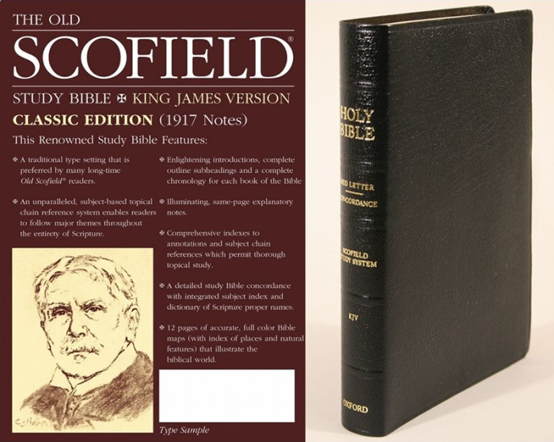



Slide 3
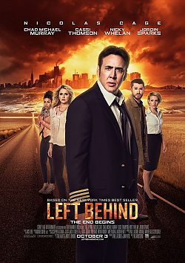
Left Behind
A small group of survivors are left behind after millions of people suddenly vanish and the world is plunged into chaos and destruction.
The sudden disappearance is the calling of Christians to heaven to be with the Lord, while those left behind face confusion and havoc.

Slide 4
Left Behind
“I think a lot of the core Christian audience, I think they’re going to be surprised at the clarity with which we presented the rapture. I think people are expecting it to be completely buried and barely mentioned,” producer and writer Paul Lalonde.

Slide 5

“Like most Christians, my family and I can truly say that we’re excited about the soon return of Jesus, and I’m sure, if you’ve been watching the news lately, you know that that return could be any day from now.”
“This movie will make you think, you know... how it all ends.”

Slide 6
"I am so excited to be a part of the brand-new feature film Left Behind," Robertson said. "As I continue my journey into the major motion-picture business, I am proud to be associated with this project, which is based off of the best-selling novel that really brings the book series to life. It's a film that audiences need to see to believe—are you ready?“
Producer/writer Paul Lalonde is pleased to have Robertson on board.
"We are thrilled that Willie Robertson is part of our team and that he shares the same vision for Left Behind and its message that will be brought to moviegoers around the world," Lalonde said. "Willie and I are both on the same page not only theologically, but also in our commitment to high-quality entertainment that reaches a wide audience. Working with him has been inspiring.”
http://www.charismanews.com/culture/45337-willie-robertson-moonlights-on-end-times-thriller-left-behind

Slide 7
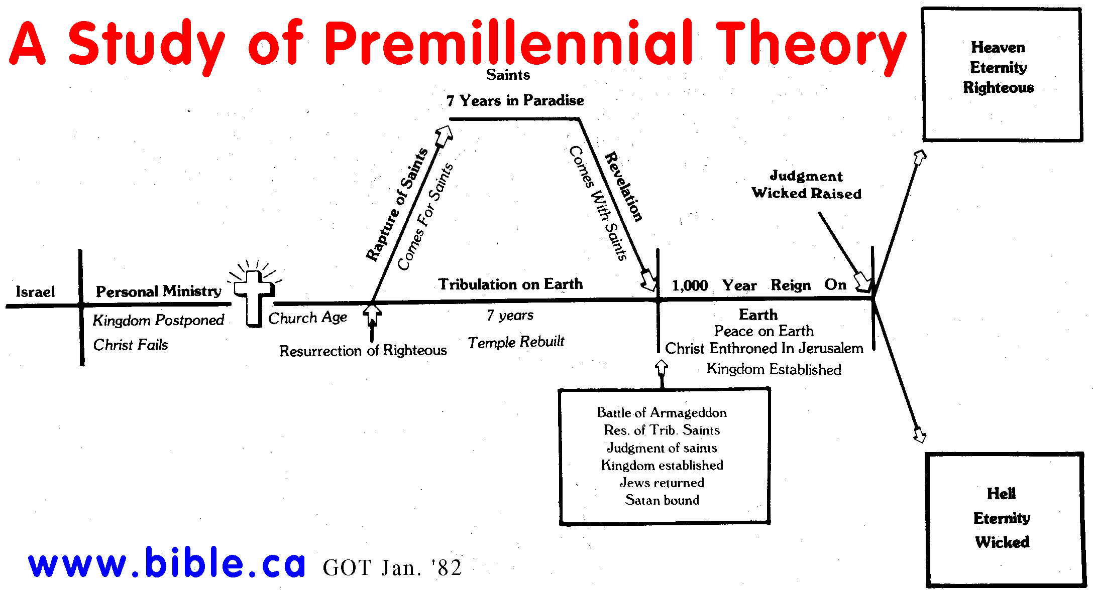

Slide 8
Problems With Premillennialism
Teaches Jesus Came To Establish An Earthly Kingdom
Teaches Jesus Failed In His Efforts To Establish An Earthly Kingdom
Teaches Jesus’ Death Was Not the Reason Jesus Came To Earth
Teaches the Church is a Substitute, Stand-In For the Kingdom
Teaches Jesus Is Not Currently Reigning As King

