Slide 2
Esther
The Courage to Stand

Slide 3
“For I know the thoughts that I think toward you, says the Lord, thoughts of peace and not of evil, to give you a future and a hope.”
Jeremiah 29:11

Slide 4
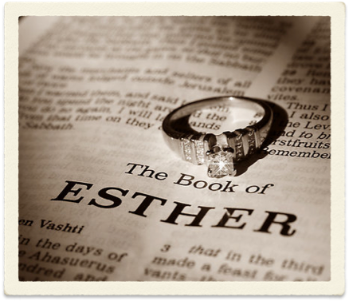

Esther
Before there was Esther there was another woman who had to stand against the world - Queen Vashti
Esther’s greatness started with obedience to Mordecai
God’s people are hated by the world - Haman

Slide 5
“For if you remain completely silent at this time, relief and deliverance will arise for the Jews from another place, but you and your father’s house will perish. Yet who knows whether you have come to the kingdom for such a time as this?”
Esther 4:14

Slide 6
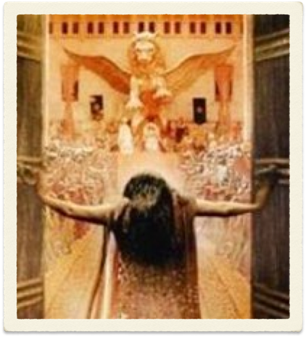
Esther
God provides the occasion but Esther must provide the courageous choice.
God is not defeated by evil men. He is always in control.
Esther musters the courage to stand against Haman and she stands up for God’s people!

Slide 7
“For I know the thoughts that I think toward you, says the Lord, thoughts of peace and not of evil, to give you a future and a hope.”
Jeremiah 29:11
God’s providence is never to be debated.
The only question is your courage.

Slide 8
Esther
The Courage to Stand

