Slide 1
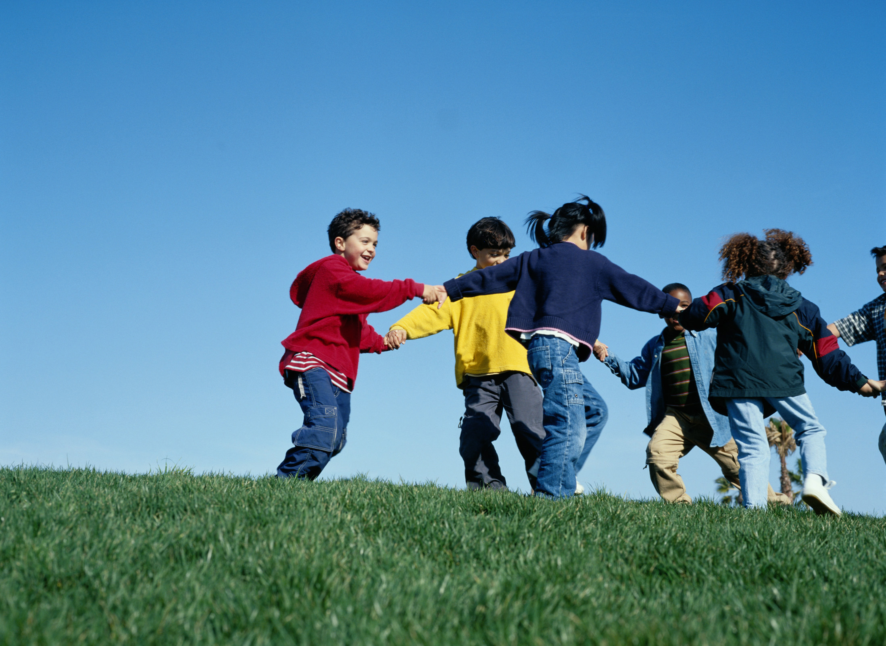
Become As Little Children
Matthew 18:1-4

Slide 2
“Who then is greatest in the kingdom of heaven?"
“Assuredly, I say to you, unless you are converted and become as little children, you will by no means enter the kingdom of heaven.”

Slide 3
Become As Little Children
Humility
Trust
Innocence
Forgiving
Growth

Slide 4
“Assuredly, I say to you, unless you are converted and become as little children, you will by no means enter the kingdom of heaven.”

