Slide 1
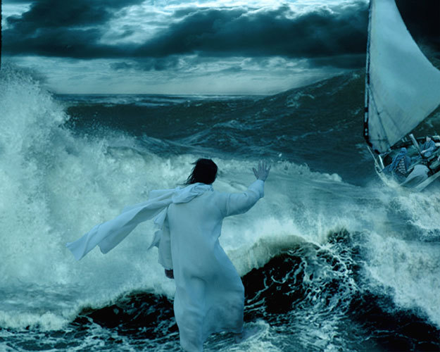
Making It Through the Storms of Life
Matthew 8:24-27
Matthew 14:22-33
John 6:15-21
Notes:
Title Slide: Making it Through the Storms of Life—Matt.8:24-27; 14:22-33; John 6:15-21

Slide 2
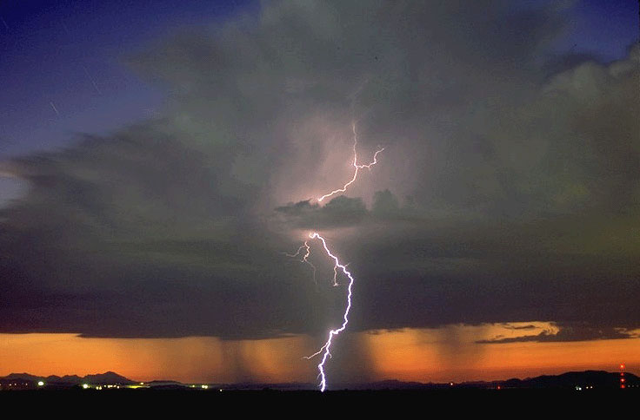
We Are Going to Have Storms!
Enjoy the good times and be thankful!
Prepare for storms before they come!
Storms often come on the heels of success!
Beware of shallow theology!
Remember six things …
James 1:2; 1 Corinthians 10:13
Notes:
We are Going to Have Storms! (Jam.1:2; 1 Cor.10:13)
Enjoy the good times and be thankful!
Prepare for storms before they come!
Storms often come on the heels of success!
Beware of shallow theology!
Remember six things…

Slide 3
Remember Who Is in Control
When storms arise—we need to turn to the sovereign Lord.
    Matthew 8:25-27
    Psalm 89:9
God may not have appointed the storm—but He does allow it.
    Job 1:9-12
    Ecclesiastes 9:11
Notes:
#1. Remember Who is in Control…
When storms arise (and they will), we need to turn to the sovereign Lord.
Matt.8:25-27—Jesus calms the stormy seas.
Psa.89:9—God rules over all things
(2) God may not have appointed the storm—but He does allow it.
Job 1:9-12--Satan was testing Job—not God!
Eccl.9:11—circumstances of life happen to everyone!

Slide 4
Remember There Is a Purpose
Jesus told the disciples to get into the boat.
    Matthew 14:22
Storms can bring about growth, strength and patience.
  Psalm 4:1
  James 1:2-6
  Romans 5:3-5
Notes:
#2. Remember There Is a Purpose…
Jesus told the disciples to get into the boat.
Matt.14:22—He knew the storm was coming, what He would do, and what they needed! Jesus calms the stormy seas.
(2) Storms can bring about growth, strength, and patience.
Psa.4:1; Jam.1:2-6; Rom.5:3-5. These lessons are not always easy, and we do not always understand while we are receiving them; but they can make us better if we put our trust in Him!

Slide 5
Remember There Is a Purpose
Through faith, storms can refine us, purify us, and bring about the salvation of our souls!
    1 Peter 1:6-9
Notes:
#2. Remember There Is a Purpose…
(3) Through faith, storms can refine us, purify us, and bring about the salvation of our souls! 1 Pet.1:6-9 (see next slide…)

Slide 6

Remember There Is a Purpose
“In this you greatly rejoice, though now for a little while, if need be, you have been grieved by various trials, that the genuineness of your faith, being much more precious than gold that perishes, though it is tested by fire, may be found to praise, honor, and glory at the revelation of Jesus Christ.”
Notes:
#2. Remember There is a Purpose… 1 Pet.1:6,7 (see next slide…)

Slide 7
Remember There Is a Purpose
“Whom having not seen you love. Though now you do not see Him, yet believing, you rejoice with joy inexpressible and full of glory, receiving the end of your faith--the salvation of your souls.”
Notes:
#2. Remember There Is a Purpose… 1 Pet.1:8,9 (see next slide…)

Slide 8
Remember There Is a Purpose
Things I Learned That Day
I walked a mile with Pleasure,
She chattered all the way;
But left me none the wiser
For all she had to say!
I walked a mile with Sorrow,
And never a word said she;
But, oh, the things I learned that day from her When sorrow walked with me!
Unknown
Notes:
#2. Remember There is a Purpose… Poem…comment…

Slide 9
Remember Jesus Is Our Intercessor
Jesus had gone up into the mountain to pray.
  Matthew 14:23
Sometimes we may wonder where Jesus is.
  John 6:17
Notes:
#3. Remember Jesus Is Our Intercessor…
Jesus had gone up into the mountain to pray.
Matt.14:23—He knew the storm that was coming in His life!
(2) Sometimes we may wonder where Jesus is.
Jno.6:17. Jesus is where He always is—there to help us!

Slide 10
Remember Jesus Is Our Intercessor
We need to know that Jesus is working for us.
    Hebrews 7:25
    Romans 8:34
He will never leave us—NEVER!
  Hebrews 13:5,6
Notes:
#3. Remember Jesus Is Our Intercessor…
(3) We need to know that Jesus is working for us.
Heb.7:25; Rom.8:34—Who better to be in our corner?
(4) He will never leave us or forsake us—NEVER!
Heb.13:5,6 Blessed assurance that is priceless and precious!

Slide 11
Remember, You Can’t Make It on Your Own
The disciples rowed for three or four miles against a strong and contrary wind.
    Matthew 14:24,25
    John 6:19
Notes:
#4. Remember You Can’t Make It on Your Own!…
(1) The disciples rowed for three or four miles against a strong and contrary wind. Matt.14:24,25; Jno.6:19—Yet, they could not, by their own actions, change the danger in which they found themselves!

Slide 12
Remember, You Can’t Make It on Your Own
Can’t you hear the disciples saying, ”row harder;” ”work harder.”
  Ephesians 2:8-10
  James 2:14-24
We need Jesus!
  Matthew 8:25
  John 14:6
Notes:
#4. Remember, You Can’t Make It on Your Own!…
(2) Can’t you hear the disciples saying, “row harder;” ”work harder”—but to no avail! Eph.2:8-10; Jam.2:14-24
(3) We need Jesus! Matt.8:25; Jno.14:6. We must do what we can, but we must understand our limitations. Turn over to God what you can’t do yourself. This will require trust in Him!

Slide 13
Remember, Jesus Is Near
He is always close by.
  Matthew 8:24,25
We may not recognize Him.
  Matthew 14:26
  John 6:19
Jesus will come to calm our fears.
  Matthew 14:25-27
  John 6:19,20
Notes:
#5. Remember Jesus Is Near!…
He is always close by. Matthew 8:24,25
We may not recognize Him! Matt.14:26; Jno.6:19
Jesus will come to calm our fears. Matt.14:25-27; Jno.6:19,20 Our Lord cannot help us if we don’t have confidence in Him and call on Him in time of need…Heb.4:16

Slide 14
Remember, Jesus Has Power Over Storms
He has power over the wind and the sea.
    Matthew 8:26,27
When Jesus is in our lives, there is peace.
    Matthew 14:31-33
Notes:
#6. Remember Jesus Has Power Over Storms!…
He has power over the wind and the sea. Matthew 8:26,27
With Jesus in our lives, there is real peace! Matt.14:31-33.

Slide 15
Remember, Jesus Has Power Over Storms
We will reach our intended destination if we, by faith, trust and obey the Lord.
    Matthew 14:22
    John 6:21
I may not know your problem, but I know the answer!
Notes:
#6. Remember Jesus Has Power Over Storms!…
(3) We will reach our destination if we, by faith, trust and obey the Lord. Matt.14:22; Jno.6:21
(4) I may not know your problem, but I know the answer and who has it!!

Slide 16
Riding out the Storms of Life
Remember who is in control.
Remember, there is a purpose.
Remember, Jesus is our Intercessor.
Notes:
Review…

Slide 17
Riding out the Storms of Life
Remember, you can’t make it on your own.
Remember, Jesus is near.
Remember, Jesus has power over the storms.
Notes:
Review…

Slide 18
Riding out the Storms of Life
The real question is how will we face them?
We are going to have storms!
Notes:
Summary…

Slide 19
Riding out the Storms of Life
God has not promised us a storm- free journey, but He will provide the faithful with a safe landing!
Notes:
Summary…

Slide 20
Riding out the Storms of Life
The greatest storm of all is coming for those who fail to trust and obey the Lord!
Are you ready?
2 Corinthians 5:10
2 Thessalonians 1:7-9
Notes:
Summary…

Slide 21
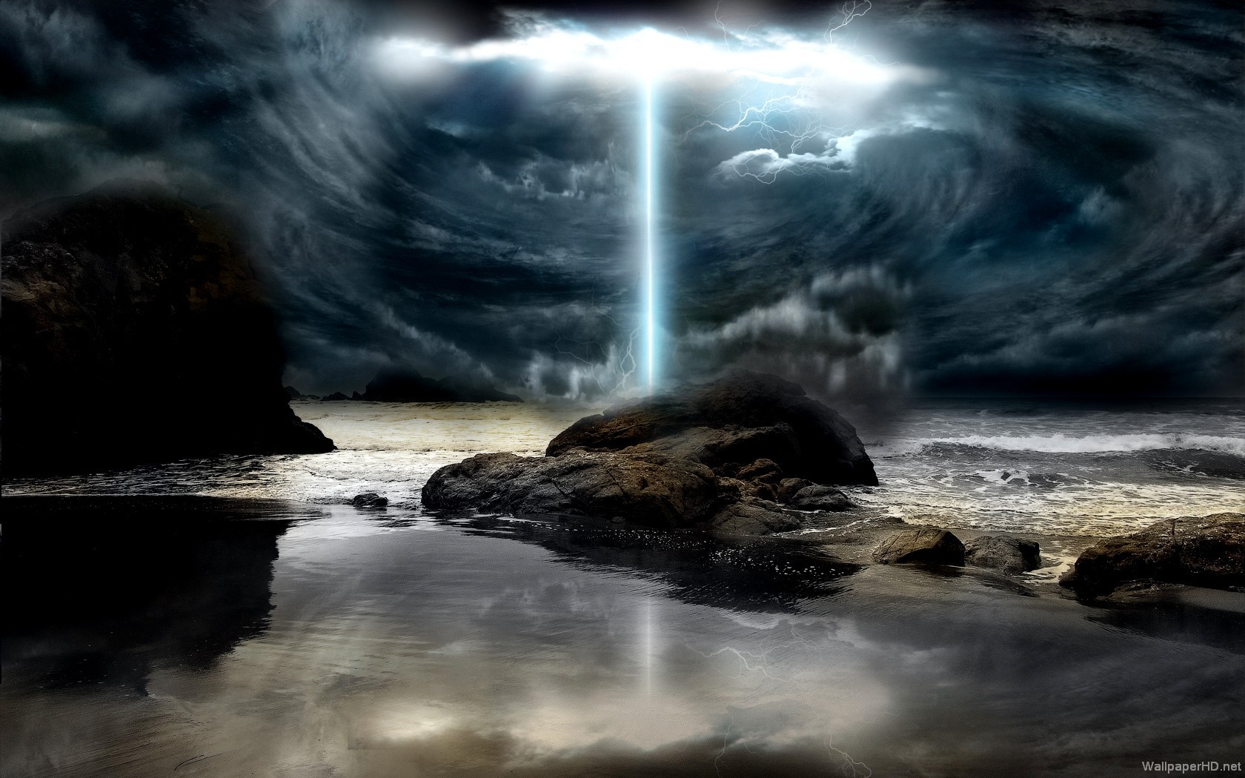
The Preparations Needed
Hear the word of God—Romans 10:17
Believe—John 8:24
Repent—Acts 17:30
Confess—Acts 8:37
Baptism—Colossians 2:12
Continue to grow—1 Corinthians 15:58
Erring Christian—James 5:16
Notes:
Preparations—Invitation…

