Slide 1
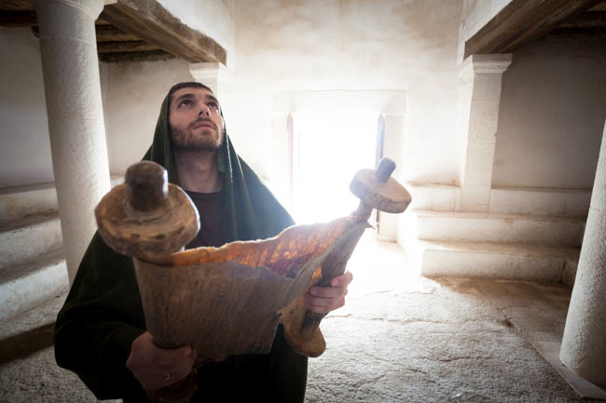
The Lost Bible
2 Chronicles 34:1-35:19
2 Kings 21:24-23:30
Notes:
Title Slide: The Lost Bible
2 Kings 21:24—23:30—Hilkiah, the High Priest, finds book of Law while repairing temple in Josiah’s early reign. Calamity will come to the nation for disobedience—but not in Josiah's days.
2 Chronicles 34:1—35:19—Repairs the temple, removes and destroys the images in the land, and observes the Passover—first since the days of Samuel the prophet!

Slide 2
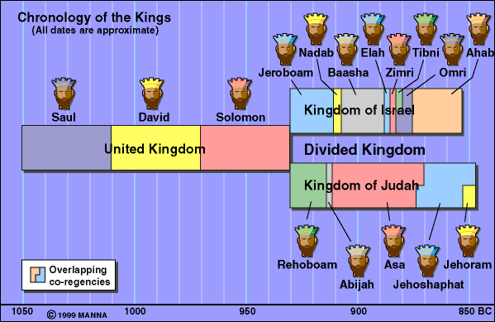
2
Notes:
United Kingdom and Divided Kingdom of Israel and Judah

Slide 3
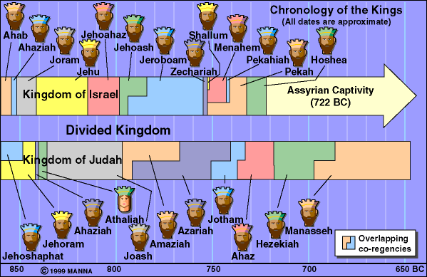
Hosea 4:6 “My people are destroyed for lack of knowledge. Because you have rejected knowledge, I also will reject you from being priest for Me; Because you have forgotten the law of your God, I also will forget your children.”
3
Notes:
Israel captivity in 722 B.C by Assyrian—evil and wicked kings and idolatry.

Slide 4
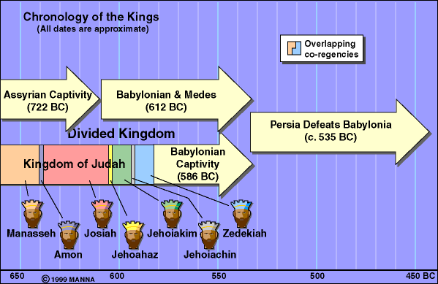
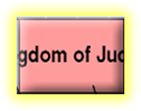

Ezekiel 23:35 “Therefore thus says the Lord God: ‘Because you have forgotten Me and cast Me behind your back, Therefore you shall bear the penalty of your lewdness and your harlotry.’ ”
8 years old when he began to reign
Reigned 31 years in Jerusalem. (641-609 BC)
Josiah did what was right in the sight of the Lord – (2 Kings 22:2; 2 Chro. 34:2)
4
Notes:
Josiah: (641-609 BC) After Amon's death at the hands of the people of the land, Josiah was given the throne. He was only 8 years old when he began to reign and he reigned 31 years in Jerusalem. In his 18th year, Josiah began the repairs of the house of the Lord. During the repairs the book of law was found (2 Kings 22:8-13). Upon reading it, Josiah rent his clothes because "our fathers have not hearkened unto the words of this book, to do according unto all that which is written." Josiah then took the bones of the idolatrous fathers out of the sepulchres and burned them upon the altar according to the word of the Lord. He also destroyed the "high places" in the cities of Samaria and did away with the wizards, idols and abominations (2 Kings 23:1-24). The greatest testimony to Josiah's goodness is stated in 2 Kings (2 Kings 23:25) - "And like unto him was there no king before him, that turned to the Lord with all his heart, and with all his soul, and with all his might, according to all the law of Moses; neither after him arose there any like him." Despite Josiah's goodness, the Lord's wrath was still against Judah for the sins of Manasseh. However, the Lord promised that punishment for Judah would not come while Josiah was alive (2 Chron. 34:24-28). When in battle against Pharoahnechoh (Pharoah Neco), king of Egypt, Josiah was killed at Megiddo (2 Kings 23:29-30).

Slide 5

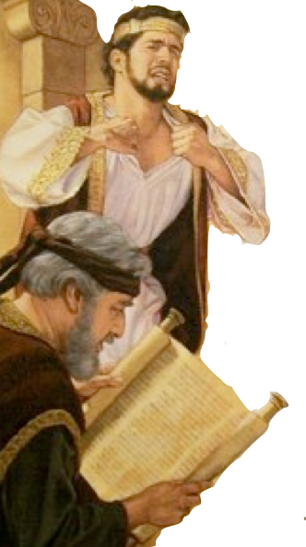
King Josiah
In his 8th year as king, Josiah began to seek the Lord – 2 Chronicles 34:3
In his 12th year he began to purge Judah and Jerusalem – 2 Chronicles 34:3-7
In his 18th year, Josiah began the repairs of the house of the Lord. It was during theses repairs that the book of law was found (2 Kings 22:8-13; 2 Chronicles 34:8,14).
Notes:
King Josiah
* In his 8th year as king, Josiah began to seek the Lord – 2 Chronicles 34:3
* In his 12th year he began to purge Judah and Jerusalem –2 Chronicles 34:3-7
* In his 18th year, Josiah began the repairs of the house of the Lord. It was during theses repairs that the book of law was found (2 Kings 22:8-13; 2 Chronicles 34:8,14).

Slide 6

Upon reading it, Josiah rent his clothes – 2 Kings 22:11,19; 2 Chronicles 34:19;
He sent Hilkiah the priest and others to go and “inquire of the Lord” because he knew that the judgment of God was resting on Judah because his fathers had not kept the Law!! – 2 Kings 22:12-20; 2 Chronicles 34:20-28
Notes:
King Josiah:
* Upon reading it, Josiah rent his clothes – 2 Kings 22:11,19; 2 Chronicles 34:19;
* He sent Hilkiah the priest and others to go and “inquire of the Lord” because he knew that the judgment of God was resting on Judah because his fathers had not kept the Law!! – 2 Kings 22:12-20; 2 Chronicles 34:20-28

Slide 7

2 Kings 23:1-25; 2 Chron. 34:29-35:19
After reading the Law of the Covenant – Josiah made a covenant with the Lord and demanded that the people take a stand - 2 Kings 23:3; 2 Chronicles 34:30-32
Purged all the land of false worship – 1 Kings 13:2; 2 Kings 23:4-25; 2 Chronicles 34:33
Kept the Passover – 2 Kings 23:21-25; 2 Chronicles 35:1-19
Notes:
King Josiah
* After reading the Law of the Covenant – Josiah made a covenant with the Lord and demanded that the people take a stand - 2 Kings 23:3; 2 Chronicles 34:30-32
* Purged all the land of false worship – 1 Kings 13:2; 2 Kings 23:4-25; 2 Chronicles 34:33
*Kept the Passover – 2 Kings 23:21-25; 2 Chronicles 35:1-19

Slide 8
Making Application
Knowledge of TRUTH is essential for True worship and acceptable service – BUT ignorance brings destruction – Hosea 4:6
Proper respect for TRUTH brings hearing, repentance and reform – but unconcern and indifference brings ignorance and compromise! – 2 Timothy 4:2-4
There is an epidemic of Biblical illiteracy today! -
Notes:
On average, 85% of U.S. households own a Bible; the average number of Bibles per household is 4.3 (American Bible Society, The State of the Bible 2012)
36% of Americans read the Bible less than once a year or never while 33% read the Bible once a week or more (American Bible Society, The State of the Bible 2012)
47% of American adults believe the Bible has too little influence in society today; only 16% believe it has too much influence, with the remaining adults expressing neutral opinions (American Bible Society, The State of the Bible 2012)
55% read the Bible to be closer to God, down 9% (from 64%) in 2011 (American Bible Society, The State of the Bible 2012)
79% believe they are knowledgeable about the Bible but 54% were unable to correctly identify the first five books of the Bible (American Bible Society, The State of the Bible 2012)
46% believe the Bible, the Koran and the Book of Mormon are different expressions of the same spiritual truths, 46% disagree (American Bible Society, The State of the Bible 2012)
Generational patterns emerged where younger adults are less likely to perceive the Bible as relevant and useful when compared with older adults (American Bible Society, The State of the Bible 2012)
Sixty-two percent of adults age 66 and older believe the Bible contains everything a person needs to know about living a meaningful life, dropping to 54% among boomers (age 47 to 65), 44% among those age 28 to 46, and dropping even further to 34% for those age 18 to 27 (American Bible Society, The State of the Bible 2012)
Nearly nine out of 10 U.S. adults (88%) say their household owns a Bible, with a median of 3.4 Bibles per household (American Bible Society, The State of the Bible 2011)
54% of adults in America believe the Bible has too little influence in U.S. society today - more than four times the proportion of those who think it has too much influence (13%) (American Bible Society, The State of the Bible 2011)
56% of those surveyed said they consider themselves to have an average knowledge of the Bible, while 23% considered themselves to be completely or highly knowledge (American Bible Society, The State of the Bible 2011)
51% of adults in the U.S. strongly - but erroneously - believe that the Bible teaches God helps those who help themselves (American Bible Society, The State of the Bible 2011)
Seven out of ten (69%) described the Bible as the Word of God (American Bible Society, The State of the Bible 2011)
The proportion who never read the Bible increased (from 21% in 1999 to 25% in 2011), while the proportion of adults who read the Bible only once or twice a year decreased over the past decade, from 16% in 1999 to 11% in 2011 (American Bible Society, The State of the Bible 2011)
Nearly six out of 10 adults who owns a Bible (57%) say they own the King James Version (American Bible Society, The State of the Bible 2011)
Nearly half of all Bible readers (45%) read the King James Version most often (American Bible Society, The State of the Bible 2011)
Nearly four in ten Bible-reading adults (37%) used a computer to read Bible content during the past year; 28% listened to an audio version of the Bible (American Bible Society, The State of the Bible 2011)
Three out of four U.S. adults (76%) are able to correctly name Genesis as the first book of the Bible (American Bible Society, The State of the Bible 2011)
A majority of Americans (57%) knows that Hebrew is the original language in which most of the Bible’s Old Testament was written. Fewer than half as many adults (27%) are able to name Greek as the original language in which most of the Bible’s New Testament was written (American Bible Society, The State of the Bible 2011)
60% of Americans can't name five of the Ten Commandments
(USA Today, March 14, 2007)
50% of high school seniors think Sodom and Gomorrah were married
(USA Today, March 14, 2007)
50% of Americans, including Christians, can't name any of the four Gospels
(NPR, Feb. 8, 2008)
22% of American teens think Moses was either one of Jesus' 12 apostles, an Egyptian pharaoh or an angel (Bible Literacy Project, Inc., 2005)
21% of American believe the Bible is a book of fables (Gallup, May 2007)

Slide 9
Age
(American Bible Society, The State of the Bible 2012)
Notes:
Sixty-two percent of adults age 66 and older believe the Bible contains everything a person needs to know about living a meaningful life, dropping to 54% among boomers (age 47 to 65), 44% among those age 28 to 46, and dropping even further to 34% for those age 18 to 27 (American Bible Society, The State of the Bible 2012)
Nearly nine out of 10 U.S. adults (88%) say their household owns a Bible, with a median of 3.4 Bibles per household (American Bible Society, The State of the Bible 2011)
54% of adults in America believe the Bible has too little influence in U.S. society today - more than four times the proportion of those who think it has too much influence (13%) (American Bible Society, The State of the Bible 2011)
56% of those surveyed said they consider themselves to have an average knowledge of the Bible, while 23% considered themselves to be completely or highly knowledge (American Bible Society, The State of the Bible 2011)
51% of adults in the U.S. strongly - but erroneously - believe that the Bible teaches God helps those who help themselves (American Bible Society, The State of the Bible 2011)
Seven out of ten (69%) described the Bible as the Word of God (American Bible Society, The State of the Bible 2011)
The proportion who never read the Bible increased (from 21% in 1999 to 25% in 2011), while the proportion of adults who read the Bible only once or twice a year decreased over the past decade, from 16% in 1999 to 11% in 2011 (American Bible Society, The State of the Bible 2011)
Nearly six out of 10 adults who owns a Bible (57%) say they own the King James Version (American Bible Society, The State of the Bible 2011)
Nearly half of all Bible readers (45%) read the King James Version most often (American Bible Society, The State of the Bible 2011)

Slide 10
Notes:
http://www.americanbible.org/uploads/content/State%20of%20the%20Bible%20Report%202013.pdf

Slide 11

"Increasingly, America is biblically illiterate." - George Barna
Regarding Biblical illiteracy and discipleship, Christian researcher and author George Barna reports: (2007)
Notes:
Nearly six out of 10 adults who owns a Bible (57%) say they own the King James Version (American Bible Society, The State of the Bible 2011)
Nearly half of all Bible readers (45%) read the King James Version most often (American Bible Society, The State of the Bible 2011)
Nearly four in ten Bible-reading adults (37%) used a computer to read Bible content during the past year; 28% listened to an audio version of the Bible (American Bible Society, The State of the Bible 2011)
Three out of four U.S. adults (76%) are able to correctly name Genesis as the first book of the Bible (American Bible Society, The State of the Bible 2011)
A majority of Americans (57%) knows that Hebrew is the original language in which most of the Bible’s Old Testament was written. Fewer than half as many adults (27%) are able to name Greek as the original language in which most of the Bible’s New Testament was written (American Bible Society, The State of the Bible 2011)
60% of Americans can't name five of the Ten Commandments
(USA Today, March 14, 2007)
50% of high school seniors think Sodom and Gomorrah were married
(USA Today, March 14, 2007)
50% of Americans, including Christians, can't name any of the four Gospels
(NPR, Feb. 8, 2008)
22% of American teens think Moses was either one of Jesus' 12 apostles, an Egyptian pharaoh or an angel (Bible Literacy Project, Inc., 2005)
21% of American believe the Bible is a book of fables (Gallup, May 2007)

Slide 12
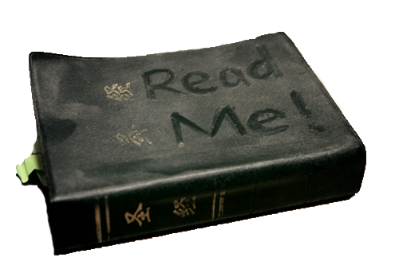
Regarding Biblical illiteracy and discipleship, Christian researcher and author George Barna reports: (2007)
Notes:
Facts about our knowledge levels of Bible truths…

Slide 13
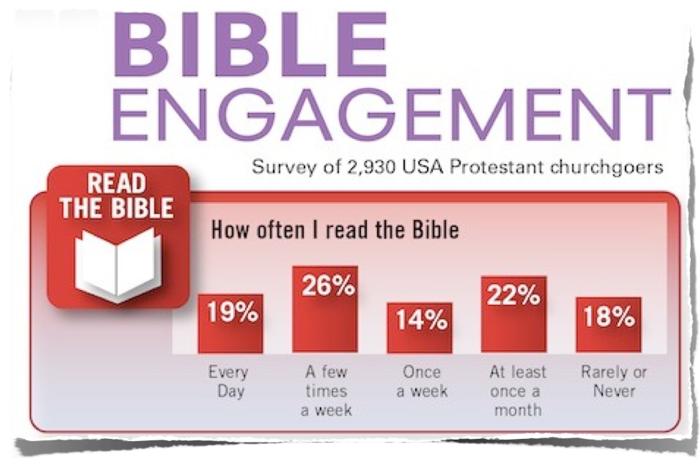
Notes:
Bible Engagement—Read the Bible Facts…

Slide 14

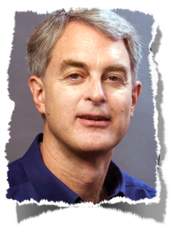
Biblical Illiteracy in US
“Bible reading has become the religious equivalent of sound-bite journalism. When people read from the Bible they typically open it, read a brief passage without much regard for the context, and consider the primary thought or feeling that the passage provided. If they are comfortable with it, they accept it; otherwise, they deem it interesting but irrelevant to their life, and move on. There is shockingly little growth evident in people’s understanding of the fundamental themes of the scriptures and amazingly little interest in deepening their knowledge and application of biblical principles . . .
https://www.barna.org/barna-update/article/12-faithspirituality/325-barna-studies-the-research-offers-a-year-in-review-perspective#.UinrSRaTy0s
Notes:
Biblical Illiteracy in US…

Slide 15
Biblical Illiteracy in US
“The problem facing the Christian Church is not that people lack a complete set of beliefs; the problem is that they have a full slate of beliefs in mind, which they think are consistent with biblical teachings, and they are neither open to being proven wrong nor to learning new insights. Our research suggests that this challenge initially emerges in the late adolescent or early teenage years . . . In a culture driven by the desire to receive value, more Bible teaching is generally not viewed as an exercise in providing such value.”
https://www.barna.org/barna-update/article/12-faithspirituality/325-barna-studies-the-research-offers-a-year-in-review-perspective#.UinrSRaTy0s
Notes:
Biblical Illiteracy in US…

Slide 16

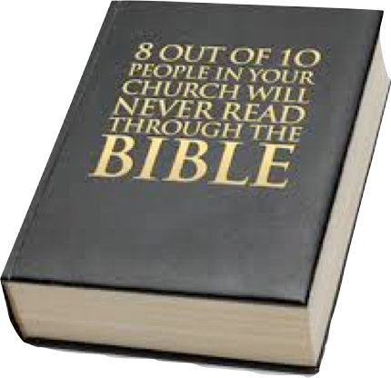
We will not believe more than we know, and we will not live higher than our beliefs.
The many fronts of Christian compromise in this generation can be directly traced to biblical illiteracy in the pews and the absence of biblical preaching and teaching in our homes and churches.
Notes:
8 out 10 people in your church will never read through the Bible!!!

Slide 17


2 Timothy 4:1–5 “I charge you therefore before God and the Lord Jesus Christ, who will judge the living and the dead at His appearing and His kingdom: ² Preach the word! Be ready in season and out of season. Convince, rebuke, exhort, with all longsuffering and teaching. ³ For the time will come when they will not endure sound doctrine, but according to their own desires, because they have itching ears, they will heap up for themselves teachers; ⁴ and they will turn their ears away from the truth, and be turned aside to fables. ⁵ But you be watchful in all things, endure afflictions, do the work of an evangelist, fulfill your ministry.”
Notes:
2 Timothy 4:1-5…

Slide 18
The Bible Is Lost In…
The Home – Deuteronomy 6:7-9; 2 Timothy 1:5; 3:14,15; Ephesians 6:1-4
The Pulpit – Jonah 3:2; Acts 17:1-3; 2 Timothy 4:2-5; 1 Peter 4:11
Sectarianism – Matthew 15:7-9; 2 Timothy 4:3,4; Galatians 1:6-9; John 17:20,21
Notes:
The Bible Is Lost In…
1. The Home – Deut. 6:7-9; 2 Tim. 1:5; 3:14,15; Eph. 6:1-4
2. The Pulpit – Jonah 3:2; Acts 17:1-3; 2 Tim. 4:2-5; 1 Peter 4:11
3. Sectarianism – Matt. 15:7-9; 2 Tim. 4:3,4; Gal. 1:6-9; John 17:20,21
4. Emotionalism – John 6:44,45; Titus 2:11,12; Gal. 5:22-24
5. Sensationalism – Acts 8:9; 1 Cor. 1:18-23; 2:1-5
6. Unconcern – Matt. 24:12; Matt.t 6:24; 1 Cor. 16:22; Mark 8:36-38

Slide 19
The Bible Is Lost In…
Emotionalism – John 6:44,45; Titus 2:11,12; Galatians 5:22-24
Sensationalism – Acts 8:9; 1 Corinthians 1:18-23; 2:1-5
Unconcern – Matthew 6:12; 24:12; 1 Corinthians 16:22; Mark 8:36-38
Notes:
The Bible Is Lost In…
1. The Home – Deut. 6:7-9; 2 Tim. 1:5; 3:14,15; Eph. 6:1-4
2. The Pulpit – Jonah 3:2; Acts 17:1-3; 2 Tim. 4:2-5; 1 Peter 4:11
3. Sectarianism – Matt. 15:7-9; 2 Tim. 4:3,4; Gal. 1:6-9; John 17:20,21
4. Emotionalism – John 6:44,45; Titus 2:11,12; Gal. 5:22-24
5. Sensationalism – Acts 8:9; 1 Cor. 1:18-23; 2:1-5
6. Unconcern – Matt. 24:12; Matt.t 6:24; 1 Cor. 16:22; Mark 8:36-38

Slide 20
The Bible Needs To Be Found!
In Our homes— Ephesians 6:1-4
In our pulpits and churches— 2 Timothy 4:1-4
As Being the ONLY STANDARD— 2 Timothy 3:16,17
Notes:
The Bible Needs to Be Found!
1. The Home –Eph. 6:1-4
2. The Pulpit and Churches – 2 Timothy 4:1-4
3. As Being the ONLY TRUE STANDARD – 2 Timothy 3:16,17
4. Molding and Controlling Our Thoughts and Lives – 2 Corinthians 10:3-5
5. Obeying From the Heart – Romans 6:16-18
6. As Being Something For Which We Hunger and Thirst – Matthew 6:5; Psalm 119:97-104

Slide 21
The Bible Needs To Be Found!
Molding and Controlling Our Thoughts and Lives! - 2 Corinthians 10:3-5
Obeying from the heart – Romans 6:16-18
As Being Something For Which We Hunger & Thirst – Psalm 119:97-104; Matthew 6:5
Notes:
The Bible Needs to Be Found!
1. The Home –Eph. 6:1-4
2. The Pulpit and Churches – 2 Timothy 4:1-4
3. As Being the ONLY TRUE STANDARD – 2 Timothy 3:16,17
4. Molding and Controlling Our Thoughts and Lives – 2 Corinthians 10:3-5
5. Obeying From the Heart – Romans 6:16-18
6. As Being Something For Which We Hunger and Thirst – Matthew 6:5; Psalm 119:97-104

Slide 22
The Bible Needs To Be Found!
Josiah sought the Lord as a young man
When Josiah found the truth he allowed it ti change him—he did not try to change it!!
Maybe we need to find the word of God!!
Maybe you have found the truth but have not yet acted upon it—don’t wait any longer!!
Are you helping others to find the truth?
Notes:
The Bible Needs to Be Found!
Summary—Invitation…

