Slide 1

The Importance Of
TIME Used WISELY
Managing our time to the glory of God
Notes:
Title Slide: Time Used Wisely—The Importance of…Managing our time to the glory of God!

Slide 2


TIME Used WISELY
Time is limited and precious
“See then that you walk circumspectly, not as fools but as wise, redeeming the time, because the days are evil. Therefore do not be unwise, but understand what the will of the Lord is.”
Ephesians 5:15-17
Notes:
Time is limited and precious—Ephesians 5:15-17…”redeeming the time”—using it wisely and productively.

Slide 3
TIME Used WISELY
Time is limited and precious
“For all our days have passed away in Your wrath; We finish our years like a sigh. The days of our lives are seventy years; And if by reason of strength they are eighty years, Yet their boast is only labor and sorrow; For it is soon cut off, and we fly away.Who knows the power of Your anger? For as the fear of You, so is Your wrath. So teach us to number our days, That we may gain a heart of wisdom.”
Psalm 90:9-12
Notes:
Time is limited and precious—Psalm 90:9-12…”number our days”—understanding out time is LIMITED...

Slide 4
TIME Used WISELY
Time Moves Quickly
“For when a few years are finished, I shall go the way of no return.” Job 16:22
“Now my days are swifter than a runner; They flee away, they see no good. They pass by like swift ships, Like an eagle swooping on its prey.” Job 9:25,26
Notes:
Time Moves Quickly—Job 9:25,26; 16:22…”Time is moving rapidly and cannot be gotten back!

Slide 5
TIME Used WISELY
Idleness is a Robber
“Go to the ant, you sluggard! Consider her ways and be wise, which, having no captain, Overseer or ruler, provides her supplies in the summer, And gathers her food in the harvest.
How long will you slumber, O sluggard? When will you rise from your sleep?
A little sleep, a little slumber, A little folding of the hands to sleep- So shall your poverty come on you like a prowler, And your need like an armed man.” (Proverbs 6:6-11)
Notes:
Idleness is a Robber—Proverbs 6:6-11…Idle hand and mind are the devil’s workshop. The devil always has “temptations” how we can fill in our time!

Slide 6
TIME Used WISELY
Idleness is a Robber
Proverbs 14:23
“In all labor there is profit, But idle chatter leads only to poverty.”
Proverbs 19:15
“Laziness casts one into a deep sleep, And an idle person will suffer hunger.”
Proverbs
23:21
“For the drunkard and the glutton will come to poverty, And drowsiness will clothe a man with rags.”
Notes:
Idleness is a Robber—Proverbs 14:23; 19:15; 23:21…Idle hand and mind are the devil’s workshop. The devil always has “temptations” how we can fill in our time!

Slide 7
TIME Used WISELY
Idleness is a Robber
“And do this, knowing the time, that now it is high time to awake out of sleep; for now our salvation is nearer than when we first believed.” Romans 13:11
“Therefore let us not sleep, as others do, but let us watch and be sober. For those who sleep, sleep at night, and those who get drunk are drunk at night. But let us who are of the day be sober, putting on the breastplate of faith and love, and as a helmet the hope of salvation.” 1 Thessalonians 5:6-8
Notes:
Idleness is a Robber—Romans 13:11; 1 Thessalonians 5:6-8…Each day we are closer to eternity! Need to be ready and prepared…

Slide 8
TIME Used WISELY
There is a Time for Everything
“To everything there is a season, A time for every purpose under heaven: A time to be born, And a time to die; A time to plant, And a time to pluck what is planted; A time to kill, And a time to heal; A time to break down, And a time to build up; A time to weep, And a time to laugh; A time to mourn, And a time to dance;”
Ecclesiastes 3:1-4
Notes:
There is a Time for Everything—Ecclesiastes 3:1-4…There is a TIME and PLACE for each things that God has appointed for man “under the sun”...

Slide 9
TIME Used WISELY
There is a Time for Everything
“A time to cast away stones, And a time to gather stones; A time to embrace, And a time to refrain from embracing;
A time to gain, And a time to lose; A time to keep, And a time to throw away;
A time to tear, And a time to sew; A time to keep silence, And a time to speak;
A time to love, And a time to hate; A time of war, And a time of peace.”
Ecclesiastes 3:5-8
Notes:
There is a Time for Everything—Ecclesiastes 3:5-8…There is a TIME and PLACE for each things that God has appointed for man “under the sun”...

Slide 10
TIME Used WISELY
There is a Time for Everything
“What profit has the worker from that in which he labors?
I have seen the God-given task with which the sons of men are to be occupied.
He has made everything beautiful in its time. Also He has put eternity in their hearts, except that no one can find out the work that God does from beginning to end.”
Ecclesiastes 3:9-11
Notes:
There is a Time for Everything—Ecclesiastes 3:9-11…There is a TIME and PLACE for each things that God has appointed for man “under the sun”...

Slide 11
TIME Used WISELY
There is a Time for Everything
“I know that nothing is better for them than to rejoice, and to do good in their lives,
and also that every man should eat and drink and enjoy the good of all his labor-it is the gift of God. I know that whatever God does, It shall be forever. Nothing can be added to it, And nothing taken from it. God does it, that men should fear before Him.”
Ecclesiastes 3:12-14
Notes:
There is a Time for Everything—Ecclesiastes 3:12-14…There is a TIME and PLACE for each things that God has appointed for man “under the sun”...

Slide 12

There’s a time for everything
Ecclesiastes 3:1-14
“To everything there is a season, A time for every purpose under heaven.”
Earthly endeavors have their proper time and place (1-8) | Subject to things beyond our control (9-10)
God makes everything beautiful in its season (11) | God wants man to enjoy moderately His earthly gifts (12-13)
God is in control (14) | The usage of our time to be in harmony with our purpose - (14; 12:13,14)
Notes:
Explaining the teaching of Eccl.3:1-14…

Slide 13

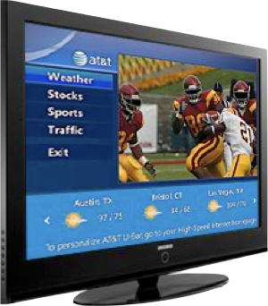
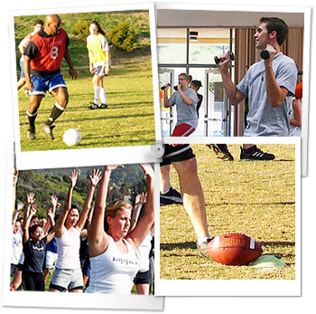



Many live over-committed, out of balance, and out of control lives!
Time is easily wasted. Many things compete for our time!
Notes:
Over-committed, out of balance and out of control—Poor choice and bad time management…

Slide 14


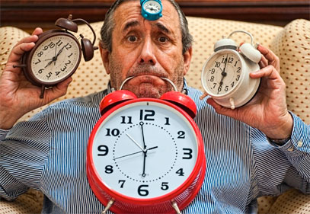
Time is easily wasted. Many things compete for our time!
Effects our spiritual life
Effects others
We Are Responsible For How We Use The Time God Has Given Us! - Ephesians 5:15,15; Colossians 4:5
Notes:
Man live over-commitment, out of balance, and out of control lives.
Time is easily wasted. Many things compete for our time.
Effects our spiritual life
Effects others
We Are Responsible For How We Use The Time God Has Given Us! -Ephesians 5:15,15;Colossians 4:5

Slide 15

Our daily activities should not be “expenditures of time; they should be investments.” (Kenneth J. Lodi, “Tapping Your Potential” pg. 28)
Notes:
Man live over-commitment, out of balance, and out of control lives.
(1) Quote from Kenneth J. Lodi book “Tapping Potential”…

Slide 16


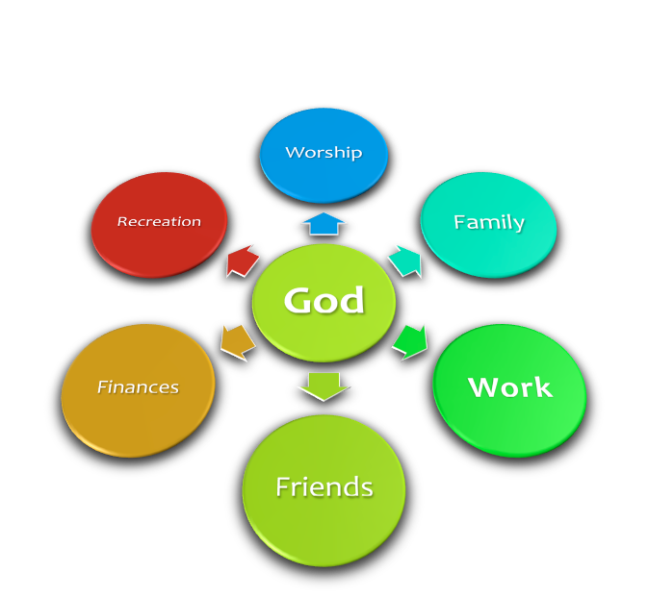
If we honestly examine how we spend / use our time - we will see where our priorities really are! - (satisfying our pride and selfishness or in humble service to God! Luke 2:49; John 4:34)
Notes:
Examine our priorities to see what they really are…Lk.2:49; Jno.4:34…

Slide 17
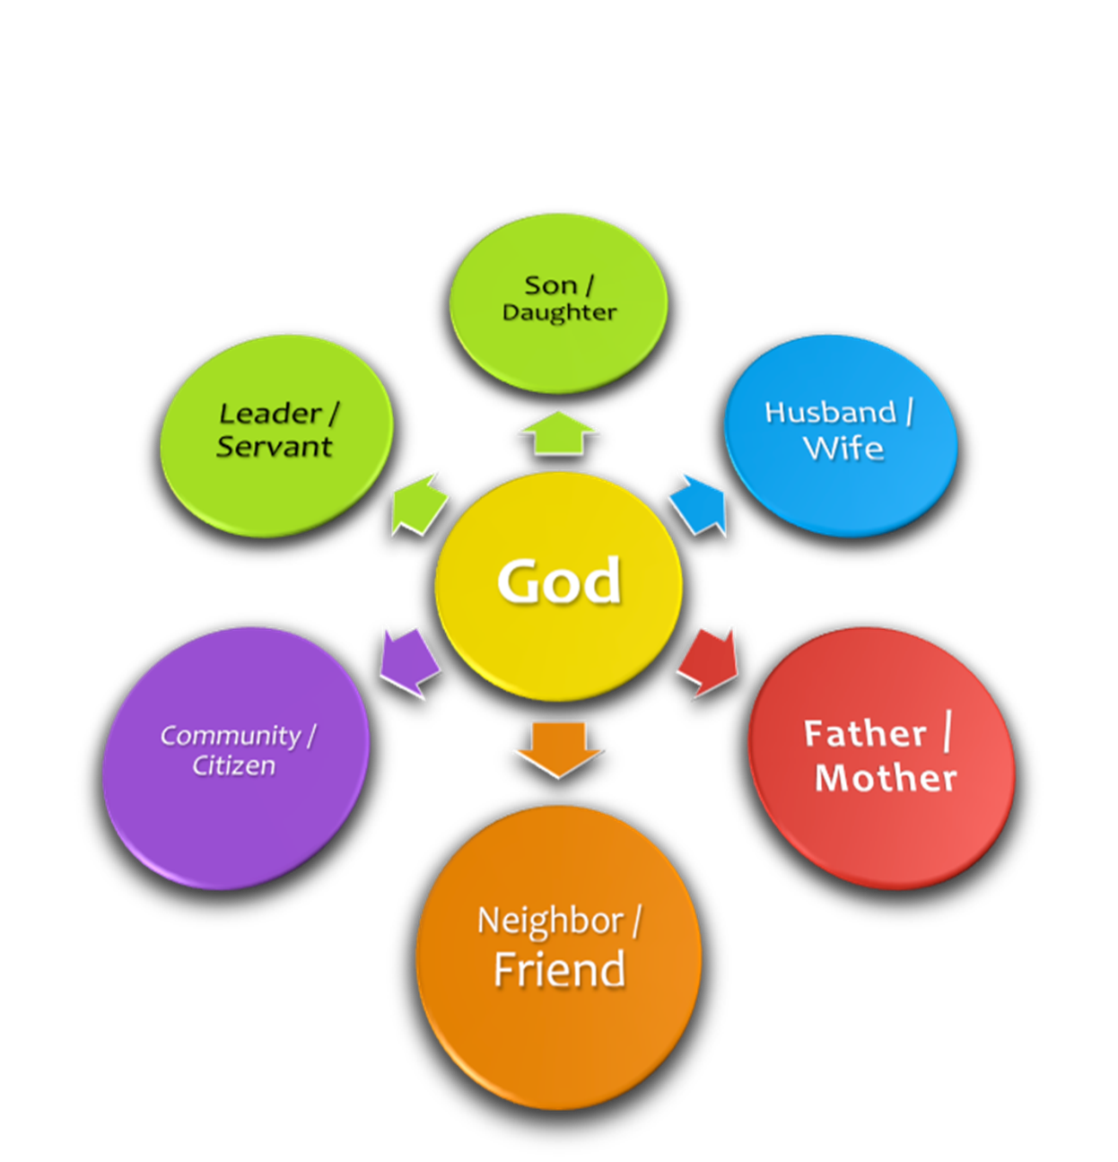
Serving God is more than worship- (Assembling/praying/singing/teaching); more than evangelism…
Time must also be invested in being the _______I should be
Notes:
Examine our priorities to see what they really are…Time Must also be invested in being the ___fill in the blank with duties on the right...

Slide 18
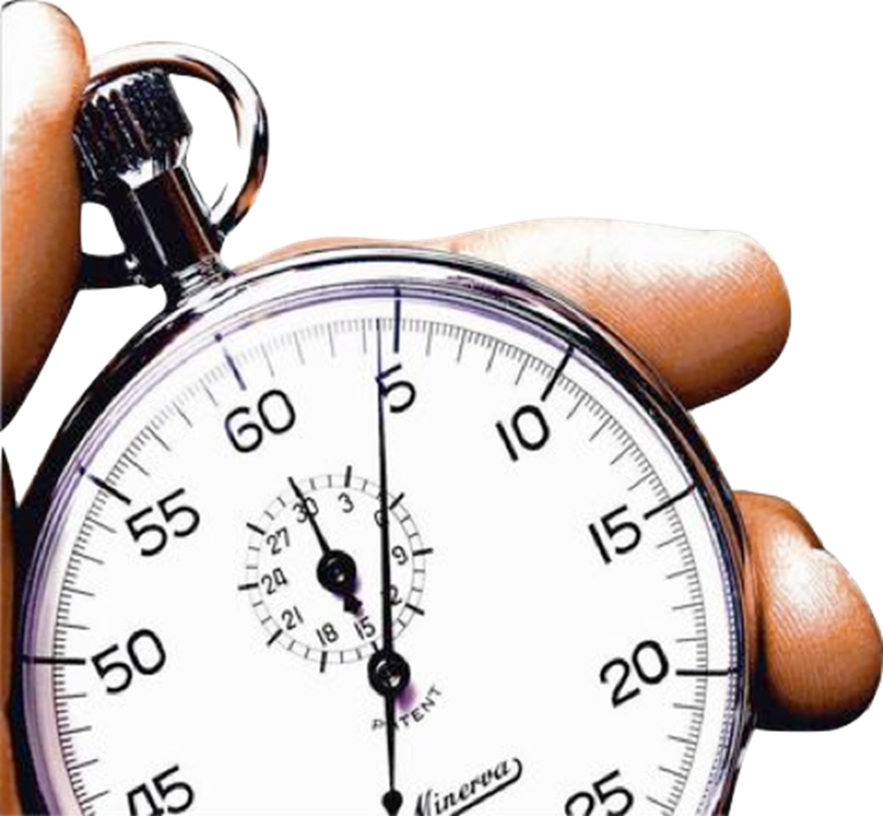
How To Make The Most of Our Time
Be aware—time is easily wasted
Budget—time is limited
Prioritize—Time is valuable
Notes:
How To Make the Most of Our time
Be aware—time is easily wasted
Budget—time is limited
Prioritize—time is valuable

Slide 19
How To Make The Most of Our Time
Be aware—time is easily wasted
Budget—time is limited
Prioritize—Time is valuable
GOD FIRST—worship-spiritual growth-service influence
Schedule of Services
SUNDAY MORNING:
Bible class:9:30 a.m.
Worship: 10:30 a.m.
SUNDAY EVENING:
Worship—6:30 p.m.
WEDNESDAY:
Bible Class: 7:00 p.m.
Notes:
How To Make the Most of Our time
Be aware—time is easily wasted
Budget—time is limited
Prioritize—time is valuable
God FIRST…

Slide 20
How To Make The Most of Our Time
Be aware—time is easily wasted
Budget—time is limited
Prioritize—Time is valuable
FAMILY--Parents need to parent-husbands need to be husbands-wives need to be wives
Ephesians 6:1-4
Ephesians 5:22-33
Notes:
How To Make the Most of Our time
Be aware—time is easily wasted
Budget—time is limited
Prioritize—time is valuable
Family…Ephesians 5:22-33; 6:1-4

Slide 21
How To Make The Most of Our Time
Be aware—time is easily wasted
Budget—time is limited
Prioritize—Time is valuable
WORK—a means to an end
REST/RENEWAL—not laziness-bodies MUST rest
1 Timothy 5:8
Romans 13:11
Notes:
How To Make the Most of Our time
Be aware—time is easily wasted
Budget—time is limited
Prioritize—time is valuable
Family…Ephesians 5:22-33; 6:1-4
Work…1 Timothy 5:8
Rest/Renewal—Romans 13:11

Slide 22
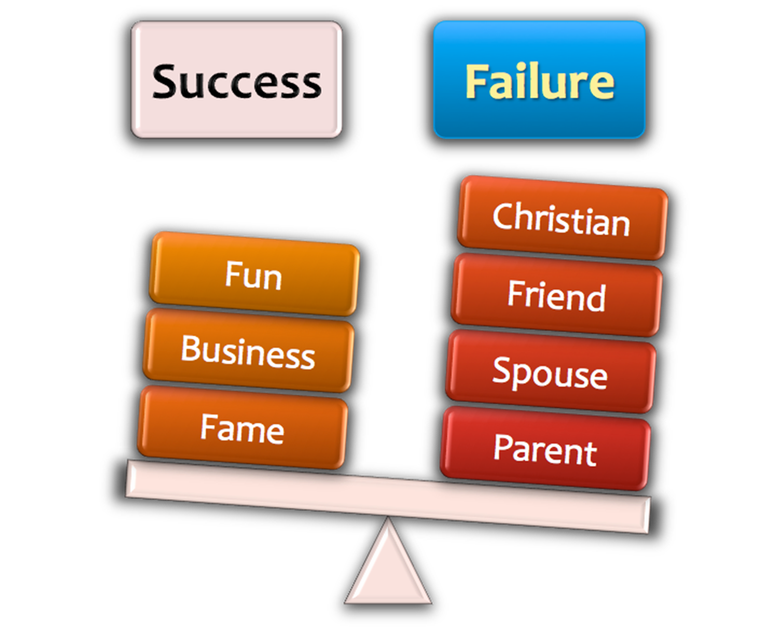

Self Evaluation
“For what profit is it to a man if he gains the whole world, and loses his own soul? Or what will a man give in exchange for his soul?”
Matthew 16:26
Notes:
Self Evaluation—Matt.16:26

Slide 23
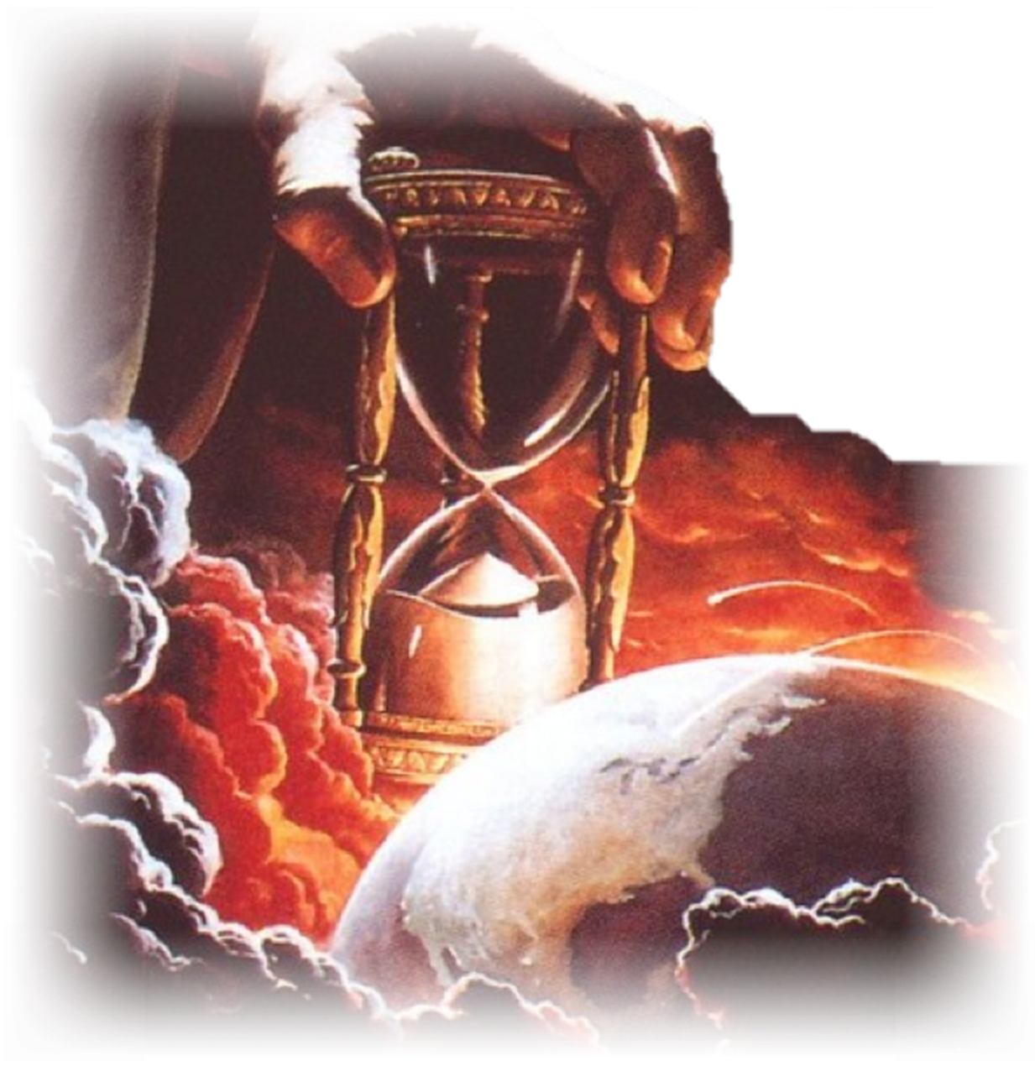
TIME Used WISELY
“But the day of the Lord will come as a thief in the night, in which the heavens will pass away with a great noise, and the elements will melt with fervent heat; both the earth and the works that are in it will be burned up. Therefore, since all these things will be dissolved, what manner of persons ought you to be in holy conduct and godliness.”
2 Peter 3:10,11
Notes:
Time is limited and precious—Time Used Wisely—2 Peter 3:10,11…—using it wisely and productively.

Slide 24
TIME Used WISELY
“Looking for and hastening the coming of the day of God, because of which the heavens will be dissolved, being on fire, and the elements will melt with fervent heat? Nevertheless we, according to His promise, look for new heavens and a new earth in which righteousness dwells.”
2 Peter 3:12,13
Notes:
Time is limited and precious—Time Used Wisely—2 Peter 3:12,13…—using it wisely and productively.

Slide 25
TIME Used WISELY
“Therefore, beloved, looking forward to these things, be diligent to be found by Him in peace, without spot and blameless.”
2 Peter 3:14
Notes:
Time is limited and precious—Time Used Wisely—2 Peter 3:14…—using it wisely and productively.

Slide 26
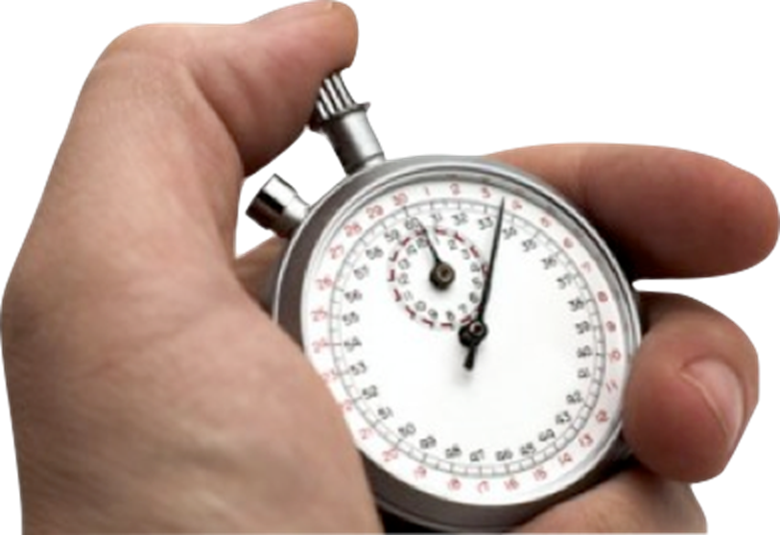

TIME Used WISELY
**How much time do you have?
**The day will come when “every one of us shall give an account of himself to God.” (Romans 14:12)
Notes:
Time is running out…Romans 14:12

Slide 27
TIME Used WISELY
**Are You:
**A child of God?
**Using your time bringing glory and honor to God?
***Acting Soberly, Loving Fervently? Serving Faithfully?
Notes:
Invitation…

Slide 28
TIME Used WISELY
**How will you live out the rest of your time? (1 Peter 4:2)
**Have you obeyed the gospel? (2 Corinthians 6:2)
***What if time ran out today?
Notes:
Invitation…

Slide 29
The Importance Of
TIME Used WISELY
What Will Happen To You When Time Runs Out…(1 Peter 4:7)
But the end of all things is at hand; therefore be serious and watchful in your prayers.
Notes:
Final Slide: Invitation…

