Slide 1
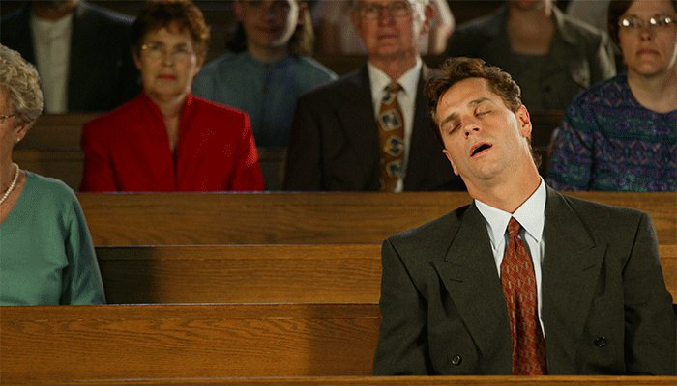
Attitudes Towards the Hearing of God’s Word

Slide 2
Attitudes Towards Hearing God’s Word
Shameless - Jeremiah 6:13-20
Harsh Words and Evil Looks - Ezekiel 2:3-8
Like Hearing a Lovely Song - Ezekiel 33:30-32
Goodness Like a Morning Cloud - Hosea 6:4
Listened Up To This Word - Acts 22:17-22

Slide 3
The Proper Attitude
“Therefore lay aside all filthiness and overflow of wickedness, and receive with meekness the implanted word, which is able to save your souls.
But be doers of the word, and not hearers only, deceiving yourselves.”
James 1:21-22

