Slide 1
Jesus
From The Gospel Of John

Slide 2
History of The Gospel of John
Last written Gospel
Written around 85-91 AD (written after 70 AD but before exile)
Written to:
  Defend Jesus’s Divinity
  Refute Gnostics and their perversion of the truth

Slide 3
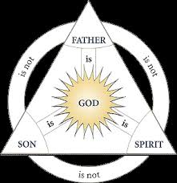
God detailed from John
Father 1:1
Spirit 1:32
Son 1:1,2,14

Slide 4
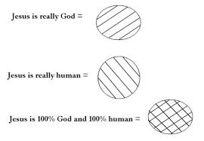
Jesus from John
As God John 1:1-2
As man John 1:14
100%
100%

Slide 5
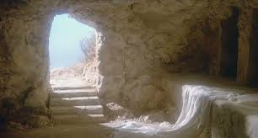
I AM the Resurrection and the Life…
John 11:25

Slide 6
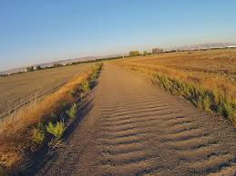
I AM the Way, Truth and Life
John 14: 1-6
Way- Direction
Truth- Mode of transportation
Life- End goal

Slide 7


I AM the True Vine…
John 15:1

Slide 8
Jesus
100% Man

Slide 9
Jesus as a man…
As a Son
  To Mary: John 2:1-10 ; 19:25-27
  To OUR Heavenly Father: John 2:14-16
Had needs
  Thirst John 4:7
Had Friends
  John 21:20
Had emotions
  Anger John 2:13-17
  Cried john 11:35

Slide 10
Jesus as a man…
  Took care of His friends (served) John 13
  Reassured them in dark time John 14
  Sent them help and comfort (through the Holy Spirit) John 14-15
  DIED, buried and rose again.

Slide 11

Jesus’s I AM’s

Slide 12
Conclusion
Option one, the stories in the Bible are all legend. Jesus never really existed and all the stories in the Bible are fables.
Option two, Jesus was a liar. Jesus willfully spun lie after lie. He laid claim to a title and a position to which He had no right. He promised to people things He knew He could not deliver.
Option three, Jesus was a lunatic. Jesus, deranged and deluded, told stories and taught things about Himself which revealed insanity, not inspiration; delusion not divinity.
Option four, the correct conclusion, Jesus is God and He came in the flesh. Jesus’ promises and claims may be relied upon. He is trust worthy and the Savior of the world.

