Slide 1
Jesus
From The Gospel Of John

Slide 2
History of The Gospel of John
Last written Gospel
Written around 85-91 AD (written after 70 AD but before exile)
Written to:
  Defend Jesus’s Divinity
  Refute Gnostics and their perversion of the truth

Slide 3
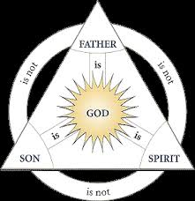
God detailed from John
Father 1:1
Spirit 1:32
Son 1:1,2,14

Slide 4
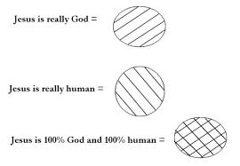
Jesus from John
As God John 1:1-2
As man John 1:14
100%
100%

Slide 5

Who was Jesus, as God?
“I AM” statements recorded in John
  Descriptive and illustrative
  Not restrictive
  Make a connection to God
    Exodus 3:14

Slide 6
Before Abraham, I AM
John 8:34-59
Abraham was brought into being
Jesus existed eternally

Slide 7
The 7 “I AM”’s from John
I AM the bread of life
I AM the light of the world
I AM the door
I AM the good shepherd
I AM the resurrection and the life
I AM the way, the truth, and the life
I AM the true vine

Slide 8
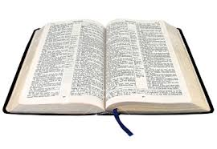
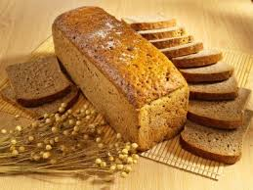
I AM the Bread of Life…
John 6:25-51

Slide 9

I AM the Light of the world…
    John 8:12, 9:5

Slide 10


I AM the Door…
John 10: 1-10

Slide 11
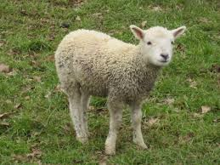
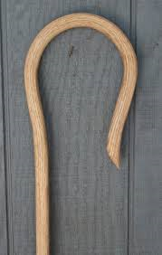
I AM the good Shepherd…
John 10:11-17

Slide 12
The 7 “I AM”’s from John
I AM the bread of life
I AM the light of the world
I AM the door
I AM the good shepherd

Slide 13
Conclusion
Option one, the stories in the Bible are all legend. Jesus never really existed and all the stories in the Bible are fables.
Option two, Jesus was a liar. Jesus willfully spun lie after lie. He laid claim to a title and a position to which He had no right. He promised to people things He knew He could not deliver.
Option three, Jesus was a lunatic. Jesus, deranged and deluded, told stories and taught things about Himself which revealed insanity, not inspiration; delusion not divinity.
Option four, the correct conclusion, Jesus is God and He came in the flesh. Jesus’ promises and claims may be relied upon. He is trust worthy and the Savior of the world.

