Slide 1

English Translations of the Bible

Slide 2
The Need For Translations
“Go into all the world and preach the gospel to every creature” (Mark 16:15).
As the gospel continued to be spread further away from the Roman Empire, there came to be a need for copies of the New Testament in the native tongues of these areas.

Slide 3
The Need For Translations
Eastern Versions Western Versions
Syriac (2-3 cen.) Old Latin (2nd cen.)
Coptic (3-4 cen.) Latin Vulgate (383-405)
Armenian (5th cen.) Gothic (4th cen.)
Georgian (5th cen.) Old Slavonic (9th cen.)
Ethiopic (5-6 cen.)
Arabic (8-9 cen.)

Slide 4
Why We Can Have Confidence in the Accuracy of English Translations

Slide 5
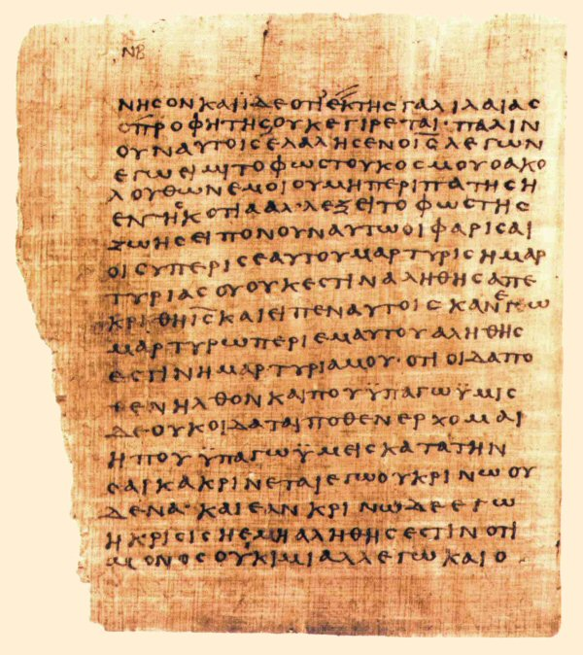
Why We Can Have Confidence in the Accuracy of English Translations
Multiple Manuscripts
Over 5,600 manuscripts of the New Testament.
Over 800 manuscripts of the Old Testament.

Slide 6
Why We Can Have Confidence in the Accuracy of English Translations
Multiple Manuscripts
Translated From “Dead Languages”

Slide 7
Why We Can Have Confidence in the Accuracy of English Translations
Multiple Manuscripts
Translated From “Dead Languages”
Early Translations

Slide 8
Why We Can Have Confidence in the Accuracy of English Translations
Multiple Manuscripts
Translated From “Dead Languages”
Early Translations
Dead Sea Scrolls

Slide 9
Why We Can Have Confidence in the Accuracy of English Translations
Multiple Manuscripts
Translated From “Dead Languages”
Early Translations
Dead Sea Scrolls
Writings of Church Fathers

Slide 10
History of the English Bible
John Wycliffe (1382) - translated the Bible into English from Latin.
William Tyndale (1526) - translated the Greek NT into English.
Geneva Bible (1560) - brought to America by the settlers of Jamestown and the Pilgrims on the Mayflower.
The Bishops Bible (1568) - Bible of the churches.
King James Version (1611) - Sought to provide an English translation for both public and private use.

Slide 11

A Contrast in Translation Styles
Is the Book of Mormon on par with the Bible?

Slide 12
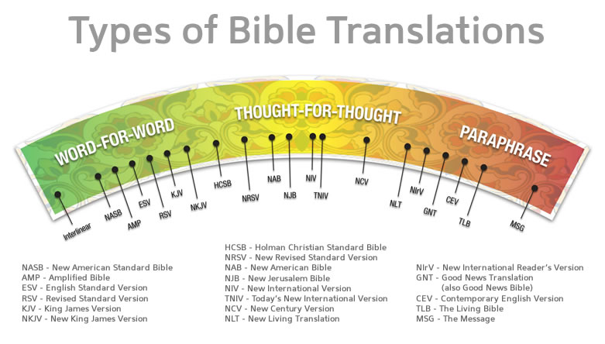

Slide 13
Choosing the Right Translation
Choose a Formal Equivalence translation.
Read what the translation says about how it was translated.
Read some verses or chapters that you are familiar with.
Find a copy that you can read with ease (language style and font size).
Beware of notes in study Bibles!

