Slide 1
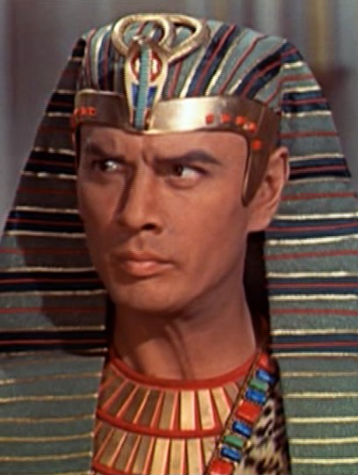
The Hardening of Pharaoh’s Heart
“And I will harden Pharaoh’s heart, and multiply My signs and My wonders in the land of Egypt.”
Exodus 7:3

Slide 2
Proof Text For Calvinists?
“God made Pharaoh wicked; that is from a wicked seed” (Martin Luther, “Bondage of the Will”).
God “bends them to do his judgments, just as if they carried their orders engraved on their minds… all the counsels and actions of men must be held to be governed by his providence, so that he not only exerts power in the elect… but also forces the reprobate to do him service” (John Calvin, “Institutes of the Christian Religion”).

Slide 3
God’s Foreknowledge, Determined Counsel, and Man’s Free Will
“Him, being delivered by the determined purpose and foreknowledge of God, you have taken by lawless hands, have crucified, and put to death”
Acts 2:23

Slide 4
God’s Foreknowledge
God knew Pharaoh would not let Israel go.
  “But I am sure that the king of Egypt will not let you go” (3:19).
God also know when Pharaoh would let Israel go.
  “Afterward, he will let you go from here” (11:1).

Slide 5
God’s Determined Counsel
Exodus 9:16-17 – God raised up Pharaoh, knowing he was a proud man with a hard heart.
Exodus 7:3-5 – God determined to:
  Bring Israel out of Egypt.
  Bring judgments upon Egypt.
  Show His power and glorify His name in all the earth.

Slide 6
Pharaoh’s Free Will
He exalted himself against God’s people (9:17).
He did not fear the Lord (9:30).
He refused to humble himself before the Lord (10:3).
How could God hold Pharaoh responsible for not letting Israel go if Pharaoh was not in control of his actions and decisions?

Slide 7
Pharaoh’s Heart Through the Plagues
Aaron’s Rod – “Pharaoh’s heart grew hard” (7:13).
Water To Blood – “Pharaoh’s heart grew hard” (7:22).
Frogs – “he hardened his heart and did not heed them” (8:15).
Lice – “Pharaoh’s heart grew hard” (8:19).
Flies – “Pharaoh hardened his heart at this time also” (8:32).
Death of Livestock – “the heart of Pharaoh became hard” (9:7).
Boils – “the Lord hardened the heart of Pharaoh” (9:12).
Hail – “he hardened his heart” (9:34).
Locusts – “the Lord hardened Pharaoh’s heart” (10:20).
Darkness – “the Lord hardened Pharaoh’s heart” (10:27).

Slide 8
How God Hardened Pharaoh’s Heart
“So shall My word be that goes forth from My mouth; it shall not return to Me void, but it shall accomplish what I please, and it shall prosper in the thing for which I sent it.”
Isaiah 55:11
God’s Word performs God’s intended will.

Slide 9
How God Hardened Pharaoh’s Heart
A distinction is made between those who feared the word of the Lord and those who did not regard the word of the Lord (Ex. 9:20-21).
  Those who feared the word of the Lord took it seriously and responded in a way that protected themselves and their possessions.
  Those who did not regard the word of the Lord did not take it seriously and lost their possessions.

Slide 10
How God Hardened Pharaoh’s Heart
After the plague ended, Pharaoh “sinned yet more; and he hardened his heart” (v. 34).
Pharaoh was in control of his actions.
He hardened his heart, but he did so in response to God’s Word.
Thus, it could rightly be said that God hardened Pharaoh’s heart.

Slide 11
How God Hardened Pharaoh’s Heart
After the plague ended, Pharaoh “sinned yet more; and he hardened his heart” (v. 34).
Pharaoh was in control of his actions.
He hardened his heart, but he did so in response to God’s Word.
Thus, it could rightly be said that God hardened Pharaoh’s heart.
Pharaoh’s heart was already hard and rebellious.
God’s Word, delivered through Moses, only served to further harden Pharaoh’s heart.
Each plague only made his heart more hardened.

Slide 12
How God Hardened Pharaoh’s Heart
God allowed Pharaoh to exercise his own free will.
God knew what Pharaoh was going to do (Foreknowledge).
God used Pharaoh’s rebellious heart as a means of accomplishing His will (Determined Counsel).
God hardened Pharaoh’s heart, not through any miraculous means, but through His Word and the Plagues.
Through His Word and the Plagues, God was able to harden Pharaoh’s heart while, at the same time, soften the hearts of many of Pharaoh’s servants and citizens.

Slide 13
Warning For Today
We must be careful to maintain a humble heart before God, yielding ourselves to His Word and His Will (Ex. 10:3).
We must develop a love for the truth - God’s Word (2 Thess. 2:9-12).
We must never turn so far away from God that He gives us up (Rom. 1:18-32).
  v. 24 – “God also gave them up to uncleanness”
  v. 26 – “God gave them up to vile passions”
  v. 28 – “God gave them over to a debased mind”

Slide 14

“Blessed is the one who fears the Lord always, but whoever hardens his heart will fall into calamity.”
Proverbs 28:14, ESV

