Slide 1


Starting the New Year off Right!
God
Church
Family
Evangelism

Slide 2

Making Evangelism A Priority

Slide 3

1. Develop Compassion for Those Who Are Lost
Matthew 9:35-38
Acts 16:9-10
Revelation 20:14-15

Slide 4

2. Look For Those Who Are Looking
Matthew 7:7-8
Acts 16:9-10
Acts 16:14

Slide 5
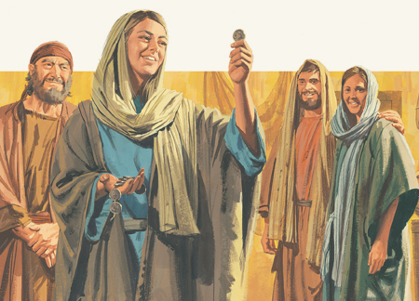
3. Rejoice in the Salvation of Lost Souls
Luke 15:7, 10, 32
Acts 8:38-39
Acts 16:34

Slide 6

4. Pray For Opportunities
Pray for laborers - Luke 10:2
Pray for opportunities to teach others - Col. 4:2-4
Pray for the salvation of specific people - Rom. 10:1
Pray for boldness - Acts 4:29

Slide 7

5. Live A Life That Promotes Opportunities
Let our light shine - Matt. 5:16
Seek and welcome opportunities
Encourage others who are seeking the lost

Slide 8
Making Evangelism A Priority
Develop Compassion for the Lost
Look For Those Who Are Looking
Rejoice in the Salvation of Lost Souls
Pray For Opportunities
Live A Life That Promotes Opportunities

