Slide 1


Starting the New Year off Right!
God
Church
Family
Evangelism

Slide 2
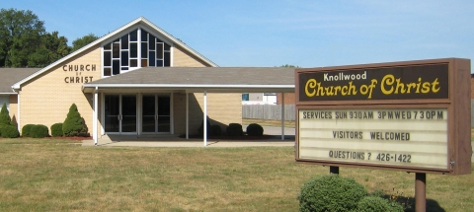
Making the Church a Priority in Our Life

Slide 3
Acts 2:42-47
v. 42 – continued steadfastly
v. 43 – fear came upon every soul
v. 44 – all who believed were together… all things in common
v. 45 – sold their possessions… divided them among all, as anyone had need
v. 46 – continuing daily with one accord… breaking bread from house to house
v. 47 – the Lord added to the church daily those who were being saved

Slide 4
1. Attendance
“And let us consider one another in order to stir up love and good works, not forsaking the assembling of ourselves together, as is the manner of some, but exhorting one another, and so much the more as you see the Day approaching.”
Hebrews 10:24-25

Slide 5



2. Contribution
Money - 2 Cor. 9:7
Time - Eph. 5:16
Talents - Matt. 25:18

Slide 6
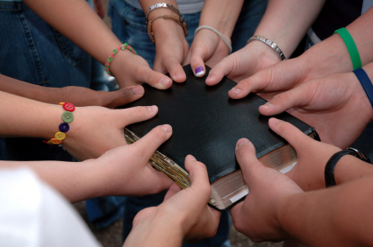
3. Develop Relationship With Brethren
Acts 2:44-46
Acts 4:32
1 Peter 5:8

Slide 7
4. Maintain Unity of the Spirit in the Bond of Peace
Ephesians 4:1-6
Grounds for this unity: one body, Spirit, hope, Lord, faith, baptism, God
Attitudes shown in maintaining this unity: lowliness, gentleness, longsuffering, bearing with one another

Slide 8
5. Grow Spiritually
Ephesians 4:11-16
  The saints are equipped to edify the body (the church).
  We are not to be tossed to and fro by error but grow up in all things.
  Every member has something to supply and a part to play in the growth of the body (the local church).

Slide 9
Making the Church a Priority in Our Life
Attendance
Contribution
Develop Relationship With Members
Maintain the Unity of the Spirit in the Bond of Peace
Grow Spiritually

