Slide 1
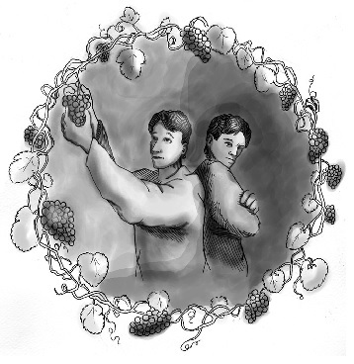
The Parable of the Two Sons
Matthew 21:28-32

Slide 2
Immediate Application
The Jews, as a whole, had disregarded God’s law.
  Some blatantly (tax collectors, harlots).
  Others cast aside the law of God for their traditions (scribes, Pharisees).
When John the Baptist came preaching, the tax collectors and harlots repented, while the scribes and Pharisees refused to repent.

Slide 3
Lessons For Today
Jesus Did Not Endorse Delayed Obedience
Words Do Not Take the Place of Obedience
The Blessings of Repentance
Hypocrisy

Slide 4
Where Are You In This Parable?
Are you unlike either son - faithfully serving the Lord?
Are you like the first son - you have told the Lord “NO” but need to repent and serve Him?
Are you like the second son - you say all the right things, but your actions do not measure up to your profession to be a Christian?

