Slide 1
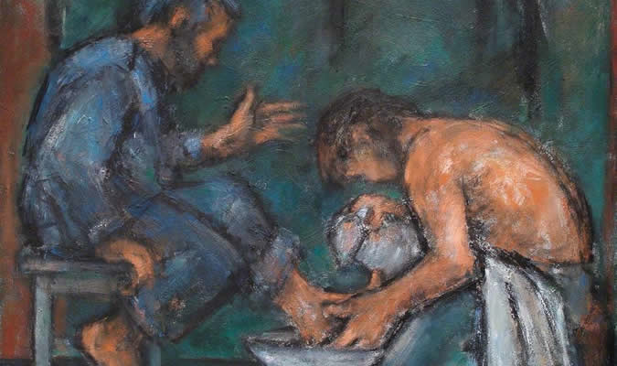
“He who is greatest among you shall be your servant.”

Slide 2
How To Be An Effective Servant
Greatness in the kingdom is found in serving others.
I owe it to my Lord to be the best servant that I can be.

Slide 3
1. Attitude
Love - Matt. 22:36-39; 1 Cor. 13:4-7
Gentleness - Matt. 11:28-30
Humility - Phil. 2:3-5

Slide 4
2. Awareness
Their Talents - Rom. 12:6-8
Their Task - Titus 2:14, 3:1, 8, 14
The Needs of Others - Matt. 9:11-12, 36-38

Slide 5
3. Availability
Luke 10:30-37
Jesus was among the people.
Jesus took time for people.

Slide 6
4. Action
James 2:15-16
1 John 3:18
John 9:4, 4:34

Slide 7
How To Be An Effective Servant
Attitude
Awareness
Availability
Action

Slide 8
How To Be An Effective Servant
Attitude
Awareness
Availability
Action
Do I have what it takes to be a good servant?

