Slide 1
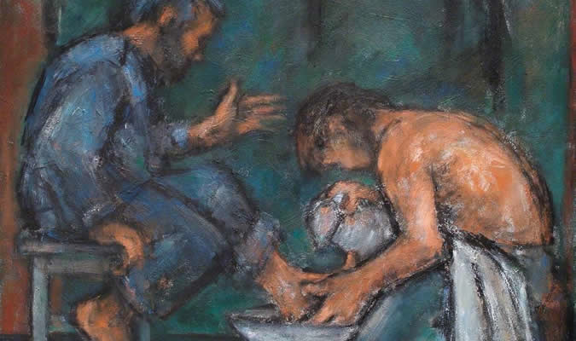
“He who is greatest among you shall be your servant.”

Slide 2
Why Be A Servant?
Matthew 20:25-28

Slide 3
The value and worth of the Christian life is not measured by what we get out of it, but by what we give to it.
Greatness in the kingdom is not found in those who demand the most from others but those who give the most of themselves.

Slide 4
Why Should I Be A Servant?
Greatness in the Kingdom - Matt. 20:26-27, 23:11-12
Follow the Lord’s Example - Matt. 20:28; John 13:13-15
We Are Created for Good Works - Eph. 2:10
Commended To Us - Rom. 16:1-2

Slide 5
Why Should I Be A Servant?
There is a Need - Titus 3:14
Show God’s Love - 1 John 4:7-11
Influence Others For Good - Matt. 5:16
We Are Rewarded - Matt. 25:34-40

