Slide 1
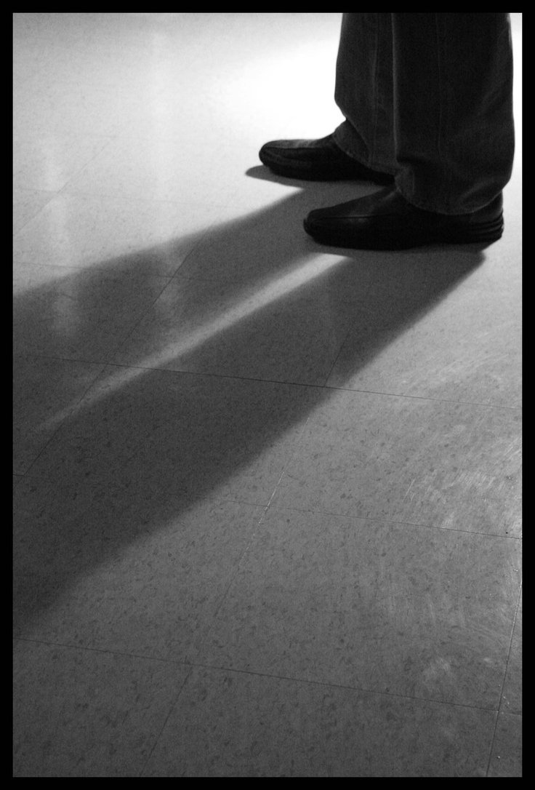
Made in the Image of God
Genesis 1:26-27

Slide 2
Man was made differently than the rest of creation.
We were the last thing that God created – the pinnacle of God’s creative work.
God spoke everything else into existence, but He took time to form us out of the dust of the ground (Gen. 2:7).
God made man in His own image (Gen. 1:26-27).

Slide 3

What does this mean?
God does not have a physical body like man.
God is an invisible spirit.
  John 4:23-24
  Col. 1:15
  Heb. 11:27

Slide 4
1. Man Has an Eternal Spirit
Man realizes his mortality, desires to continue to exist after his physical death (Job 14:14).
Man is made up of both a physical body and an immortal spirit (Matt. 10:28).
Physical death occurs when man’s spirit leaves his body (James 2:26). The body returns to the dust (Eccl. 12:7) and the soul lives on forever in the spiritual realm.

Slide 5

2. Man Can Think and Reason
“Come now, and let us reason together” (Isaiah 1:18).
God tried to reason with Jonah (Jonah 4:9-11).

Slide 6
2. Man Can Think and Reason
Man is aware of his mortality, accountability to those in positions of authority, impact of his actions upon others, etc.
Man can plan for the future (James 4:13-15).
Man can weigh the merits of ideas. He can “count the cost” (Luke 14:28-33).
Man alone can connect with God on an intellectual and spiritual level.

Slide 7
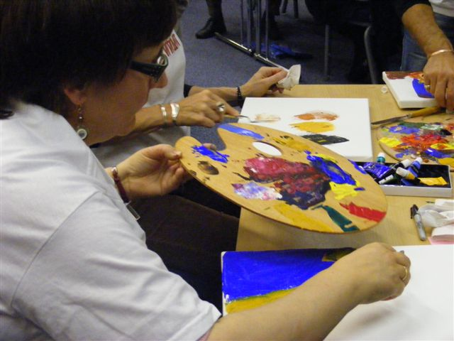
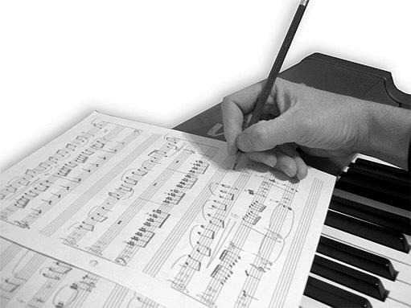

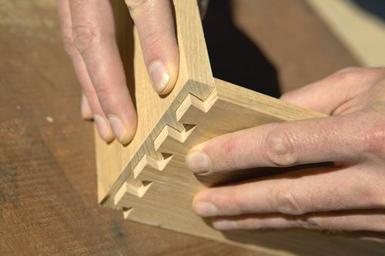

3. Man is Creative

Slide 8
3. Man is Creative
“In the beginning God created the heavens and the earth” (Gen. 1:1).
“The heavens declare the glory of God; and the firmament shows His handiwork” (Ps. 19:1).

Slide 9
3. Man is Creative
“For since the creation of the world His invisible attributes are clearly seen, being understood by the things that are made, even His eternal power and Godhead, so that they are without excuse” (Rom. 1:20).

Slide 10
4. Man Loves With Sacrifice
This world would not know about love if it were not for God (1 John 4:7-8).
The love of God is only made known because God has expressed it in a sacrifice.
  1 John 4:9-11, 19
  John 3:16
  Rom. 5:8

Slide 11
4. Man Loves With Sacrifice
Husbands are commanded to love their wives sacrificially (Eph. 5:25).
Soldiers and civilians lay down their lives for others (John 15:13).
We honor this kind of sacrifice, but it was first shown by God.

Slide 12
Made in the Image of God
Has an Eternal Soul
Can Think and Reason
Is Creative
Loves with a Sacrifice

Slide 13
Made in the Image of God
Has an Eternal Soul
Can Think and Reason
Is Creative
Loves with a Sacrifice
We have been fearfully and wonderfully made in the image of our God.

Slide 14
Made in the Image of God
Has an Eternal Soul
Can Think and Reason
Is Creative
Loves with a Sacrifice
We have been fearfully and wonderfully made in the image of our God.
Have you thought about your eternal soul? Counted the cost? Obeyed the gospel?

