Slide 1

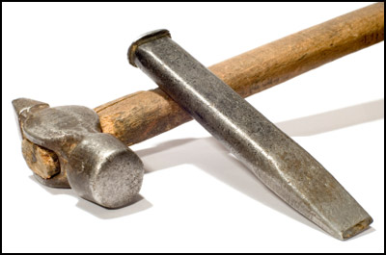
Making God in Man’s Image

Slide 2
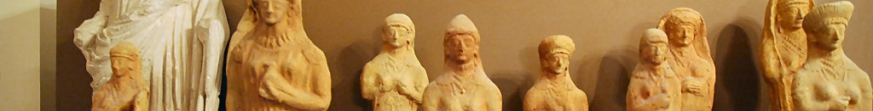
Man has always made God in his image
Romans 1:18-25

Slide 3
Man has always made God in his image
Romans 1:18-25
“although they knew God, they did not glorify Him as God, now were thankful” (v. 21)

Slide 4
Man has always made God in his image
Romans 1:18-25
“changed the glory of the incorruptible God into an image made like corruptible man – and birds and four-footed animals and creeping things” (v. 23)

Slide 5
Man has always made God in his image
Romans 1:18-25
“exchanged the truth of God for the lie, and worshiped and served the creature rather than the Creator” (v. 25)

Slide 6
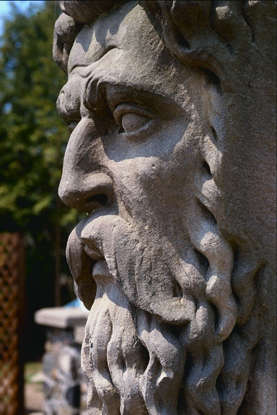
Man has always made God in his image
Men gave their gods human form and human weaknesses and limitations.
1 Kings 18:27

Slide 7
God condemned idolatry
“You shall not make for yourself a carved image — any likeness of anything that is in heaven above, or that is in the earth beneath, or that is in the water under the earth; you shall not bow down to them nor serve them. For I, the Lord your God, am a jealous God, visiting the iniquity of the fathers upon the children to the third and fourth generations of those who hate Me” (Exodus 20:4-5).

Slide 8
We are not to look upon God as our equal
“These things you have done, and I kept silent; you thought that I was altogether like you; but I will rebuke you, and set them in order before your eyes.”
Psalm 50:21

Slide 9
We are not to look upon God as our equal
“If you then, being evil, know how to give good gifts to your children, how much more will your Father who is in heaven give good things to those who ask Him!”
Matthew 7:11

Slide 10
We are not to look upon God as our equal
“‘For My thoughts are not your thoughts, nor are your ways My ways,’ says the Lord. ‘For as the heavens are higher than the earth, so are My ways higher than your ways, and My thoughts than your thoughts.’”
Isaiah 55:8-9

Slide 11
We are not to look upon God as our equal
“But they do not know the thoughts of the Lord, nor do they understand His counsel; for He will gather them like sheaves to the threshing floor.”
Micah 4:12

Slide 12
Modern Day Examples of Man Making God in His Image

Slide 13
1. God Does Not Keep His Word
God is not a man, and thus is not capable of this shortcoming - Num. 23:19; Joshua 21:43-45
God is faithful - 1 Cor. 10:13
God does not forget - Heb. 6:10
God’s will cannot be hindered by man - Job 23:13, 42:2

Slide 14
2. God Has “Mellowed” With Age
“For I am the Lord, I do not change; therefore you are not consumed, O sons of Jacob” (Malachi 3:6).
“Jesus Christ is the same yesterday, today, and forever” (Hebrews 13:8).

Slide 15
2. God Has “Mellowed” With Age
“Every good gift and every perfect gift is from above, and comes down from the Father of lights, with whom there is no variation or shadow of turning” (James 1:17).

Slide 16
3. God Can Be Fooled
God sees and knows everything - Prov. 15:3; Heb. 4:13
God cannot be fooled - Gal. 6:7-8
God sees through all the games and tricks we try to play - Acts 5:1-11
God sees what is in our heart - 1 Sam. 16:7; 1 Pet. 3:4

Slide 17
4. God Can Be Bribed
Our good deeds cannot make God overlook our sin - Isaiah 1:10-17
We are to behold both the goodness and the severity of God - Rom. 11:22

Slide 18
5. God Just Wants Me To Be Happy
God wants us to…
Love Him - Matt. 22:37
Put Him First - Matt. 6:33
Be Reconciled To Him - Col. 1:20-23
Come Out From the World and Be Separate - 2 Cor. 6:17-18
Abstain From Evil - 1 Thess. 5:21-22

Slide 19
6. God Is Out To Get Me
God does not fly off in a blind rage - Hosea 11:9
God is no respecter of persons - Rom. 2:11
God wants everyone to be saved - including you - 1 Tim. 2:3-4
God takes no pleasure in the punishment of sinners - Ezek. 33:11

Slide 20
7. God Will Not Send Anyone To Hell
God is love - 1 John 4:7-8
God is also righteous and just - Gen. 18:25
God holds man accountable - 2 Cor. 5:10
Sin will be punished with eternal torment - Rom. 2:5-11; 2 Thess. 1:8-9

Slide 21
The Mistake of Making God in Man’s Image
God Does Not Keep His Word
God Has “Mellowed” With Age
God Can Be Fooled
God Can Be Bribed
God Just Wants Me To Be Happy
God Is Out To Get Me
God Will Not Send Anyone To Hell

Slide 22
Actually, God wants us to be made in the image of His Son

Slide 23
Actually, God wants us to be made in the image of His Son
“…since you have put off the old man with his deeds, and have put on the new man who is renewed in knowledge according to the image of Him who created him.”
Colossians 3:9-10

Slide 24
Actually, God wants us to be made in the image of His Son
“Let this mind be in you which was also in Christ Jesus” (Phil. 2:5).
“My little children, for whom I labor in birth again until Christ is formed in you” (Gal. 4:19).

