Slide 2
Two Questions:
Who’s your Nineveh?
What’s your plant?

Slide 3
“For the Son of Man came to seek and to save the lost.”
Luke 19:10
“The Lord is not slow to fulfill his promise as some count slowness, but is patient toward you, not wishing that any should perish, but that all should reach repentance.”
2 Peter 3:9
“I am speaking the truth in Christ—I am not lying; my conscience bears me witness in the Holy Spirit—that I have great sorrow and unceasing anguish in my heart. For I could wish that I myself were accursed and cut off from Christ for the sake of my brothers, my kinsmen according to the flesh.”
Romans 9:1-3
“Brothers, my heart's desire and prayer to God for them is that they may be saved.”
Romans 10:1

Slide 4
4 Lessons From Jonah
  If you want to disobey God, the devil will always make sure a boat is nearby
  Sometimes God sends us on a mission so we will get the message

Slide 5
“So Peter opened his mouth and said: ‘Truly I understand that God shows no partiality, but in every nation anyone who fears him and does what is right is acceptable to him.’”
Acts 10:34-35

Slide 6
4 Lessons From Jonah
  God will not deliver us from obedience
  Our disobedience in the past will not disqualify us from being used by God in the present

Slide 7
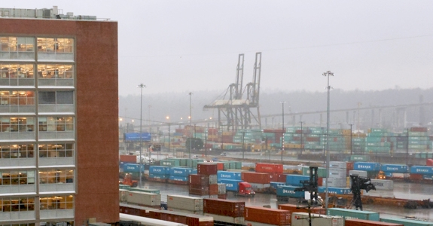

Slide 8


