Slide 1
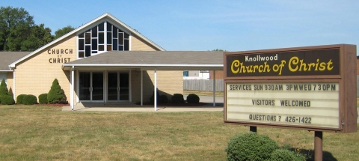
What the Church Needs Today

Slide 2

What the Church Needs Today

Slide 3



What the Church Needs Today

Slide 4




What the Church Needs Today

Slide 5
What the Church Needs Today
Preachers Who Will Preach the Word
Elders Who Will Oversee the Church
Deacons Who Will Serve
Teachers Who Will Teach
Members Who Will Work

