Slide 1
Daniel 1:3-8
³ Then the king instructed Ashpenaz, the master of his eunuchs, to bring some of the children of Israel and some of the king’s descendants and some of the nobles, ⁴ young men in whom there was no blemish, but good-looking, gifted in all wisdom, possessing knowledge and quick to understand, who had ability to serve in the king’s palace, and whom they might teach the language and literature of the Chaldeans. ⁵ And the king appointed for them a daily provision of the king’s delicacies and of the wine which he drank, and three years of training for them, so that at the end of that time they might serve before the king. ⁶ Now from among those of the sons of Judah were Daniel, Hananiah, Mishael, and Azariah. ⁷ To them the chief of the eunuchs gave names: he gave Daniel the name Belteshazzar; to Hananiah, Shadrach; to Mishael, Meshach; and to Azariah, Abed-Nego. ⁸ But Daniel purposed in his heart that he would not defile himself with the portion of the king’s delicacies, nor with the wine which he drank; therefore he requested of the chief of the eunuchs that he might not defile himself.

Slide 2
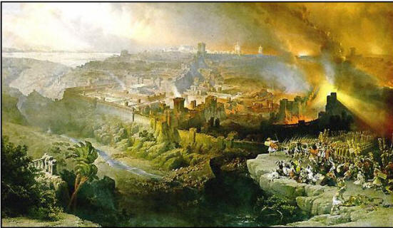
In 587 BC Nebuchadnezzar, king of Babylon, led his forces against Jerusalem for the third time—the siege brought an end to Judah (2 Ki 25:1-17).
Eighteen years earlier (605 BC) Nebuchadnezzar took the first Jewish captives to Babylon, including Daniel, Shadrach, Meshach, Abed-Nego (Dan 1:1-7).

Slide 3
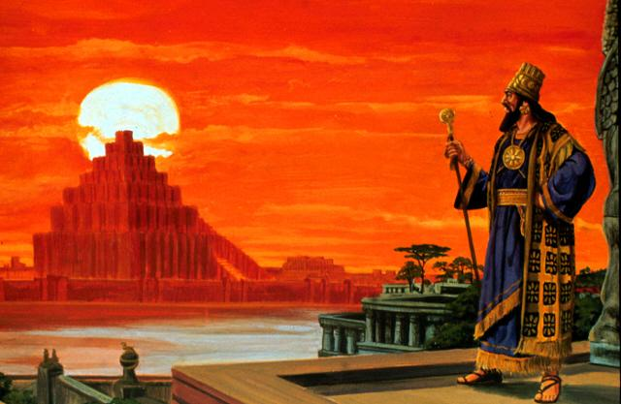

Daniel spent his enter life in Babylon
He was taken captive while a boy (est. 16)
Began as a household slave
Became an advisor to kings
Saw the overthrow of Babylon by Persians
Served in the court of Darius the Mede
Survived the Lion’s Den
Observed the remnant return to Jerusalem

Slide 4
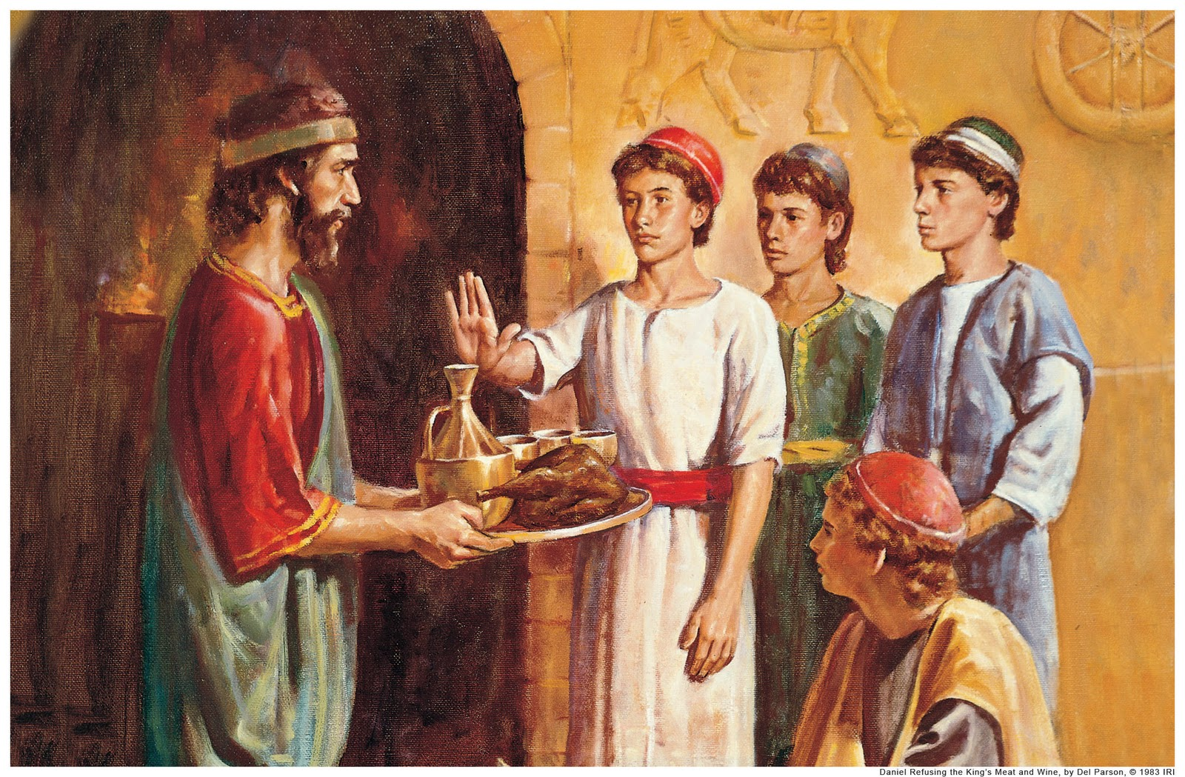
Purposed: “rehearsed & determined”
Heart: “mind, intellect”
But Daniel purposed in his heart that he would not defile himself with the portion of the king’s delicacies, nor with the wine which he drank; therefore he requested of the chief of the eunuchs that he might not defile himself (Dan 1:8). [NKJB]
But Daniel made up his mind that he would not defile himself with the king's choice food or with the wine which he drank; so he sought permission from the commander of the officials that he might not defile himself (Dan 1:8). [NASB]

Slide 5

No Other Way to Serve God
Acts 11:23—With purpose of heart . . . continue with the Lord

Slide 6

Purpose of Heart
Prepares you to face Temptations
Prepares you for diligent Service
Prepares you for Tribulations

