Slide 1
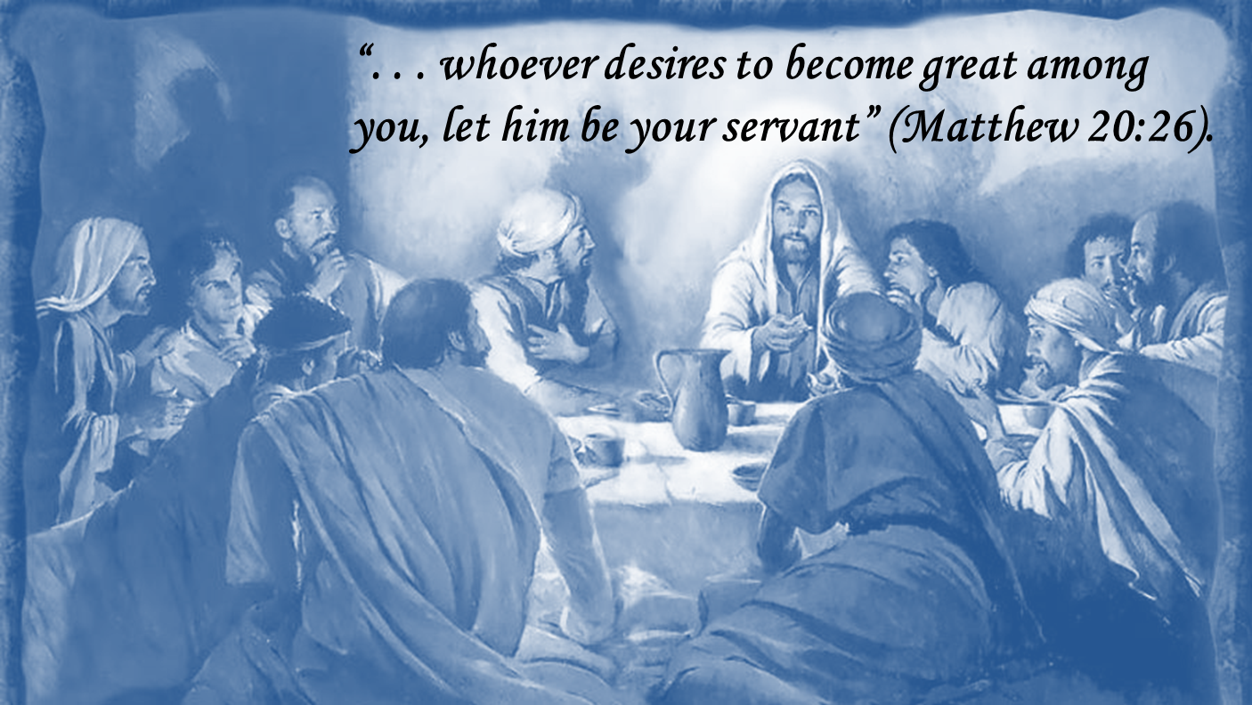
“But he who is greatest among you shall be your servant. and whoever exalts himself will be humbled, and he who humbles himself will be exalted” (Matthew 23:11-12).
“And He sat down, called the twelve, and said to them, if anyone desires to be first, he shall be last of all and servant of all,” (Mark 9:35).

Slide 2


The Heart of a Servant
Now there was also a dispute among them, as to which of them should be considered the greatest. (Luke 22:24)
. . . he who is greatest among you, let him be as the younger, and he who governs as he who serves. (Luke 22:26)
After that, He poured water into a basin and began to wash the disciples' feet, and to wipe them with the towel with which He was girded. (John 13:5)
For I have given you an example, that you should do as I have done to you. Most assuredly, I say to you, a servant is not greater than his master . . . (John 13:15-16)

Slide 3
The Heart of a Servant
Phoebe ~ Romans 16:1
Paul ~ 1 Corinthians 9:19
Samaritan ~ Luke 10:33-36
All Christians ~ Galatians 5:13

Slide 4
The Heart of a Servant
“Let love be without hypocrisy . . . Be kindly affectionate to one another . . . in honor giving preference to one another . . . distributing to the needs of the saints . . . Rejoice with those who rejoice, and weep with those who weep,” (Romans 12:9-15).
“No one engaged in warfare entangles himself with the affairs of this life, that he may please him who enlisted him as a soldier,” (2 Timothy 2:4).
“Yes, all of you be submissive to one another, and be clothed with humility, for God resists the proud, but gives grace to the humble,” (1 Peter 5:5).
“Therefore, as we have opportunity, let us do good to all, especially to those who are of the household of faith,” (Galatians 6:10).
Is Always Available
“Moreover it is required in stewards that one be found faithful,” (1 Corinthians 4:2).
Is Always Attentive
Never Makes Excuses
Is Clothed w/Humility
Is Always Dependable

Slide 5

Do I have the Heart of a Servant?
If I never volunteer to teach the lost?
If I never volunteer to encourage others?
If I never volunteer to clean the building?
If I never volunteer to teach a Bible Class?
If I never volunteer to help the needy?

Slide 6

41 Then He will also say to those on the left hand, depart from Me, you cursed, into the everlasting fire prepared for the devil and his angels:
42 for I was hungry and you gave Me no food; I was thirsty and you gave Me no drink;
43 I was a stranger and you did not take Me in, naked and you did not clothe Me, sick and in prison and you did not visit Me.
44 Then they also will answer Him, saying, Lord, when did we see You hungry or thirsty or a stranger or naked or sick or in prison, and did not minister to You?
45 Then He will answer them, saying, assuredly, I say to you, inasmuch as you did not do it to one of the least of these, you did not do it to Me.
And these will go away into everlasting punishment, but the righteous into eternal life.
Matthew 25:41-46
These did not have hearts of Servants!

