Slide 1
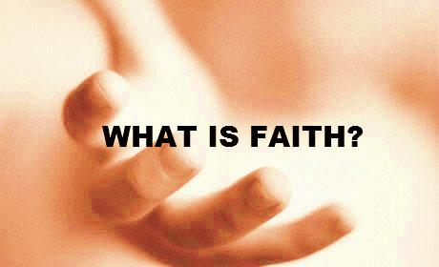
Hebrews 11:1-10
NOT: A Blind Leap in the Dark
NOT: Superstition
¹ Now faith is the substance of things hoped for, the evidence of things not seen. ² For by it the elders obtained a good testimony. ³ By faith we understand that the worlds were framed by the word of God, so that the things which are seen were not made of things which are visible. ⁴ By faith Abel offered to God a more excellent sacrifice than Cain, through which he obtained witness that he was righteous, God testifying of his gifts; and through it he being dead still speaks. ⁵ By faith Enoch was taken away so that he did not see death, and was not found, because God had taken him; for before he was taken he had this testimony, that he pleased God. ⁶ But without faith it is impossible to please Him, for he who comes to God must believe that He is, and that He is a rewarder of those who diligently seek Him. ⁷ By faith Noah, being divinely warned of things not yet seen, moved with godly fear, prepared an ark for the saving of his household, by which he condemned the world and became heir of the righteousness which is according to faith. ⁸ By faith Abraham obeyed when he was called to go out to the place which he would receive as an inheritance. And he went out, not knowing where he was going. ⁹ By faith he dwelt in the land of promise as in a foreign country, dwelling in tents with Isaac and Jacob, the heirs with him of the same promise; ¹⁰ for he waited for the city which has foundations, whose builder and maker is God.
¹ Now faith is the substance of things hoped for, the evidence of things not seen. ² For by it the elders obtained a good testimony. ³ By faith we understand that the worlds were framed by the word of God, so that the things which are seen were not made of things which are visible. ⁴ By faith Abel offered to God a more excellent sacrifice than Cain, through which he obtained witness that he was righteous, God testifying of his gifts; and through it he being dead still speaks. ⁵ By faith Enoch was taken away so that he did not see death, and was not found, because God had taken him; for before he was taken he had this testimony, that he pleased God. ⁶ But without faith it is impossible to please Him, for he who comes to God must believe that He is, and that He is a rewarder of those who diligently seek Him. ⁷ By faith Noah, being divinely warned of things not yet seen, moved with godly fear, prepared an ark for the saving of his household, by which he condemned the world and became heir of the righteousness which is according to faith. ⁸ By faith Abraham obeyed when he was called to go out to the place which he would receive as an inheritance. And he went out, not knowing where he was going. ⁹ By faith he dwelt in the land of promise as in a foreign country, dwelling in tents with Isaac and Jacob, the heirs with him of the same promise; ¹⁰ for he waited for the city which has foundations, whose builder and maker is God.
14 Times
NOT: A Mental Crutch
NOT: A Divine ATM

Slide 2
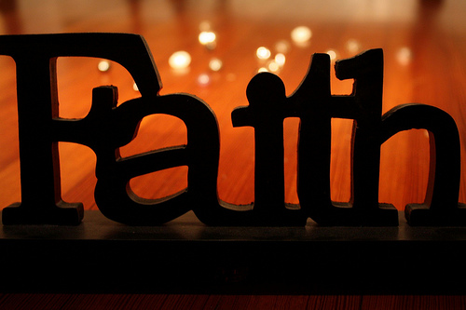
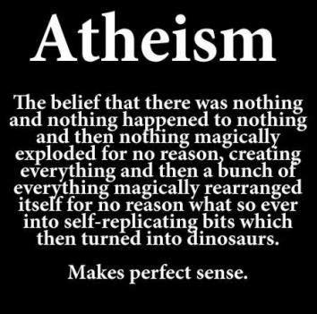
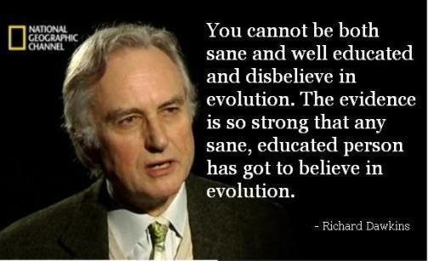

Slide 3
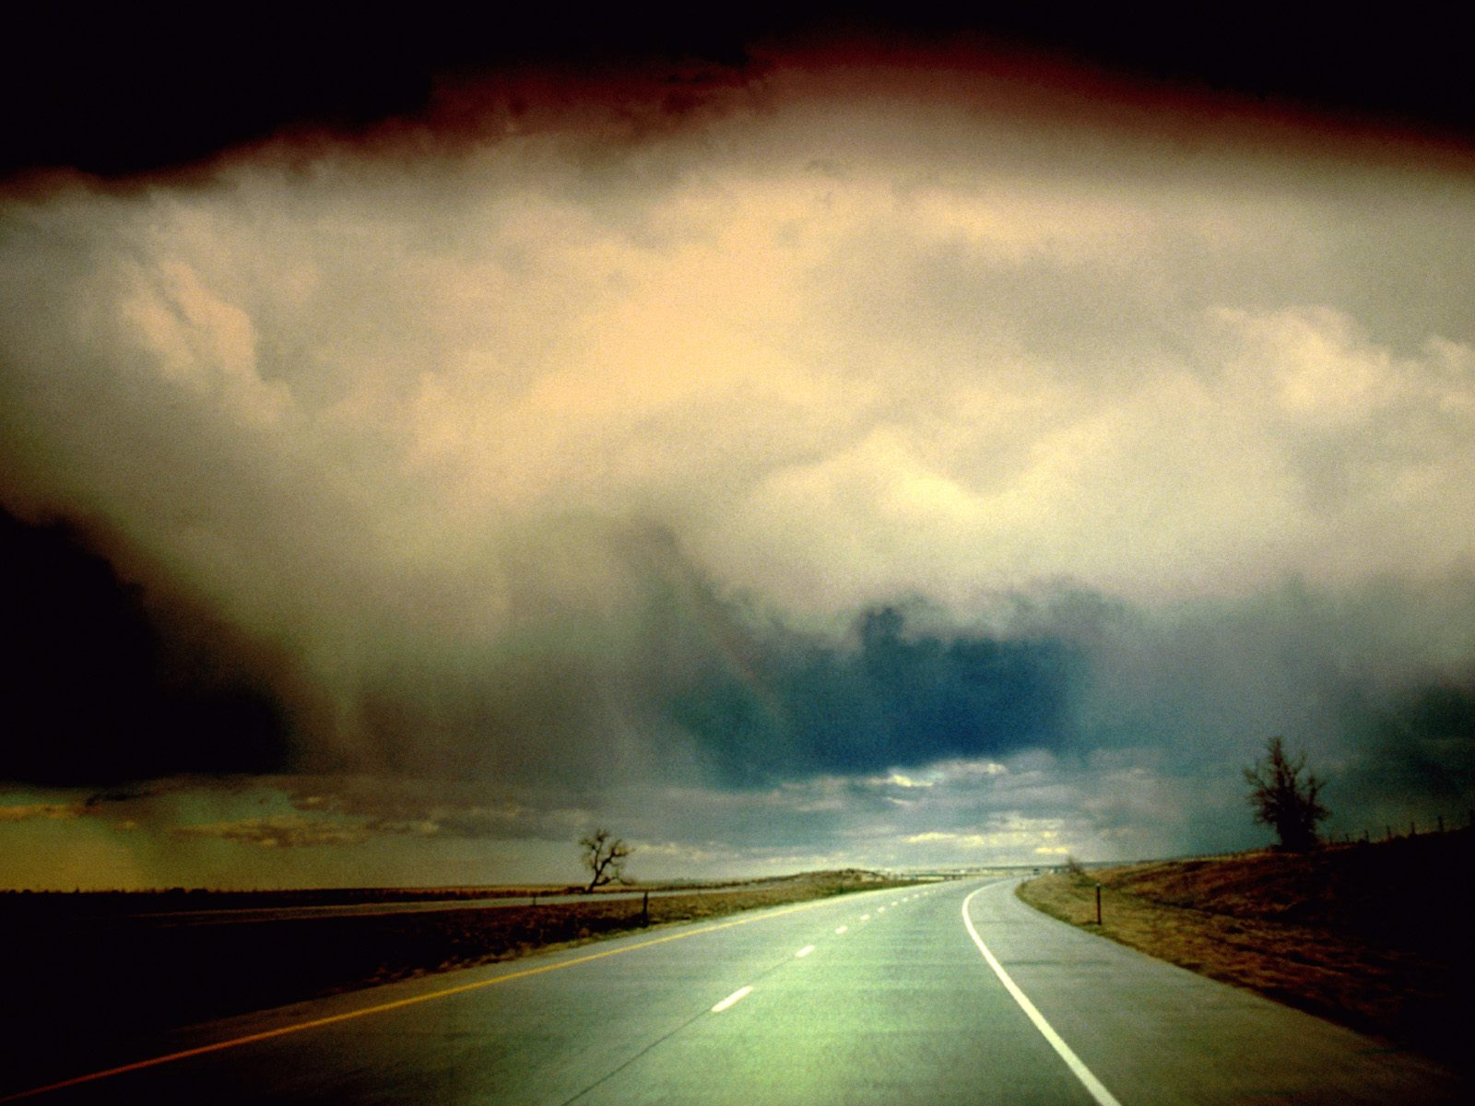
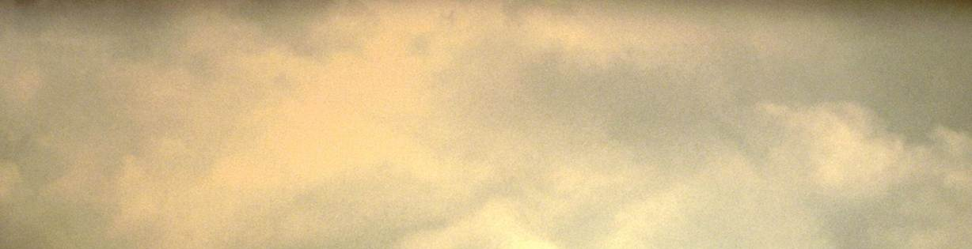
FAITH
Hebrews 11: 1, 3, 6
Now faith is the substance of things hoped for, the evidence of things not seen.
By faith we understand that the worlds were framed by the word of God, so that the things which are seen were not made of things which are visible.
But without faith it is impossible to please Him, for he who comes to God must believe that He is, and that He is a rewarder of those who diligently seek Him.
Commitment
Comprehend
Conviction
Confidence

Slide 4
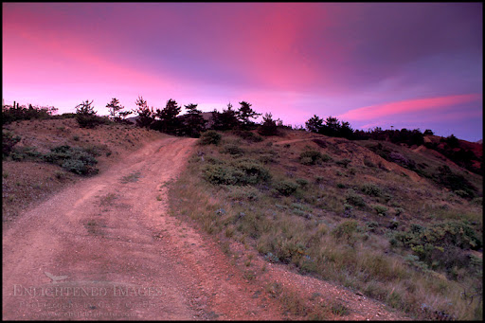
FAITH
By faith he dwelt in the land of promise as in a foreign country, dwelling in tents with Isaac and Jacob, the heirs with him of the same promise; for he waited for the city which has foundations, whose builder and maker is God (vss 9-10).
By faith Abel offered to God a more excellent sacrifice than Cain, through which he obtained witness that he was righteous (vs 4).
By faith Noah, being divinely warned of things not yet seen, moved with godly fear, prepared an ark for the saving of his household (vs 7).
By faith Enoch was taken away so that he did not see death, and was not found, because God had taken him (vs 5).
Waits
Works
Walks
Worships

