Slide 1

Overcoming the Sin of

Slide 2
We Are Commanded To Forgive

Slide 3

We Are Commanded To Forgive
“And be kind to one another, tenderhearted, forgiving one another, even as God in Christ forgave you.”
Ephesians 4:32

Slide 4
We Are Commanded To Forgive
“For if you forgive men their trespasses, your heavenly Father will also forgive you. But if you do not forgive men their trespasses, neither will your Father forgive your trespasses.”
Matthew 6:14-15

Slide 5
We Are Commanded To Forgive
“And whenever you stand praying, if you have anything against anyone, forgive him, that your Father in heaven may also forgive you your trespasses. But if you do not forgive, neither will your Father in heaven forgive your trespasses.”
Mark 11:25-26

Slide 6
Forgiveness Must Be Without Limit
“Then Peter came to Him and said, ‘Lord, how often shall my brother sin against me, and I forgive him? Up to seven times?’ Jesus said to him, ‘I do not say to you, up to seven times, but up to seventy times seven.’”
Matthew 18:21-22

Slide 7
Our Willingness To Forgive Must Be Comparable To God’s Willingness
“Should you not also have had compassion on your fellow servant, just as I had pity on you?”
Matthew 18:33
Psalm 103:8-14
1 John 1:9

Slide 8
When Our Brother Repents
“Take heed to yourselves. If your brother sins against you, rebuke him; and if he repents, forgive him. And if he sins against you seven times in a day, and seven times in a day returns to you, saying, ‘I repent,’ you shall forgive him.”
Luke 17:3-4

Slide 9
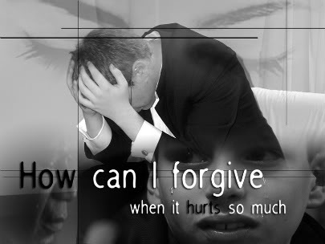
When Our Brother Repents
“Take heed to yourselves. If your brother sins against you, rebuke him; and if he repents, forgive him. And if he sins against you seven times in a day, and seven times in a day returns to you, saying, ‘I repent,’ you shall forgive him.”
Luke 17:3-4

Slide 10
When Our Brother Repents
2 Corinthians 2:6-11
  Forgive Him
  Comfort Him
  Reaffirm Our Love For Him

Slide 11
When There Is No Repentance
Where there is no repentance there can be no reconciliation.
“Actually, we must have a willingness to forgive even if our enemy does not repent. If he does not repent, our willingness to forgive will not profit him but it will certainly profit us.”

Slide 12
When There Is No Repentance
“Father, forgive them, for they do not know what they do.”
Luke 23:34

Slide 13
How To Overcome Unforgiveness
Take Heed To Ourselves - Luke 17:3
Do Away With Limits To Our Forgiveness - Luke 17:3-4; Matt. 18:21-22
Value Reconciliation and Renewed Fellowship Over Defending Our Injured Pride - Psalm 133:1; John 13:35

Slide 14
How To Overcome Unforgiveness
Remember That We Stand In Need Of Forgiveness - Matt. 6:12, 14-15
Remember That Sins Committed Against Us Do Not Compare To Sins We Commit Against God - Matt. 18:24, 28
Remember That Receiving Mercy Obligates Us To Show Mercy - Matt. 18:33; Col. 3:13

Slide 15
How To Overcome Unforgiveness
Remember That God’s Blessings Are Given With the Same Measure We Use Upon Others - Matt. 7:2; Luke 6:38; James 2:13
Love Others As We Love Ourselves - Matt. 22:39; 7:12

Slide 16
“For if you forgive men their trespasses, your heavenly Father will also forgive you. But if you do not forgive men their trespasses, neither will your Father forgive your trespasses.”
Matthew 6:14-15

