Slide 1
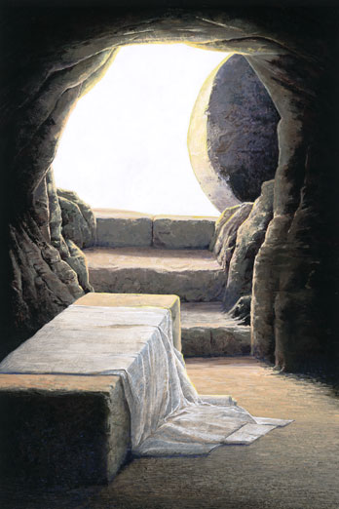
Why I Believe Jesus Rose From the Dead

Slide 2
Importance of the Lord’s Resurrection
Jesus Himself claimed that His resurrection would prove His identity
    Matthew 12:38-40
    John 2:19-22

Slide 3
Importance of the Lord’s Resurrection
The resurrection was the means by which God declared that Jesus was His Son
    Romans 1:4

Slide 4
“The resurrection is the foundation upon which we base our faith and hope in Christ. Even the enemies of Christ know this. If the resurrection can be disproven, then the entire Bible is nullified as a claimant for valid faith. But if it is true, then it stands as the single greatest testimony to the validity of the Scriptures and the Christian faith. So the question before us now is, did Jesus really rise from the dead?”
Doy Moyer, Standing on Solid Ground, p. 37

Slide 5
1. The Way Jesus Died

Slide 6
1. The Way Jesus Died
One argument against the resurrection suggests that Jesus didn’t really die on the cross.
He only appeared to be dead.
He was taken to Joseph’s tomb where He later revived and walked away from the tomb.
Called the “Swoon Theory.”

Slide 7
1. The Way Jesus Died
The Bible says that Jesus died.
“For I delivered to you first of all that which I also received: that Christ died for our sins according to the Scriptures, and that He was buried, and that He rose again the third day according to the Scriptures” (1 Cor. 15:3-4).

Slide 8
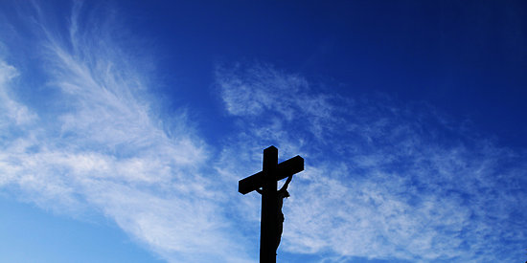
What Do We Know About Jesus’ Crucifixion?
No one survived a crucifixion.

Slide 9
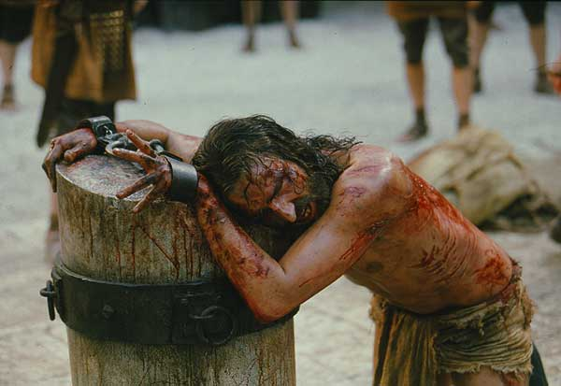
What Do We Know About Jesus’ Crucifixion?
No one survived a crucifixion.
Scourging.

Slide 10
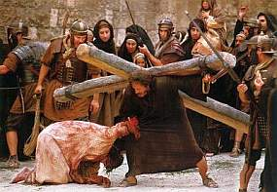
What Do We Know About Jesus’ Crucifixion?
No one survived a crucifixion.
Scourging.
Could not carry His cross.

Slide 11
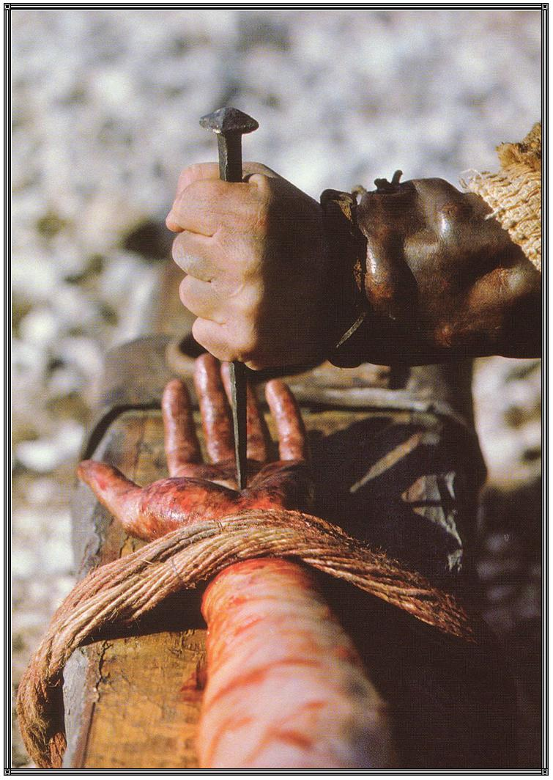
What Do We Know About Jesus’ Crucifixion?
No one survived a crucifixion.
Scourging.
Could not carry His cross.
Nailed to the cross.

Slide 12
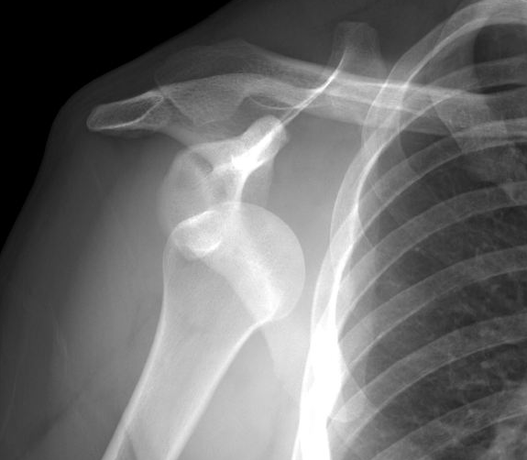
What Do We Know About Jesus’ Crucifixion?
No one survived a crucifixion.
Scourging.
Could not carry His cross.
Nailed to the cross.
Dislocated shoulders.

Slide 13
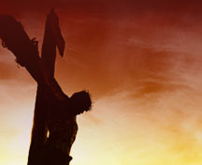
What Do We Know About Jesus’ Crucifixion?
No one survived a crucifixion.
Scourging.
Could not carry His cross.
Nailed to the cross.
Dislocated shoulders.
Death by asphyxiation.

Slide 14
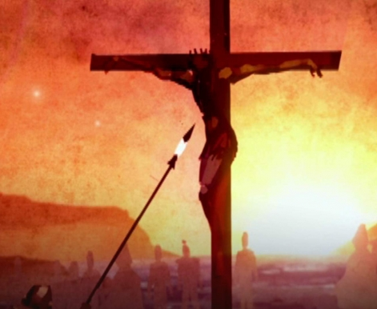
What Do We Know About Jesus’ Crucifixion?
No one survived a crucifixion.
Scourging.
Could not carry His cross.
Nailed to the cross.
Dislocated shoulders.
Death by asphyxiation.
Side pierced.

Slide 15
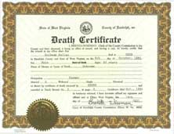
What Do We Know About Jesus’ Crucifixion?
No one survived a crucifixion.
Scourging.
Could not carry His cross.
Nailed to the cross.
Dislocated shoulders.
Death by asphyxiation.
Side pierced.
Pilate confirmed His death.

Slide 16
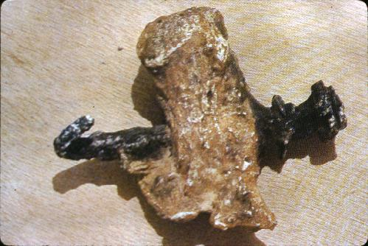
2. His Burial

Slide 17
2. His Burial
Jesus was buried according to the custom of the Jews (John 19:38-40).
  body wrapped three times
  spices mixed in with the cloths
  total encasement would have weighed 117-120 pounds

Slide 18
3. The Empty Tomb
Matthew 27:59-28:8
  this was a new tomb, His was the only body in the tomb
  hewn out of rock - no back door
  large stone rolled against the door
  seal was set and guard was posted to keep it undisturbed

Slide 19
3. The Empty Tomb
What happened to the body?
  the women did not go to the wrong tomb - they carefully observed where His body was laid
  Jesus did not revive and walk out - couldn’t have moved the stone or gotten past the guard
  disciples did not steal the body - weren’t of a frame of mind to do so, couldn’t have gotten past the guard
  enemies did not steal the body

Slide 20
3. The Empty Tomb
What happened to the body?
Jesus rose from the dead!

Slide 21
4. Post-Resurrection Appearances
Many different people saw the risen Lord on different occasions doing different things.
  John 20:24-28
  1 Corinthians 15:5-8

Slide 22
5. Circumstantial Evidence
Bravery of the Disciples
Beginning Place of the Church
Conversion of Skeptics
  Thomas
  James, brother of the Lord
  Paul
First Day of the Week

Slide 23
Why I Believe Jesus Rose From the Dead
The Way He Died
The Way He Was Buried
The Empty Tomb
Post-Resurrection Appearances
Circumstantial Evidence

