Slide 2

Running Ahead of God

Slide 3
“Wait on the Lord; be of good courage, and He shall strengthen your heart; wait, I say, on the Lord!”
Psalm 27:14

Slide 4
Those Who Ran Ahead of God
Sarah - Genesis 16:1-12
King Saul - 1 Samuel 13:5-15
King David - 1 Chronicles 13
Peter - Matthew 16:21-23, 26:31-35, 26:50-54

Slide 5
Consequences of Running Ahead of God
Destroy our family life.
Disobey commandments of God.
Presume to improve upon God’s pattern and will for the church.
Find ourselves actually opposing the will of God.

Slide 6
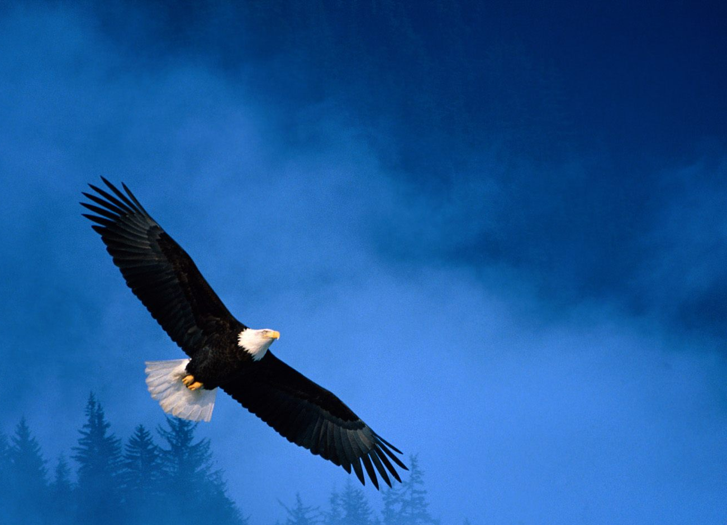
“But those who wait on the Lord shall renew their strength; they shall mount up with wings like eagles, they shall run and not be weary, they shall walk and not faint.”
Isaiah 40:31

