Slide 1
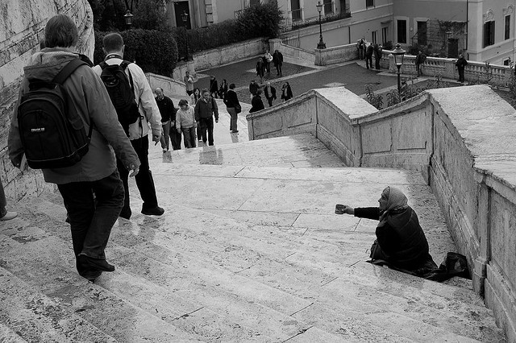
Overcoming the Sin of Indifference

Slide 2
What is “Indifference”?
indifferent: 1 having or showing no partiality, bias, or preference; neutral 2 having or showing no interest, concern or feeling; uninterested, apathetic, or unmoved.
indifference: a lack of concern, interest, or feeling; apathy
Webster’s Dictionary

Slide 3
Indifference is the opposite of what God expects from us.

Slide 4
Indifference is the opposite of what God expects from us.
“I call heaven and earth as witnesses today against you, that I have set before you life and death, blessing and cursing; therefore choose life, that both you and your descendants may live.”
Deuteronomy 30:19

Slide 5
Indifference is the opposite of what God expects from us.
“And if it seems evil to you to serve the Lord, choose for yourselves this day whom you will serve, whether the gods which your fathers served that were on the other side of the River, or the gods of the Amorites, in whose land you dwell. But as for me and my house, we will serve the Lord.”
Joshua 24:15

Slide 6
Indifference is the opposite of what God expects from us.
“And Elijah came to all the people, and said, ‘How long will you falter between two opinions? If the Lord is God, follow Him; but if Baal, follow him.’ But the people answered him not a word.”
1 Kings 18:21

Slide 7
Indifference is the opposite of what God expects from us.
“I know your works, that you are neither cold nor hot. I could wish you were cold or hot. So then, because you are lukewarm, and neither cold nor hot, I will vomit you out of My mouth.”
Revelation 3:15-16

Slide 8
Indifference is the opposite of what God expects from us.
“He who is not with Me is against Me, and he who does not gather with Me scatters abroad.”
Matthew 12:30

Slide 9
Indifference is a Sin
Jesus told the indifferent and lukewarm Laodiceans to “repent” (Rev. 3:19).
He was ready to “vomit” them out of His mouth (v. 16).
The need to repent and the threat of losing fellowship with Christ indicates that they were in sin.

Slide 10
Consequences of Indifference
Disgusts God - Rev. 3:16
Discourages faithful brethren - Prov. 10:26
God’s “house” is abandoned - Hag. 1:4-11
Needy are neglected - Mark 14:7; Gal. 6:10; James 1:27; Eccl. 4:1; Is. 57:1, Ps. 142:4
We will lose our souls - Ps. 28:5; Prov. 19:16; Zeph. 1:12-13; Heb. 2:3; Phil. 2:12

Slide 11
How to Overcome Indifference
Love - 1 Cor. 13:4-7
Zeal - Rev. 3:19; Rom. 12:11; Heb. 6:11-12, 10:24-25; 2 Cor. 9:2
Let Christ In Our Heart - Rev. 3:20
Give of Ourselves - 2 Cor. 8:5
Pray

