Slide 1
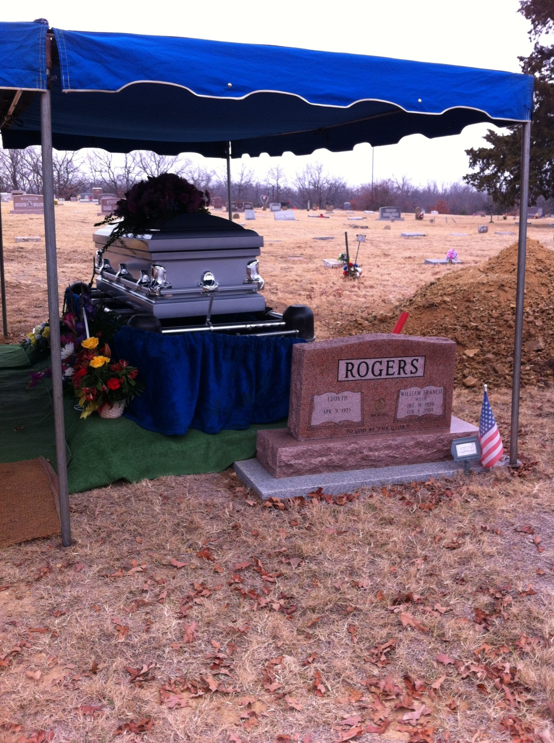
Coping With the Loss of a Loved One

Slide 2
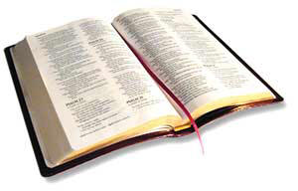
Death is the common experience of all mankind.
“Now the days of David drew near that he should die, and he charged Solomon his son, saying: ‘I go the way of all the earth…’”
1 Kings 2:1-2

Slide 3
1. Mourn Their Loss

Slide 4
1. Mourn Their Loss
Grief is Natural

Slide 5
“A time to weep, and a time to laugh; A time to mourn, and a time to dance”
Ecclesiastes 3:4

Slide 6
“Then the king was deeply moved, and went up to the chamber over the gate, and wept. And as he went, he said thus: ‘O my son Absalom - my son, my son Absalom - if only I had died in your place! O Absalom my son, my son!’”
2 Samuel 18:33

Slide 7
“Then Jacob tore his clothes, put sackcloth on his waist, and mourned for his son many days. And all his sons and all his daughters arose to comfort him; but he refused to be comforted, and he said, ‘For I shall go down into the grave to my son in mourning.’ Thus his father wept for him.”
Genesis 37:34-35

Slide 8
“Therefore, when Jesus saw her weeping, and the Jews who came with her weeping, He groaned in the spirit and was troubled. And He said, ‘Where have you laid him?’ They said to Him, ‘Lord, come and see.’ Jesus wept.”
John 11:33-35

Slide 9
1. Mourn Their Loss
Grief is Natural
Grief is Painful

Slide 10
1. Mourn Their Loss
Grief is Natural
Grief is Painful
Grief is Both Universal and Personal

Slide 11
1. Mourn Their Loss
Grief is Natural
Grief is Painful
Grief is Both Universal and Personal
Grief Takes Time

Slide 12
2. Seek Comfort From God
“Be merciful to me, O God, be merciful to me! For my soul trusts in You; and in the shadow of Your wings I will make my refuge, until these calamities have passed by.”
Psalm 57:1

Slide 13
2. Seek Comfort From God
Scripture
  1 Thess. 4:13; Rev. 14:13, 21:4, Luke 16:25
Our Faith – Heb. 6:19
Prayer – Phil. 4:6-7; 1 Pet. 5:7
Worship – Heb. 10:24-25

Slide 14
3. Accept Comfort From Others
“Blessed be the God and Father of our Lord Jesus Christ, the Father of mercies and God of all comfort, who comforts us in all our tribulation, that we may be able to comfort those who are in any trouble, with the comfort with which we ourselves are comforted by God.”
2 Corinthians 1:3-4

Slide 15
4. Be Grateful
“‘Naked I came from my mother's womb, and naked shall I return there. The Lord gave, and the Lord has taken away; blessed be the name of the Lord.’ In all this Job did not sin nor charge God with wrong.”
Job 1:21-22

Slide 16
5. Go On With Life
2 Samuel 12:15-23
“The Good Days Outnumber the Bad”

Slide 17
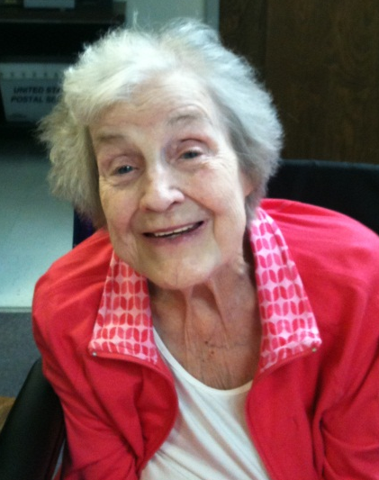
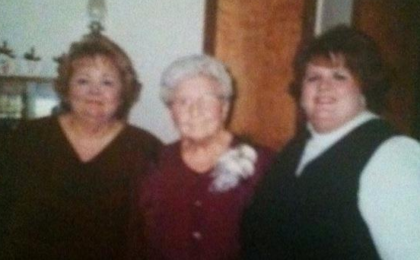
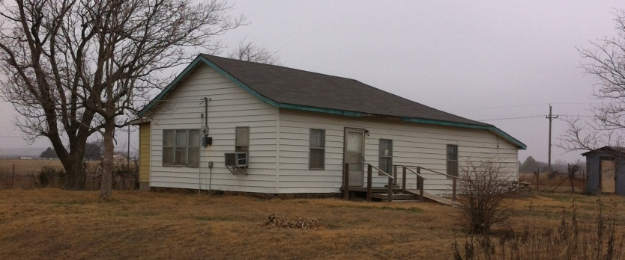
6. Cherish the Memories
We do not abandon them, but take them with us.
We honor them by living the best life we can – Prov. 17:25, 19:13

Slide 18
6. Cherish the Memories
“Conscious remembering and shared reminiscing enrich our present living. And they enable us to carry much of lasting value into the future. Memory allows us to reclaim and revive our appreciation of those we still love and the gifts they continue to give us. We can cherish their legacies here and now. We take delight in having known and loved them. As we cherish them, we experience again the praise, gratitude, and joy they bring to our hearts” (Thomas Attig, The Heart of Grief, p. 111).

Slide 19
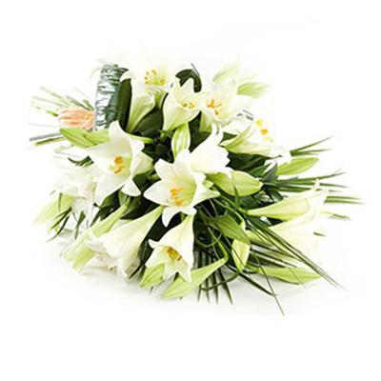
How To Cope With Loss
Mourn Their Loss
Seek Comfort From God
Accept Comfort From Others
Be Grateful
Go On With Life
Cherish the Memories

