Slide 1
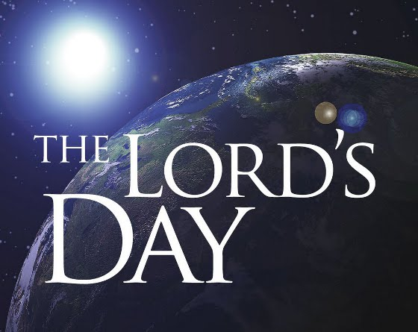

Slide 2
We have an extra Sunday this year!
The Sabbath
The Lord’s Day
What we are to do with the Lord’s Day
Poor attitudes towards the Lord’s Day

Slide 3
The Sabbath Day
Children of Israel were to remember the Sabbath and keep it holy (Ex. 20:8-11)
The Sabbath Day (seventh day - Saturday) rest was based on God’s cessation of work during the creation week (v. 11)

Slide 4
The Sabbath Day
This ordinance was given to Israel to commemorate their deliverance from slavery in Egypt (Deut. 5:12-15)
The Law of Moses was only given to Israel, not other nations or the Patriarchs (v. 3)
No record of Adam, Noah, Abraham, Isaac, Jacob, Joseph, or Job keeping the Sabbath

Slide 5
The Sabbath Day
The end of the Sabbath was subject of prophecy (Hosea 2:11)
This prophecy was fulfilled when Jesus died on the cross (Col. 2:14-17)
We do not keep the Sabbath, nor are we to allow anyone to judge us regarding the Sabbath (Seventh Day Adventists, etc.)

Slide 6
The First Day of the Week
Jesus rose from the dead (Mark 16:9)
Jesus appeared to the disciples (John 20:19)
Holy Spirit was poured out (Acts 1:8, 2:1-4)
Gospel was first preached (Acts 2:22-36)
Church was established (Acts 2:41, 47)
Church assembled (Acts 20:6-7; 1 Cor. 16:2)
John called it “the Lord’s Day” (Rev. 1:10)

Slide 7
What are we to do with the “Lord’s Day”?
It is His day!
We do what He wants done!
God wants His children to assemble and worship Him.

Slide 8
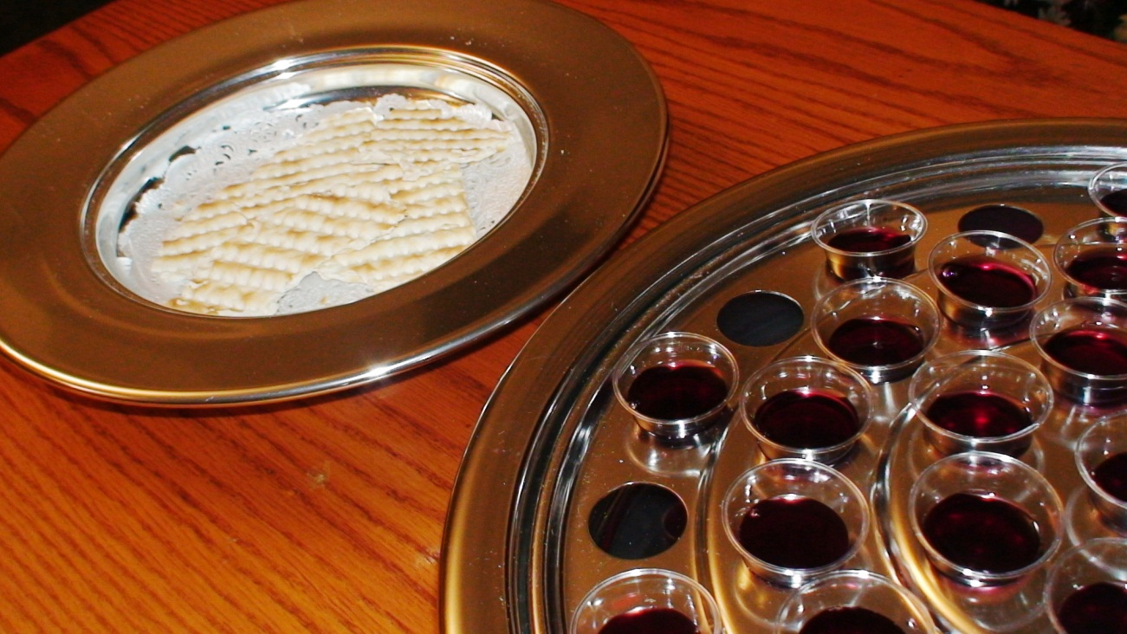
What are we to do with the “Lord’s Day”?
1. Partake of the Lord’s Supper
Acts 20:7
1 Cor. 11:23-30

Slide 9

What are we to do with the “Lord’s Day”?
2. Take Up Collection
1 Cor. 16:1-2
2 Cor. 9:6-7

Slide 10
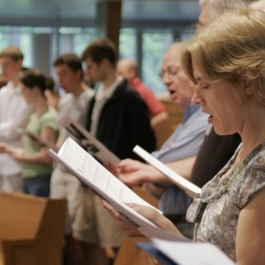
What are we to do with the “Lord’s Day”?
3. Sing
Colossians 3:16

Slide 11
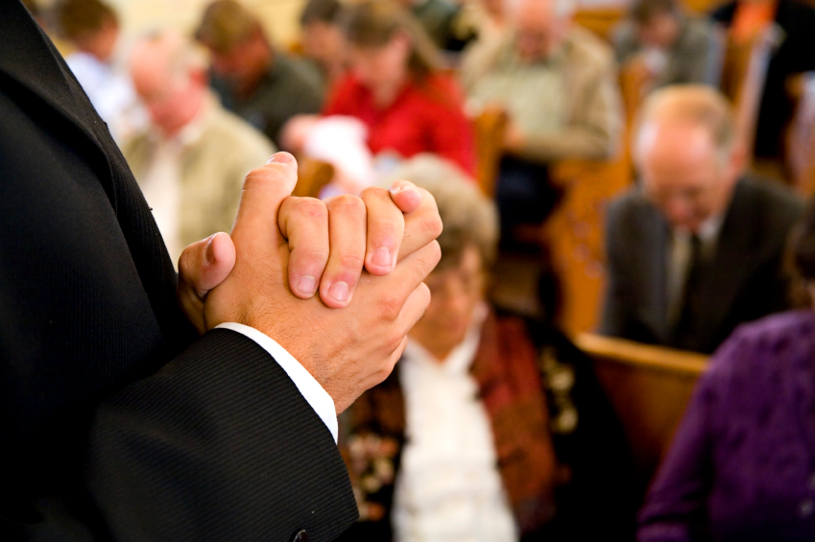
What are we to do with the “Lord’s Day”?
4. Pray
1 Cor. 14:15

Slide 12
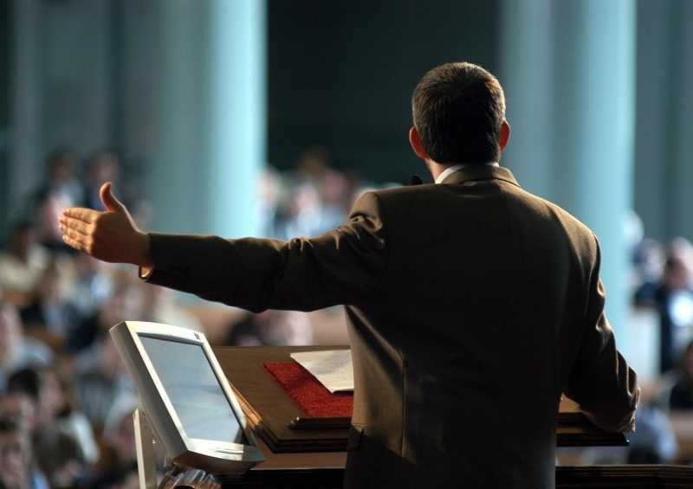
What are we to do with the “Lord’s Day”?
5. Hear God’s Word
Acts 20:7, 32

Slide 13
Poor Attitudes Towards the “Lord’s Day”
Forsaking the Assembly - Heb. 10:24-25
Viewing It As A Burden - Amos 8:5-7
Going Through Motions - Mal. 1:6-11; John 4:23-24; Matt. 15:7-8
Elevating Our Doctrines and Traditions Over God’s Word - Matt. 15:9
Refusing To Reconcile With Brethren - Matt. 5:23-24; 1 John 4:20-21

